Slide 1
VITAMINS-6
Dr. Shariq Syed

Slide 2
Pop Quiz !!
Vitamin B5 is also known as
Pantothenic Acid
Chloroacetic acid
Nicotinic acid
Some acid, cant remember
Notes:
Vital Amines: important for growth & thought to be Amines

Slide 3
Pop Quiz !!
Vitamin B5 is important part of
CoC
CoB
CoA
Sorry, forgot
Notes:
Vital Amines: important for growth & thought to be Amines

Slide 4
Pop Quiz !!
Vitamin B6 is also known as
Hydrodoxine
Pyridoxine
benzodoxine
I Don’t know
Notes:
Vital Amines: important for growth & thought to be Amines

Slide 5
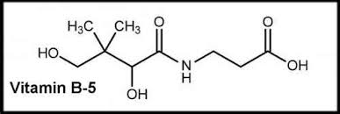
Vitamin B5 Summary
B5 or Pantothenic acid or pantothenate
Role:
Required to synthesize coenzyme-A (CoA)
coenzyme-A (CoA) is needed to Synthesize and metabolize : Proteins, carbohydrates, and fats (Generate energy)
Deficiency:
Occurs rarely
headache, fatigue, insomnia, intestinal disturbances, numbness and tingling of their hands and feet

Slide 6
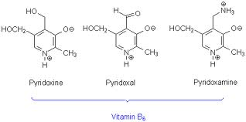
Vitamin B6 Summary
B5 or Pyridoxine, Pyridoxal, Pyridoxamine
Phosphate ester form is active
Role:
Coenzyme for glucose generation
Synthesis of neurotransmitter, Hemoglobin
Hormonal function
Nucleic acid synthesis
Deficiency:
Occurs rarely
Abnormal EEG patterns
Neurologic symptoms
Inflammation

Slide 7
Vitamin B Complex
Group of water soluble vitamins, chemically distinct
Play an important role in metabolism
B-complex
B1 (Thiamine
B2 (riboflavin)
B3 (Niacin)
B5 (Pantothenic A
B6 (Pyridoxine)
B7 (Biotin)
B9 (Folic Acid)
B12 (Cobalamins)
Notes:
Chemically distinct but similar properties, act in synergy, that’s why clubbed together as B-complex

Slide 8
Vitamin B7
Also known as vitamin H or coenzyme R or Biotin
Biotin is necessary for
cell growth,
production of fatty acids,
metabolism of fats and amino acids
Synthesized only by bacteria, yeasts, molds, algae, and some plant species

Slide 9
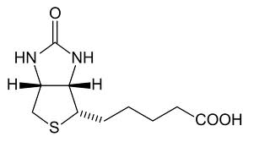
Vitamin B7 Structure
Tetra-hydro-imidizalone
tetra-hydro-thiophene
valeric acid

Slide 10
Vitamin B7 : What’s the role
Biotin is attached at the active site of five mammalian enzymes known as carboxylases
Acetyl-CoA carboxylase I and II catalyze the binding of bicarbonate to acetyl-CoA to form malonyl-CoA
Malonyl-CoA is required for the synthesis of fatty acids
Pyruvate carboxylase is a critical enzyme in gluconeogenesis—the formation of glucose from sources other than carbohydrates, for example, amino acids
Methylcrotonyl-CoA carboxylase catalyzes an essential step in the catabolism of leucine, an essential amino acid
Propionyl-CoA carboxylase catalyzes essential steps in the metabolism of certain amino acids, cholesterol, and odd chain fatty acids

Slide 11
Vitamin B7 : What’s the role
Histone biotinylation:
Histones are proteins that bind to DNA to form chromosomes
Biotinylation of histones plays a role in
regulating DNA replication and transcription
cellular proliferation and other cellular responses

Slide 12
Vitamin B7 : Deficiency
Biotin deficiency is very rare
Biotin is needed in diet in two different situations:
Prolonged intravenous feeding (parenteral) without biotin supplementation
Consumption of raw egg white for a prolonged period (many weeks to years). Avidin is an antimicrobial protein found in egg white that binds biotin and prevents its absorption
Sign/symptoms
Hair loss and a scaly red rash around the eyes, nose, mouth
Neurologic symptoms include depression, lethargy, hallucination, and numbness and tingling of the extremities
Individuals with hereditary disorders of biotin metabolism have similar physical findings

Slide 13
Vitamin B7 : How much do we need ?
Infants :
5 ug/day
Children:
8 ug/day
Adults:
25 – 30 ug/day

Slide 14
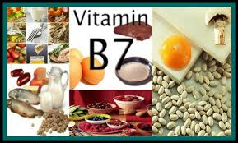
Vitamin B7 : Food Source
Egg yolk, liver, and yeast are rich sources of biotin

Slide 15
Vitamin B9
Also known as Folic acid, Folate, general term for Vitamin B9
Folate is a naturally occurring form of the vitamin, found in food, while folic acid is synthetically produced
Folate refers to the various tetrahydrofolate derivatives naturally found in food

Slide 16
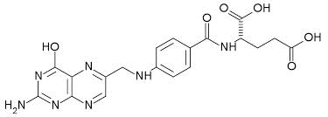
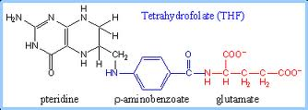
Folic Acid Structure
Folic Acid
Tetrahydrofolate

Slide 17
Folic Acid: What’s the role
One carbon metabolism:
folate coenzymes mediate the transfer of one-carbon units
Act as acceptors and donors of one-carbon units in a variety of reactions critical to the metabolism of nucleic acids and amino acids
Nucleic Acid metabolism:
The synthesis of DNA from its precursors (thymidine and purines)
Required for the synthesis of methionine
Amino Acid metabolism:
Metabolism of several important amino acids
Synthesis of methionine from homocysteine

Slide 18
Folic Acid: Deficiency
Symptoms appear late as the effects of deficiency are gradual
Rapidly dividing cells are most vulnerable to the effects of folate deficiency
Blood cell division becomes abnormal resulting in fewer but larger red blood cells
This results in anemia (megaloblastic anemia, enlarged immature RBC)
Anemia results in decreased oxygen carrying capacity of the blood
Ultimately result in symptoms of fatigue, weakness, and shortness of breath

Slide 19
Folic Acid: How much do we need ?
Infants :
65 – 80 ug/day
Children:
150 – 200 ug/day
Adults:
400 ug/day

Slide 20
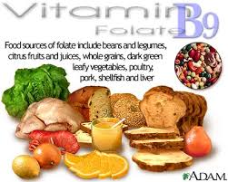
Folic Acid: Food Source
Green leafy vegetables are rich sources of folate and provide the basis for its name
Citrus fruit juices, legumes, and fortified cereals are also excellent sources of folate

Slide 21
Folic Acid: Food Source
Food | Serving | Folate (mcg)
Orange juice (from concentrate) | 6 ounces | 83
Spinach (cooked) | 1/2 cup | 132
Asparagus (cooked) | 1/2 cup (~ 6 spears) | 134
Lentils (cooked) | 1/2 cup | 179
Garbanzo beans (cooked) | 1/2 cup | 141
Lima beans (cooked) | 1/2 cup | 78
Bread | 1 slice | 20 (Folic acid)*
Pasta (cooked) | 1 cup | 60 (Folic acid)*
Rice (cooked) | 1 cup | 60 (Folic acid)*

Slide 22
Vitamin B12
Vitamin B₁₂ has the largest and most complex chemical structure of all the vitamins
It is unique among vitamins in that it contains a metal ion, cobalt
For this reason cobalamin is the term used to refer to compounds having vitamin B₁₂activity

Slide 23
Vitamin B12
Methylcobalamin and 5-deoxyadenosyl cobalamin are the forms of vitamin B₁₂ used in the human body
The form of cobalamin used in most supplements, cyanocobalamin, is readily converted to 5-deoxyadenosyl and methylcobalamin in the body
In mammals, cobalamin is a cofactor for only two enzymes, methionine synthase and L-methylmalonyl-CoA mutase

Slide 24
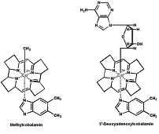
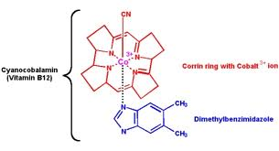
Vitamin B12 Structure
Methylcobalamin
5-deoxyadenosyl cobalamin

Slide 25
Vitamin B12 : What’s the role
Coenzyme for methionine synthase
Methylcobalamin is required for the function of methionine synthase
Homocysteine methionine
Methionine S-adenosylmethionine (a methyl group donor)

Slide 26
Vitamin B12 : What’s the role
Coenzyme for L-methylmalonyl-CoA mutase
5-Deoxyadenosylcobalamin is required by the enzyme that catalyzes the conversion of L-methylmalonyl-CoA to succinyl-CoA
This biochemical reaction plays an important role in the production of energy from fats and proteins
Succinyl CoA is also required for the synthesis of hemoglobin

Slide 27
Vitamin B12 Absorption
Absorption of vitamin B₁₂ from food requires normal function of the stomach, pancreas, and small intestine
Stomach acid and enzymes free vitamin B₁₂ from food, allowing it to bind to other proteins called R proteins
In the alkaline environment of the small intestine, R proteins are degraded by pancreatic enzymes, freeing vitamin B₁₂ to bind to intrinsic factor (IF)
Receptors on the surface of the small intestine take up the IF-B₁₂ complex only in the presence of calcium, which is supplied by the pancreas

Slide 28
Vitamin B12 : Deficiency
Megaloblastic Anemia:
Diminished activity of methionine synthase inhibits the regeneration of tetrahydrofolate (THF)
Vitamin B₁₂deficiencies, folate is unavailable to participate in DNA synthesis
This impairment of DNA synthesis affects the rapidly dividing cells of the bone marrow earlier than other cells,
Resulting in the production of large, immature, hemoglobin-poor red blood cells

Slide 29
Vitamin B12 : Deficiency
Neurologic symptoms:
Numbness and tingling of the arms and, more commonly, the legs
Difficulty walking
Memory loss,
Disorientation, and dementia with or without mood changes
Notes:
These neurological symptoms are gradual to develop & sometimes not reversible with B12 supplementation

Slide 30
Vitamin B12: How much do we need ?
Infants :
0.4 ug/day
Children:
0.9 – 1.8 ug/day
Adults:
2.4 ug/day

Slide 31
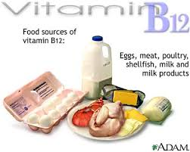
Vitamin B12: Food Source
Vitamin B12 is present in animal products such as meat, poultry, fish
lesser extent in milk
Not generally present in plant products or yeast
Older individuals (>50 yrs) should obtain their vitamin B₁₂ in supplements or fortified foods like fortified cereal because of the increased likelihood of food-bound vitamin B₁₂malabsorption.

