Slide 1
VITAMINS-5
Dr. Shariq Syed

Slide 2
Plan for today
Review last lecture
Summarize what’s done
Notes:
Vital Amines: important for growth & thought to be Amines

Slide 3
Pop Quiz !!
Riboflavin exists in body as a part of
FAD, FMN
FTD, FSH
NAD, NADH
I Don’t know, I’m busy preparing for exams!
Notes:
Vital Amines: important for growth & thought to be Amines

Slide 4
Pop Quiz !!
Ariboflavinosis is due to deficiency of vitamin
B2
B12
B3
Sorry forgot, too many B’s
Notes:
Vital Amines: important for growth & thought to be Amines

Slide 5
Pop Quiz !!
Vitamin B3 gets incorporated with which compound
NAD
DAD
FAD
Sorry , Don’t know
Notes:
Vital Amines: important for growth & thought to be Amines

Slide 6
Pop Quiz !!
Severe Niacin deficiency is medically termed
Allegra
Pellagra
Deodra
Sorry , Don’t know
Notes:
Vital Amines: important for growth & thought to be Amines

Slide 7
Vitamin B Complex
Group of water soluble vitamins, chemically distinct
Play an important role in metabolism
B-complex
B1 (Thiamine
B2 (riboflavin)
B3 (Niacin)
B5 (Pantothenic A
B6 (Pyridoxine)
B7 (Biotin)
B9 (Folic Acid)
B12 (Cobalamins)
Notes:
Chemically distinct but similar properties, act in synergy, that’s why clubbed together as B-complex

Slide 8
Vitamin B5
B5 or Pantothenic acid or pantothenate
Name derived from the Greek “pantothen” meaning "from everywhere“ as small quantities of pantothenic acid are found in nearly every food
Pantothenic acid was discovered by Roger J. Williams in 1933
Required to synthesize coenzyme-A (CoA)
Synthesize and metabolize : Proteins, carbohydrates, and fats

Slide 9
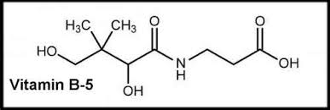
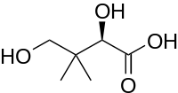
Vitamin B5 Structure
+
Pantoic Acid
β-alanine

Slide 10
Vitamin B5 : What’s the role
B5 is an important component of coenzyme A (CoA)
Role of CoA
Required for chemical reactions that generate energy from food (fat, carbohydrates, and proteins)
Synthesis of essential fats, cholesterol, steroid hormones , acetylcholine, melatonin and Heme
Metabolism of a number of drugs and toxins by the liver
B5 is an important component of acyl-carrier protein
Required for the synthesis of fatty acids

Slide 11
Vitamin B5 : Deficiency
Naturally occurring deficiency is rare in humans
Only observed in cases of sever malnutrition
Experimentally induced deficiency: headache, fatigue, insomnia, intestinal disturbances, numbness and tingling of their hands and feet
Research on experimental animals to understand deficiency
Symptoms show the diverse role of Vit B5 as a part of CoA

Slide 12
Vitamin B5 : How much do we need ?
Infants :
1.8 mg/day
Children:
2 – 4 mg/day
Adults:
5 mg/day

Slide 13
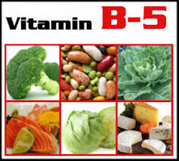
Vitamin B5 : Food Source
Rich sources include liver and kidney, yeast, egg yolk, and broccoli
Fish, shellfish, chicken, milk, yogurt, mushrooms, avocado, and sweet potatoes are also good sources
When found in foods, most pantothenic acid is in the form of CoA or acyl carrier protein (ACP)
CoA and ACP are hydrolyzed into 4'-phosphopantetheine
The 4'-phospho-pantetheine is then dephosphorylated into pantetheine
Pantetheine hydrolysed into free pantothenic acid
Notes:
When found in foods, most pantothenic acid is in the form of CoA or acyl carrier protein (ACP). For the intestinal cells to absorb this vitamin, it must be converted into free pantothenic acid.^{[17]}Within the lumen of the intestine, CoA and ACP are hydrolyzed into 4'-phosphopantetheine.^{[17]} The 4'-phosphopantetheine is then dephosphorylated into pantetheine.^{[17]} Pantetheinase, an intestinal enzyme, then hydrolyzes pantetheine into free pantothenic acid.^{[17]}
Free pantothenic acid is absorbed into intestinal cells via a saturable, sodium-dependent active transport system.^{[8]} At high levels of intake, when this mechanism is saturated, some pantothenic acid may also be absorbed via passive diffusion.^{[16]} As intake increases 10-fold, however, absorption rate decreases to 10%.^{[8]}

Slide 14
Vitamin B6
First isolated in the 1930s
Three compounds typically referred to as Vit B6: Pyridoxine, Pyridoxal, Pyridoxamine
The phosphate ester derivative Pyridoxal 5'-phosphate (PLP) is the Active form
PLP has an important role in human metabolism

Slide 15
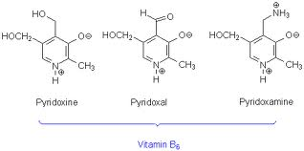
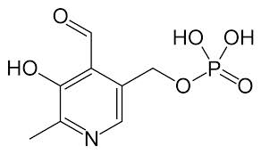
Vitamin B6 Structure
Based on a Pyridine ring, with hydroxyl, methyl, and hydroxymethyl substituents
Pyridoxal Phophate

Slide 16
Vitamin B6 : What’s the role
PLP plays a vital role in the function of approximately 100 enzymes that catalyze essential chemical reactions in the human body
Coenzyme for
glycogen phosphorylase, an enzyme that catalyzes the release of glucose from stored glycogen
generating glucose from amino acids
Synthesis of
Neurotransmitter- serotonin
Heme, an iron-containing component of hemoglobin

Slide 17
Vitamin B6 : What’s the role
Hormonal function:
Inhibits the binding of steroid hormones, thus decreasing their effects
Nucleic Acid Synthesis
Coenzyme for synthesis of nucleic acids
Notes:
Uric acid is efficient water soluble, antioxidant in blood

Slide 18
Vitamin B6 : Deficiency
Severe deficiency of vitamin B₆ is uncommon
Alcoholics are thought to be most at risk of vitamin B₆ deficiency due to low dietary intakes and impaired metabolism of the vitamin
Studies suggest that deficiency results in:
Abnormal EEG patterns
Neurologic symptoms
Inflammation

Slide 19
Vitamin B6 : How much do we need ?
Infants :
0.1 – 0.3 mg/day
Children:
0.5 – 1.0 mg/day
Adults:
1.3 mg/day

Slide 20
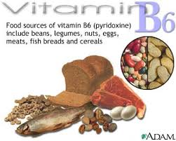
Vitamin B6 : Food Source

Slide 21
Vitamin B7
Also known as vitamin H or coenzyme R or Biotin
Biotin is necessary for
cell growth,
production of fatty acids,
metabolism of fats and amino acids
Synthesized only by bacteria, yeasts, molds, algae, and some plant species

Slide 22
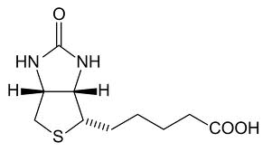
Vitamin B7 Structure
Tetra-hydro-imidizalone
tetra-hydro-thiophene
valeric acid

