Slide 1
SUNSCREEN AGENTS

Slide 2
ULTRAVIOLET RADIATION SPECTRUM
UVA (Longwave Radiation)
Range 320-400 nm
Erythrogenic activity is weak, however penetrates dermis
Responsible for development of slow natural tan
Most drug-induced photosensitivity rxn occurs
UVA may augment the effects of UVB

Slide 3
ULTRAVIOLET RADIATION SPECTRUM
UVB (Middlewave Radiation)
Range 290-320 nm
Erythrogenic activity is the highest
Produces new pigment formation, sunburn, Vit D synthesis
Responsible for inducing skin cancer

Slide 4
ULTRAVIOLET RADIATION SPECTRUM
UVC (Shortwave or Germicidal Radiation)
Range 100-290 nm.
Does not reach the surface of the earth.
Is emitted from artificial ultraviolet sources.

Slide 5
ULTRAVIOLET RADIATION SPECTRUM
Long-term hazards of skin damage from radiation:
Malignancy:
Squamous cell epithelioma
Actinic keratosis
Basal cell carcinoma
Premature aging
nevus, seborrheic keratosis, solar lentigo
wrinkles, lines, etc

Slide 6
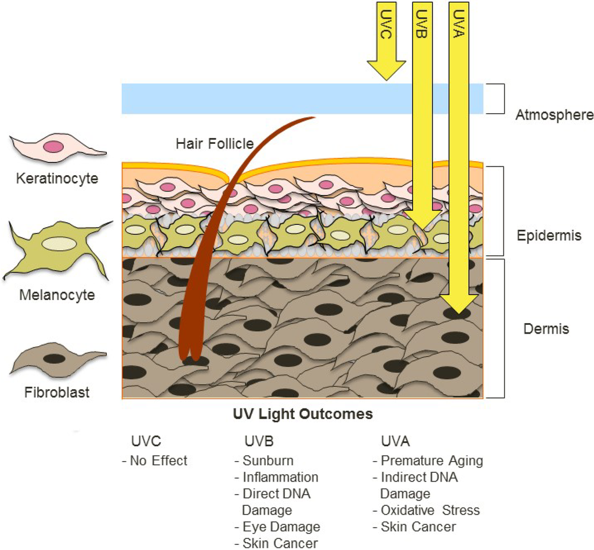
TANNING OF SKIN

Slide 7
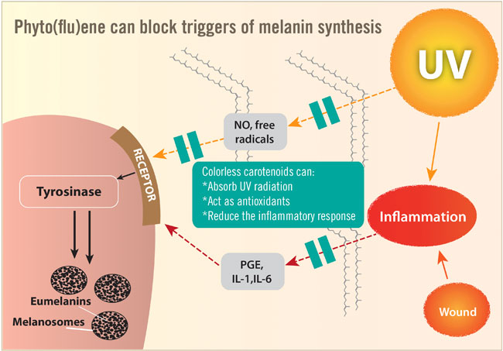

Slide 8
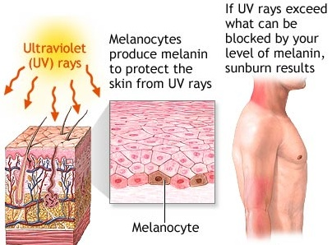
NATURAL MECHANISM OF SUN DEFENCE

Slide 9
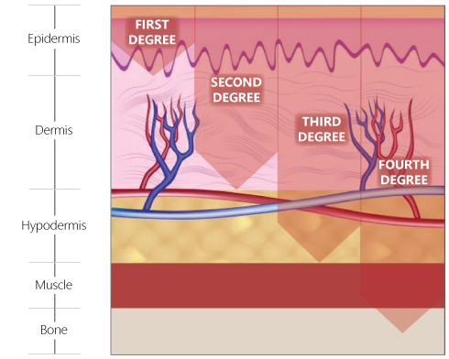
MINIMAL ERTHYMA
20 MIN
VIVID ERTHYMA
50 MIN
PAIN FUL BURN
100 MIN
BLISTERING BURN 200 MIN

Slide 10
CLASSIFICATION OF SUNSCREENS ACCORDING TO APPLICATION
SUNSCREENS
( PREVENT HARMFUL EFFECTS OF SUN AND TO ASSIT IN TANNING WITHOUT PAINFUL EFFECTS
SUNBURN PREVENTIVE AGENTS
ABSORBS 95% OR MORE WITHIN 290-320 NM
SUNTANNING AGENTS
ABSORB ATLEAST 85% FROM 290-320 NM BUT TRANSMITS LONGER THAN 320NM PRODUCING TRANSIET TAN

Slide 11
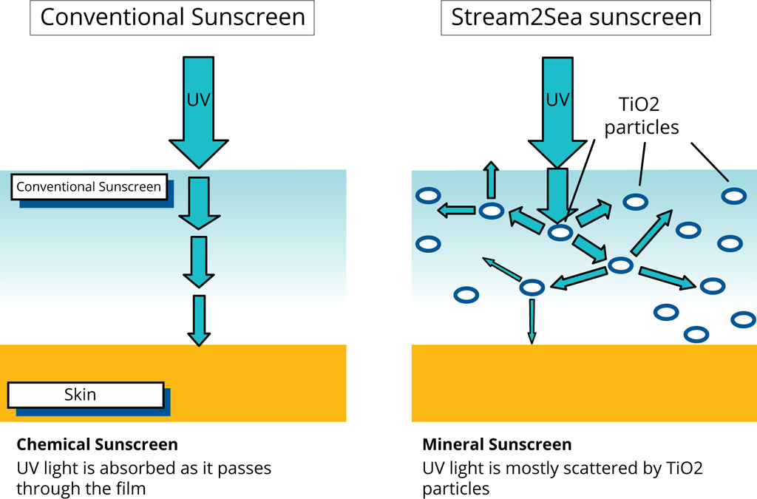
MECHANISMS OF OPERATION OF SUNSCREENING AGENTS
ACCORDING TO CONC DIFFERS IN SUNTAN AND SUNBURN
MINIMISES BOTH SUNBURN AND SUNTAN

Slide 12
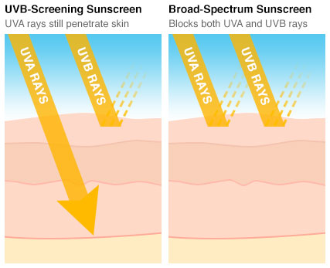
IDEAL PROPERTIES OF A SUNSCREEN AGENTS
ABSORB ERYTHMOGENIC RADIATION IN 290-320NM RANGE WITHOUT BREAKDOWN INTO TOXIC OR IRRITANT PRODUCT
NON VOLATILE, RESISTANT TO WATER AND PERSPIRATION
SUITABLE SOLUBILITY TO BE INCORPORATED INTO THE VEHICLE
RETAINING ITS PROPERTIES FOR SEVERAL HOURS AND NON STAINING TO CLOTHES
NON ODOROUS , NON TOXIC, NON IRRITATING , STABLE

Slide 13
SUNSCREEN AGENTS
Chemical
Formulations containing one or more:
PABA, PABA esters
benzophenones
cinnamates
salicylates
digalloyl trioleate
anthranilates
Mechanism: absorbs UV radiation

