Slide 1
STOMACH & INTESTINE
Presented by—
Mirza Salman Baig
Faculty of Pharmacy
School of Pharmacy
AIKTC, New Panvel

Slide 2
STOMACH
The stomach is a J-shaped dilated portion of the alimentary tract situated in the epigastric, umbilical and left hypochondriac regions of the abdominal cavity

Slide 3
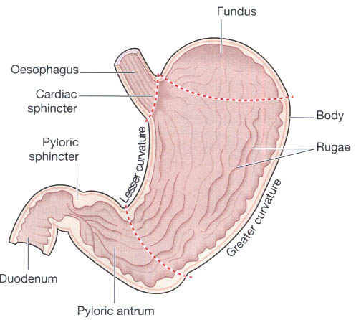

Slide 4
The stomach is continuous with the oesophagus at the cardiac sphincter and with the duodenum at the pyloric sphincter
The lesser curvature is short, lies on the posterior surface of the stomach and is the downwards continuation of the posterior wall of the oesophagus
The anterior region angles acutely upwards, curves downwards forming the greater curvature

Slide 5
When the stomach is inactive the pyloric sphincter is relaxed and open and when the stomach contains food the sphincter is closed
Muscle layer This consists of three layers of smooth muscle fibres

Slide 6
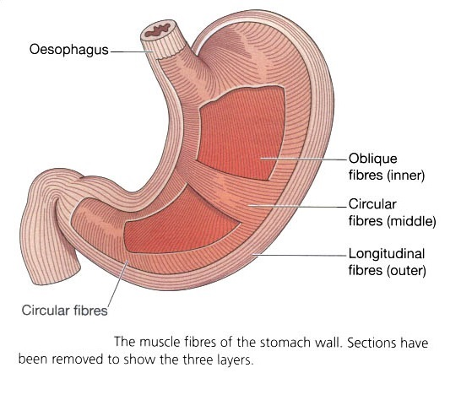

Slide 7
• Outer layer of longitudinal fibres
• Middle layer of circular fibres
• Inner layer of oblique fibres

Slide 8
Mucosa.
When the stomach is empty the mucous membrane
lining is thrown into longitudinal folds or rugae.
Numerous gastric glands are situated below the surface in the mucous membrane.
They consist of specialised cells that secrete gastric juice into the stomach.

Slide 9
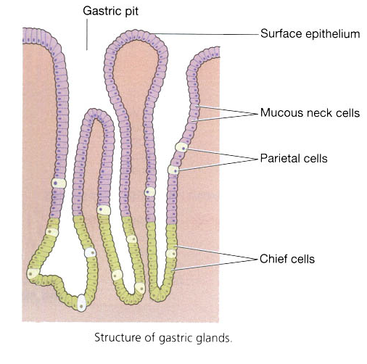

Slide 10
The stomach is divided into three regions
The fundus
The body and
The antrum

Slide 11
Blood supply
Arterial blood is supplied to the stomach by branches of the coeliac artery and
Venous drainage is into the portal vein

Slide 12
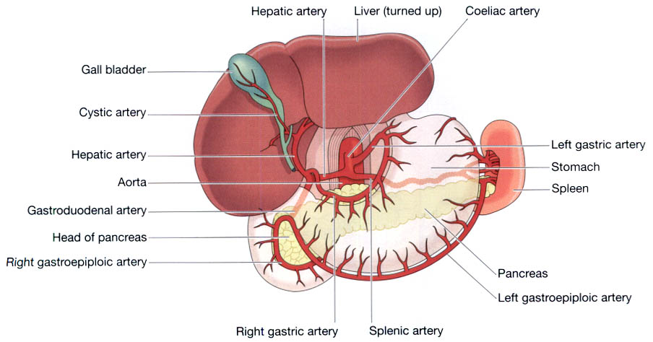

Slide 13
Nerve supply
The sympathetic supply to the stomach is mainly from the coeliac plexus and the parasympathetic supply is from the vagus nerves
Sympathetic stimulation reduces the motility of the stomach and the secretion of gastric juice.

Slide 14
Gastric juice
About 2 litres of gastric juice are secreted daily by special secretory glands in the mucosa
It consists of --
water
mineral salts
mucus (secreted by goblet cells in the glands)
hydrochloric acid secreted by parietal cell
intrinsic factor secreted by parietal cell
inactive enzyme precursors: pepsinogens secreted by chief cells in the glands.

Slide 15
Functions of gastric juice
Water further liquefies the food swallowed
Hydrochloric acid:— acidifies the food and stops the action of salivary amylase kills ingested microbs provides the acid environment needed for pepsin activation for protein digestion.
Pepsins act most effectively at pH 1.5 to 3.5.
Intrinsic factor (a protein) is necessary for the absorption of vitamin B12 from the ileum.
Mucus prevents mechanical injury to the stomach wall by lubricating the contents. It prevents chemical injury by acting as a barrier between the stomach wall and the corrosive gastric juice.

Slide 16
Secretion of gastric juice
Secretion reaches its maximum level about 1 hour
3 Phases of gastric secretion are--
Cephalic phase. This flow of juice occurs before food reaches the stomach and is due to reflex stimulation of the vagus nerves initiated by the sight, smell or taste of food.
Gastric phase. When stimulated by the presence of food the enteroendocrine cells in the pyloric antrum and duodenum secrete gastrin (hormone) which stimulates the gastric glands to produce more gastric juice
Intestinal phase. When the partially digested contents of the stomach reach the small intestine, a hormone complex enterogastrone (secretin + cholecystokinin )is produced by endocrine cells in the intestinal mucosa which slow down emptying rate of the stomach.
The rate of emptying stomach depends on the type of food eaten.
--A carbohydrate meal leaves the stomach in 2 to 3 hours,
--A protein meal remains longer
--A fatty meal remains in the stomach longest.

Slide 17
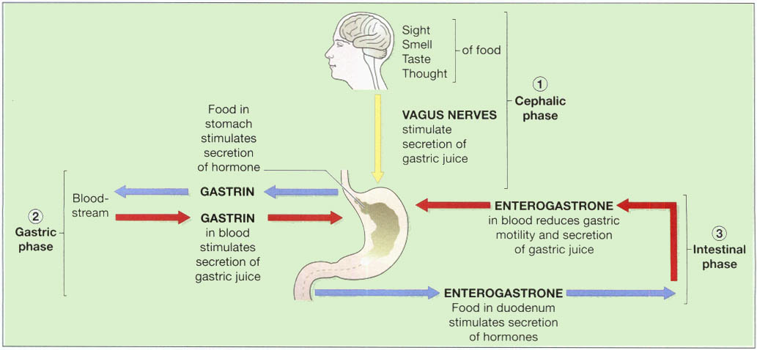
3 Phases of secretion of gastric juice.

Slide 18
Functions of the stomach
Temporary storage allowing time for the digestive enzymes, pepsins, to act chemical digestion — pepsins convert proteins to polypeptides
Mechanical breakdown — the three smooth muscle layers enable the stomach to act as a churn, gastric juice is added and the contents are liquefied to chyme
Limited absorption of water, alcohol and some lipophylic drugs
Defence against microbes — provided by hydrochloric acid in gastric juice. Vomiting may be a response to ingestion of gastric irritants,
e.g. microbes or chemicals
Preparation of iron for absorption— the acid environment of the stomach solubilises iron salts, which is required before iron can be absorbed
Production of intrinsic factor needed for absorption of vitamin B12 in the terminal ileum
Regulation of the passage of gastric contents into the duodenum When the chyme is acidified and liquefied, the pyloric antrum forces small jets of gastric contents through pyloric sphincter into the duodenum.

Slide 19
SMALL INTESTINE

Slide 20
SMALL INTESTINE
The small intestine is continuous with the stomach at the pyloric sphincter and leads into the large intestine at the ileocaecal valve
It is a little over 5 metres long and lies in the abdominal cavity surrounded by the large intestine.
In the small intestine the chemical digestion of food is completed and most of the absorption of nutrients takes place

Slide 21
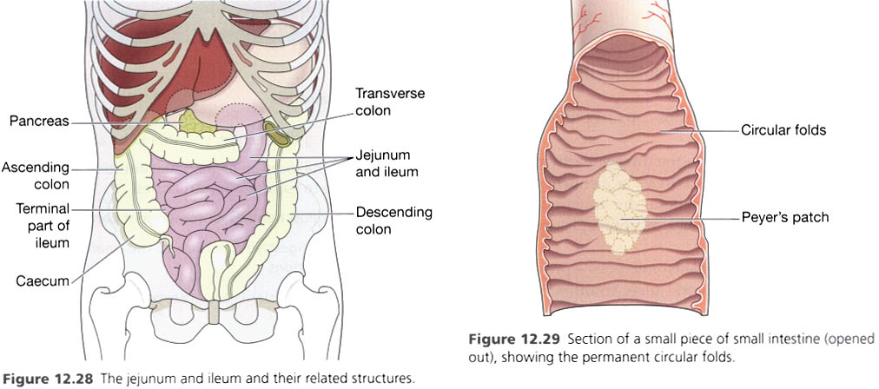
INTESTINE

Slide 22
Parts of small intestine
The duodenum is about 25 cm long
The jejunum is the middle section of the small intestine and is about 2 metres long
The ileum, or terminal section, is about 3 metres long and ends at the ileocaecal valve, which controls the flow of material from the ileum to the caecum.

Slide 23
Structure of the small intestine
Peritoneum. A double layer of peritoneum called the mesentery attaches the jejunum and ileum to the posterior abdominal wall
Mucosa. The surface area of the small intestine mucosa is greatly increased by permanent circular folds, villi and microvilli.
The villi are tiny finger-like projections of the mucosal layer into the intestinal lumen, about 0.5 to 1 mm long

Slide 24
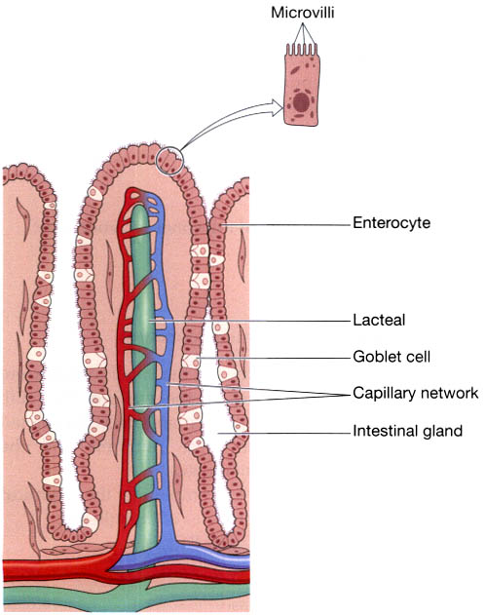

Slide 25
Functions of the small intestine
Movement of its contents which is produced by peristalsis
Secretion of intestinal juice
Completion of chemical digestion of carbohydrates, protein and fats in the enterocytes of the villi
Protection against infection by microbes that have survived the antimicrobial action of the hydrochloric acid in the stomach, by the solitary lymph follicles and aggregated lymph follicles
Secretion of the hormones cholecystokinin (CCK) and secretin
Absorption of nutrients.

Slide 26
Chemical digestion in the small intestine
When acid chyme passes into the small intestine it is mixed with pancreatic juice, bile and intestinal juice, and is in contact with the enterocytes of the vill—
Carbohydrates are broken down to monosaccharides
Proteins are broken down to amino acids
Fats are broken down to fatty acids and glycerol.

Slide 27
Pancreatic juice
water
mineral salts
Enzymes:
— amylase
— lipase
Inactive enzyme (precursors)
— trypsinogen
— chymotrypsinogen
— procarboxypeptidase.
Pancreatic juice is alkaline (pH 8) because it contains significant quantities of bicarbonate ions, which are alkaline in solution

Slide 28
Functions of intestine

Slide 29
Digestion of proteins
Trypsinogen and chymotrypsinogen are inactive enzyme precursors activated by enterokinase (enteropeptidase), an enzyme in the microvilli, which converts them into the active proteolytic enzymes trypsin and chymotrypsin. These enzymes convert polypeptides to tripeptides, dipeptides and amino acids. It is important that they are produced as inactive precursors and are activated only upon arrival in the duodenum, otherwise they would digest the pancreas.

Slide 30
Digestion of carbohydrates
Pancreatic amylase converts all digestible polysaccharides (starches) not acted upon by salivary amylase to disaccharides

Slide 31
Digestion of fats
Lipase converts fats to fatty acids and glycerol. To aid the action of lipase, bile salts emulsify fats, i.e. reduce the size of the globules, increasing their surface area.

Slide 32
Bile
Bile has a pH of 8 and between 500 and 1000 ml are secreted daily
It consist of –
water
mineral salts
mucus
bile salts
bile pigments, mainly bilirubin
cholesterol.

Slide 33
Functions of Bile
The bile salts, sodium taurocholate and sodium glycocholate, emulsify fats in the small intestine.
The bile pigment, bilirubin, is a waste product of the breakdown of erythrocytes and is excreted in the bile rather than in the urine because of its low solubility in water. Bilirubin is altered by microbes in the large intestine. Some of the resultant urobilinogen, which is highly water soluble, is reabsorbed and then excreted in the urine, but most is converted to stercobilin and excreted in the faeces.
Fatty acids are insoluble in water, which makes them very difficult to absorb through the intestinal wall. Bile salts make fatty acids soluble, enabling both these and fat-soluble vitamins (e.g. vitamin K) to be readily absorbed.
Stercobilin colours and deodorises the faeces.

Slide 34
Chemical digestion associated with enterocytes
The enzymes involved in completing the chemical digestion of food in the enterocytes of the villi are:
• peptidases
• lipase
• sucrase, maltase and lactase.
Alkaline intestinal juice (pH 7.8 to 8.0) assists in raising the pH of the intestinal contents to between 6.5 and 7.5.
Enterokinase activates pancreatic peptidases such as trypsin which convert some polypeptides to amino acids and some to smaller peptides. The final stage of breakdown to amino acids of all peptides occurs inside the enterocytes.
Lipase completes the digestion of emulsified fats to fatty acids and glycerol partly in the intestine and partly in the enterocytes. Sucrase, maltase and lactase complete the digestion of carbohydrates by converting disaccharides such as sucrose, maltose and lactose to monosaccharides inside the enterocytes.

Slide 35
Absorption of nutrients
Diffusion. Monosaccharides, amino acids, fatty acids and glycerol diffuse slowly down their concentration gradients into the enterocytes from the intestinal lumen.
Active transport. Monosaccharides, amino acids, fatty acids and glycerol may be actively transported into the villi; this is faster than diffusion. Disaccharides, dipeptides and tripeptides are also actively transported into the enterocytes where their digestion is completed before transfer into the capillaries of the villi.

Slide 36
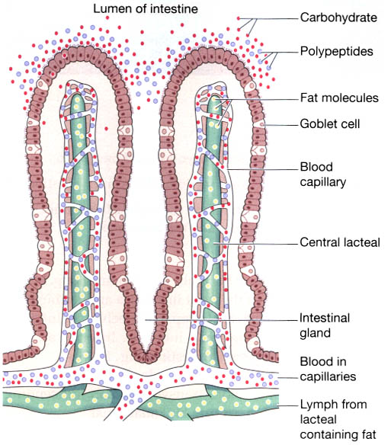
The absorption of nutrients

Slide 37
Thank you

