Slide 1
Skin
The skin completely covers the body and is continuous with the membranes lining the body orifices:
• protects the underlying structures from injury and
from invasion by microbes
• contains sensory (somatic) nerve endings of pain,
temperature and touch
• is involved in the regulation of body temperature.

Slide 2
Structure of the skin
The skin has a surface area of about 1.5 to 2 m2 in adults and it contains glands, hair and nails. There are two main layers:
• epidermis
• dermis.
Between the skin and underlying structures there is a
layer of subcutaneous fat.

Slide 3
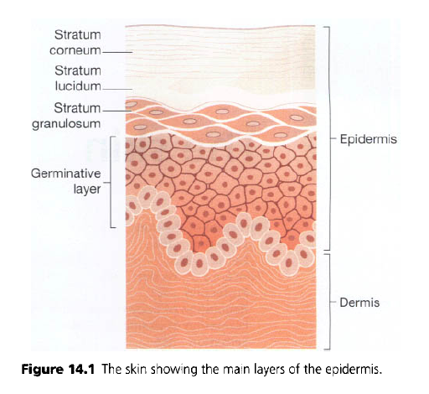
Structure of the skin

Slide 4
The structures in the dermis are:
• blood vessels
• lymph vessels
• sensory (somatic) nerve endings
• sweat glands and their ducts
• hairs, sebaceous glands.
Sensory nerve endings.
Sensory receptors (specialised nerve endings)
which are sensitive to touch, change in temperature, pressure and pain are widely distributed in the dermis.
Incoming stimuli activate different types of sensory receptors.
The skin is an important sensory organ through which individuals receive information about their environment.
Nerve impulses, generated in the sensory receptors in the dermis, are conveyed to the spinal cord by sensory (somatic cutaneous) nerves, then to the sensory area of the cerebrum where the sensations are perceived.

Slide 5
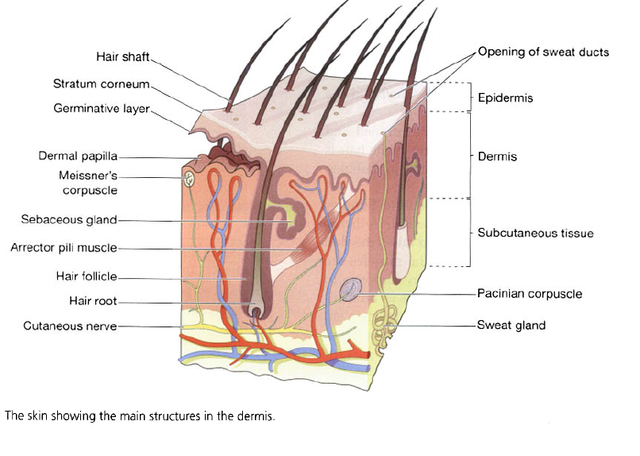

Slide 6
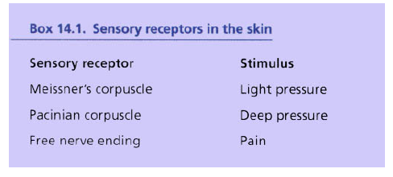

Slide 7
Sensation
Sensory receptors consist of nerve endings in the dermis
that are sensitive to touch, pressure, temperature or pain.
Stimulation generates nerve impulses in sensory nerves that are transmitted to the cerebral cortex
Some areas have more sensory receptors than
others causing them to be especially sensitive, e.g. the
lips and fingertips.

