Slide 1
SKIN SENSITIZATION AND SENSITIVITY TESTING
SUBSTANCES THAT INDUCE INFLAMMATION ARE KNOWN AS IRRITANTS
IRRITANTS
PRIMARY IRRITANT
INFLAMMATION ON FIRST CONTACT
SECONDARY IRRITANT
INFLAMATION ON REPEATED CONTACT

Slide 2
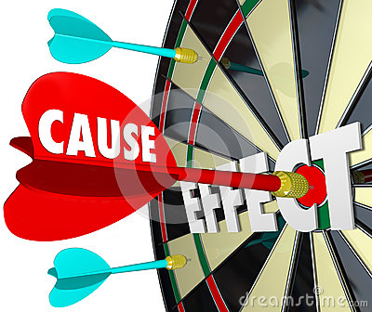
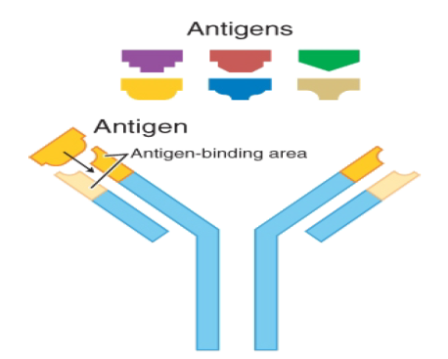
DIFFERENCE BETWEEN
IRRITATION AND SENSITIZATION
Irritation is a chemical or mechanical surface reaction on skin that may occur immediately, such as in response to hot water or strong acid or base -
Sensitization is a warning mechanism designed to protect the body from a strong allergic reaction that can be fatal, such as a bee sting. It is an immune response that is slower to develop, taking 12 to 21 days of repeated exposures

Slide 3
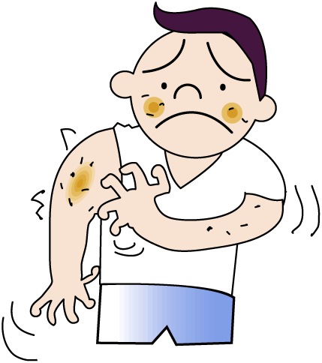
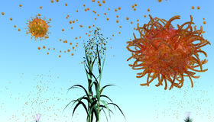
SENSITIVITY AND ALLERGIC REACTIONS
CONTACT URTICARIA- LOCAL OEDEMA AND ERYTHMA AT THE SITE OF APPLICATION OF SUBSTANCE
STINGING- REFERS TO ILL DEFINED RESPONSE
HYPERSENSITIVITY – IMMUNOLOGICAL RESPONSE OF ANY TYPE WHICH IS GREATER THAN NORMAL RESPONSE

Slide 4
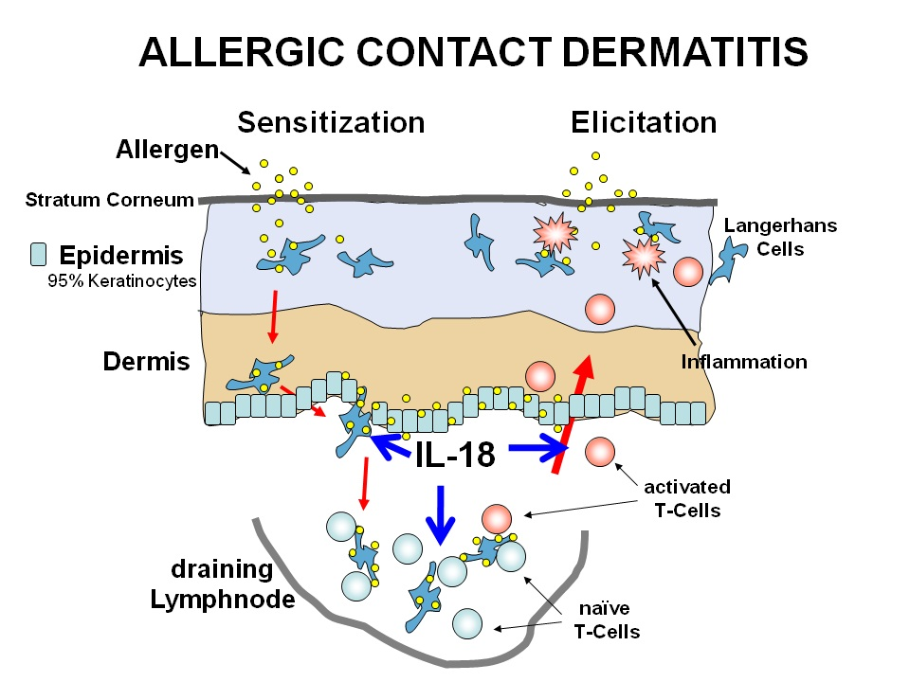
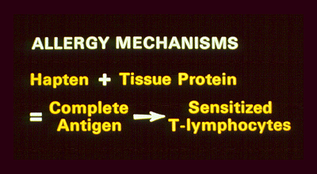

Slide 5
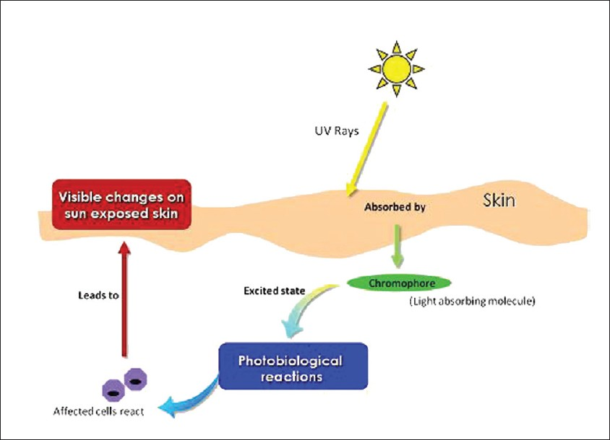
PHOTOALLERGIC REACTIONS
300-800 NM

Slide 6
SENSITIVITY TESTING by DRAIZE TEST
RABBITS SKIN ARE COVERED WITH A PATCH OF TEST MATERIAL FOR 24 HOURS
THE SITES OF APPLICATIONS ARE EXAMINED AT INTERVALS
IF NO REACTION OCCURS ON RABBIT SKIN SAME TEST PERFORMED ON SKIN OF FOREARM OF 10 VOLUNTEERS

Slide 7
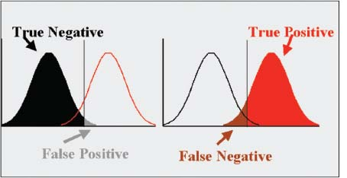
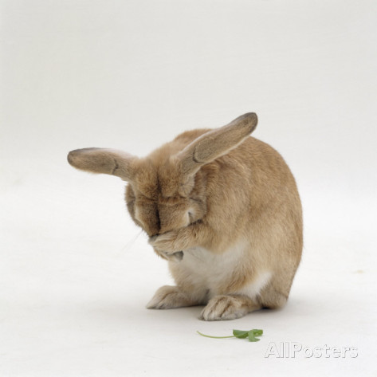
DISADVANTAGES
RABBIT SKIN IS MORE SUSCEPTIBLE THAN HUMAN
CAN SHOW FALSE POSITIVE OR FALSE NEGATIVE RESULT

