Slide 1
REGULATORY PROVISIONS RELATING TO COSMETICS

Slide 2
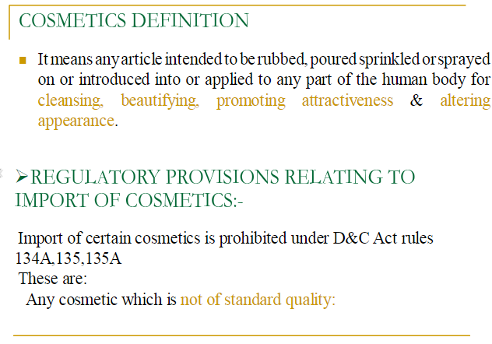

Slide 3
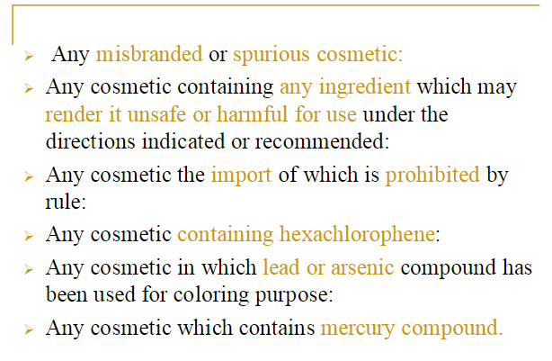

Slide 4
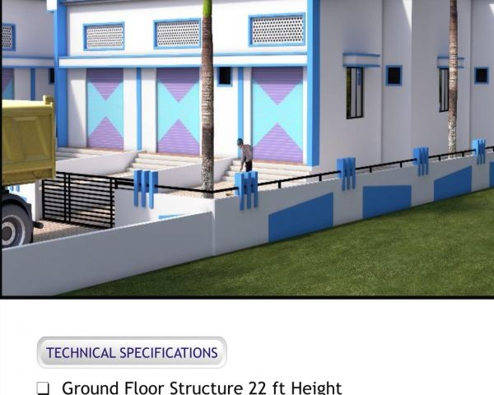
Schedule M II
Requirement of factory premises for manufacture of cosmetics
Schedule S
Standards of skin cosmetics
Schedule Q
List of coaltar colors to be added in cosmetics
D and C Schedules governing Cosmetics

Slide 5
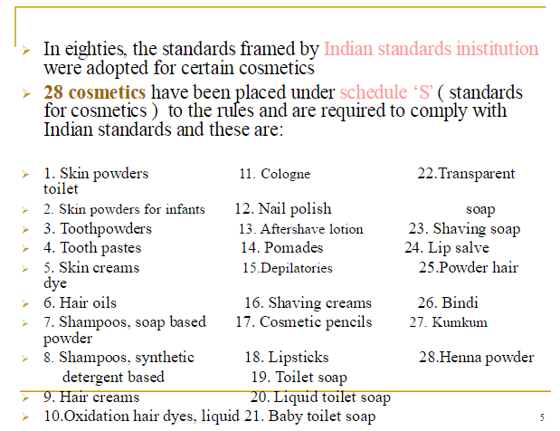
institution

Slide 6
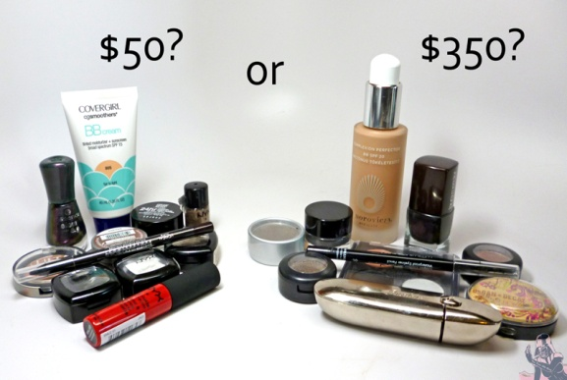

Slide 9
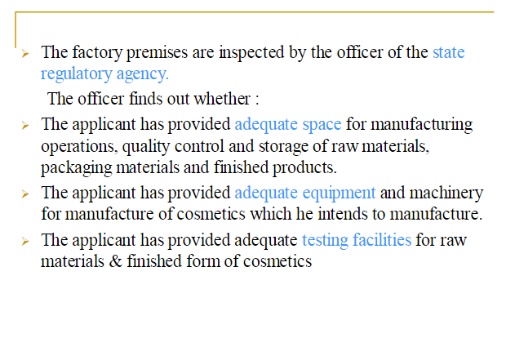

Slide 11
