Slide 1
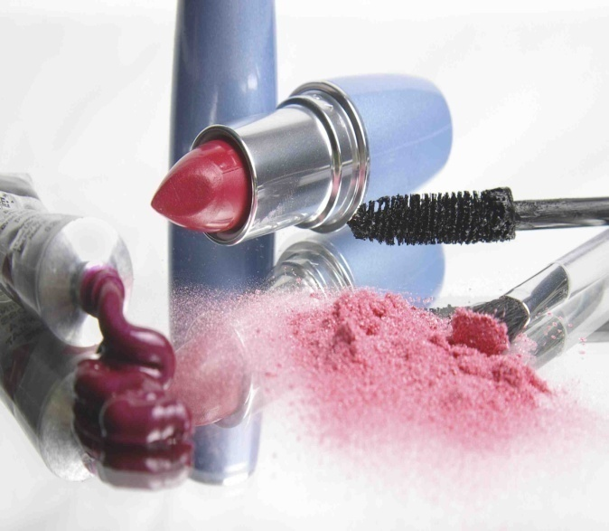
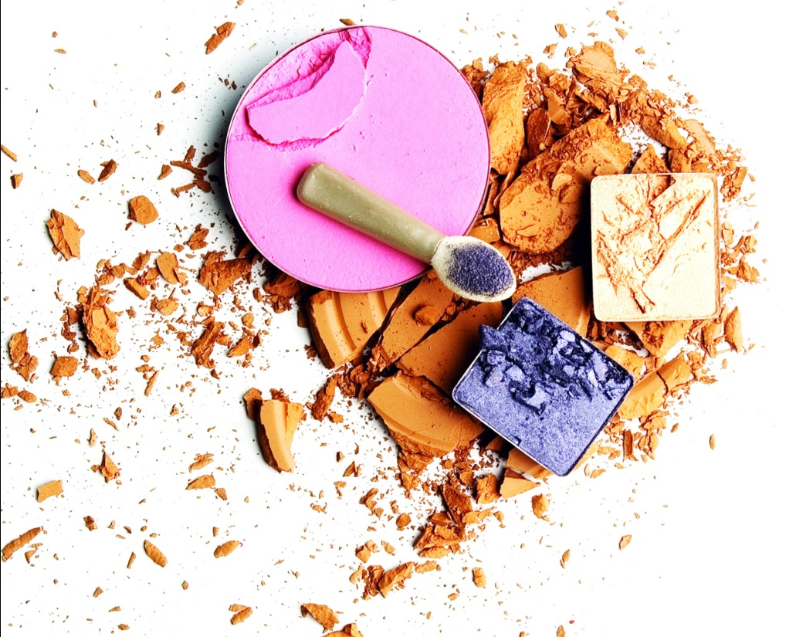
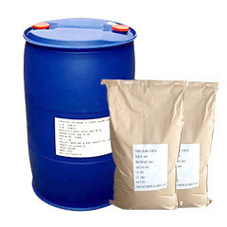
RAW MATERIALS USED IN COSMETICS

Slide 2
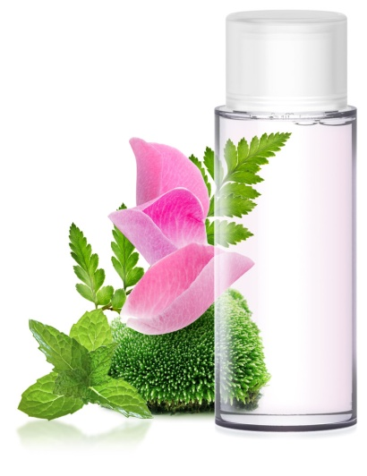
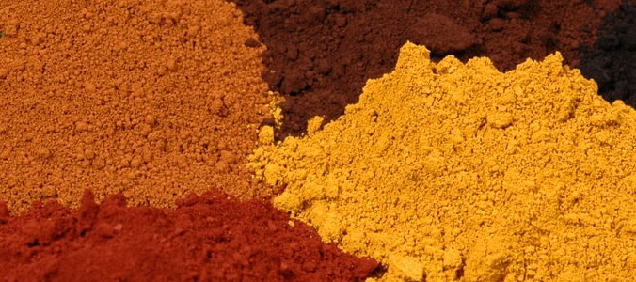
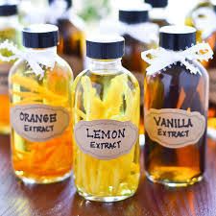
RAW MATERIALS USED IN COSMETICS
COLORS
PERFUMES
PRESERVATIVES
WATER
ANTIMICROBIAL
ANTIOXIDANTS

Slide 3
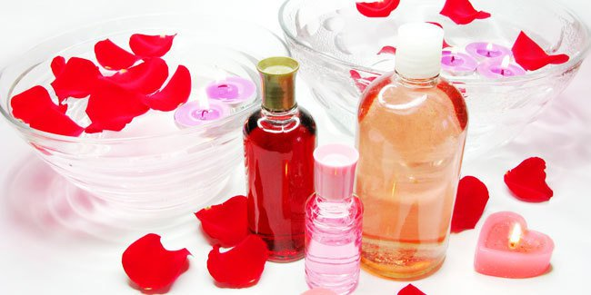
1.WATER
Why used…….
Cheap
Abundance
Innocuous
Universal Solvent
Used as solvent

Slide 4
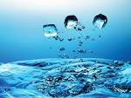
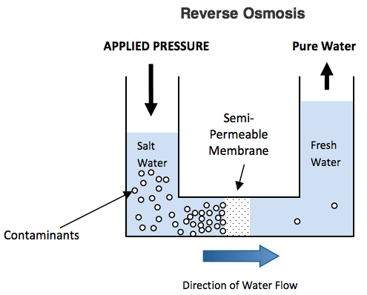
Filtration
Membrane filters(0.2mµ)
Distillation /Double distillation
Ion exchange system
resins are used – to remove cations and anions to form de-ionised water.
Columns are made up of resins can be regenerated.
Reverse Osmosis – 75% purified water collected and 25% as concentrated water
Membranes are made up of cellulose nitrate and polyamide.
Boiling
Steam
Condensation

Slide 5
Microbiological purification
Chemical treatment- Chlorine (1 to 4ppm)
to de-ionised water. Formaldehyde also used .
Heat treatment –boiling –helding for 20 mins. For spores-boiling after 2hrs.
UV radiation – below 300nm-lethal effect on microbes.
Filtration – membrane filters

Slide 6
COLORS
A Generic term for any color imparting substance
Colors can be classified as :
Colorants: substances soluble in the medium which is to used
Pigments and color lakes: insoluble in the medium but coloring achieved by uniform distribution
Color lakes : Produced by precipitation of water soluble colorant with aluminum hydroxide
Water dispersible pigments: dispersed with the help of a dispersing agent
Color additive : dye, pigment derived from a vegetable derivative
Chrome: Vividness of a color
Opacity: Degree of impenetrability by light
Bleed: Leaching of an impurity or minor constituent from a colored article

Slide 7
Natural Colors
Cochineal
Saffron
Chlorophyll
Iron oxide
Chromium oxide
Ultramarines
Carbon black
Titanium dioxide
Zinc oxide
Inorganic
Colors
Amaranth
Indigocarmine
Orange G
Coaltar
Colors

Slide 8
Type of Coloring agent | Cosmetic product used
Water soluble colorants | Bath products, creams, soaps, toothpastes and gels
Oil Soluble Colorants and pigments | face make up , lipsticks, soaps
Color lakes | Eye make up, Lipsticks.
Water dispersible pigments | Soaps

Slide 9
EVALUATION OF COLOURED COSMETICS
OIL SOLUBLE PIGMENTS
DRY POWDER CONTAINED COLOURS
WATER SOLUBLE BASED COLOUR
EMULSION BASED MAKE UP PRODUCTS

Slide 15
Type of PERFUMES | Cosmetic product used
Top notes | Aqueous or hydro alcoholic preparation
Bottom notes | Oils based cosmetics and powders
Middle notes | Soaps and emulsions

Slide 16
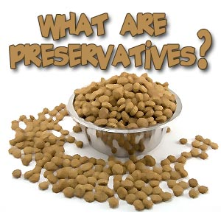
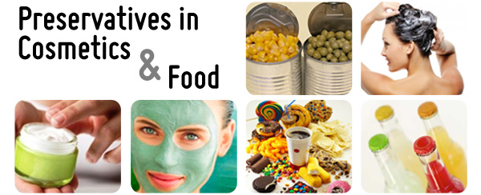
PRESERVATIVES

Slide 17
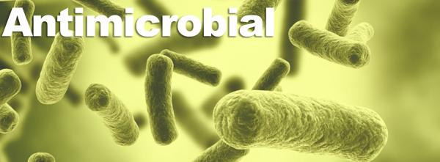
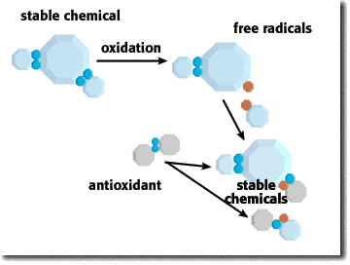
DEFINATION: Preservatives are used to prevent spoilage of skin cosmetics
TWO MAIN REASONS FOR SPOILAGE:
Oxidation of oils and fats
Microbial growth
PRESERVATIVES
ANTIMICROBIAL
ANTIOXIDANT

Slide 18
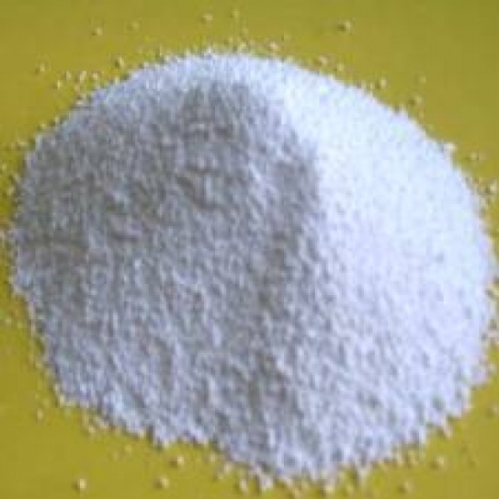
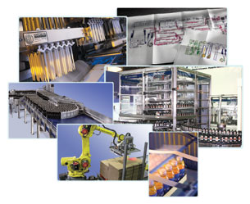
SOURCES OF ANTI- MICROBIAL AGENTS:
Raw materials
Environment
Equipment
Packaging material
Personnel

Slide 19
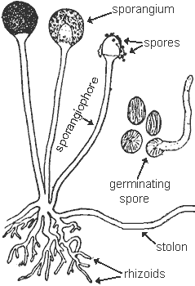
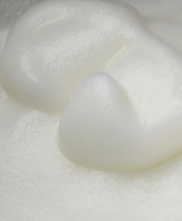
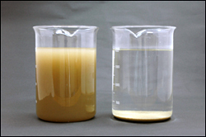
Consequences
Interfere with the ingredients present
Moulds and fungi can be seen on the surface
Turbidity and sedimentation in liquid preparations
Color change
Bubbles or froth formation
Pathogens can cause serious infection

Slide 20
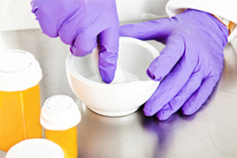
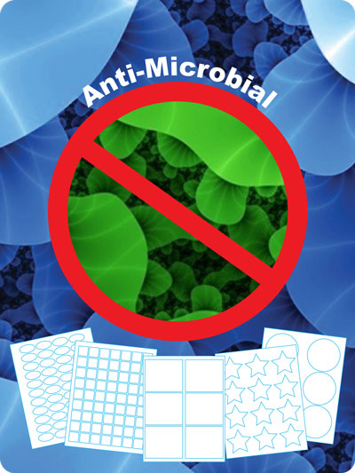
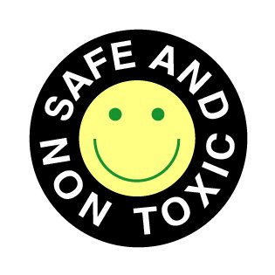
Ideal preservative should be :
Compatible with the formulation
Soluble to such an extent that effective concentration is achieved
Remain stable to provide sustained anti microbial effect
Colorless and odorless
Non toxic , non irritant and non allergic

Slide 21
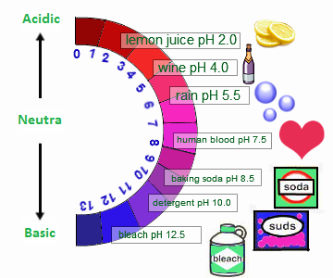
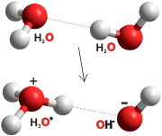
Factors affecting effectiveness of preservatives:
A. Dissociation and pH
1. Ideal preservative effective at wide range of pH but they are highly reactive in nature
2. Weak acids depends on undissociated form which in turn depends upon dissociation constant and pH of the system
3. Preservatives which are active only in dissociated form are effective in higher pH but ineffective at lower pH

Slide 22
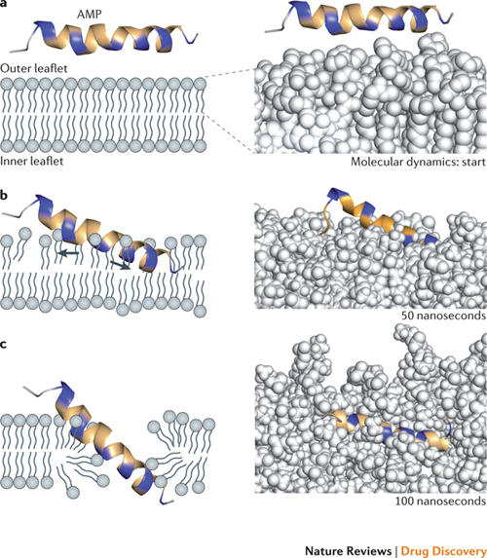
B. CONCENTRATION
No values set for the concentration of preservative
Some materials used are itself antimicrobial so less preservative required
Some ingredients promote micro organisms hence more concentration
Recommended limit for organic mercury compounds( 0.001%) and 0.5-1% for weak acids
Availability to microorganisms more important since it depends upon permeability across the cell wall, diffusion rate and degree of absorption and partition coefficient of preservative

Slide 23
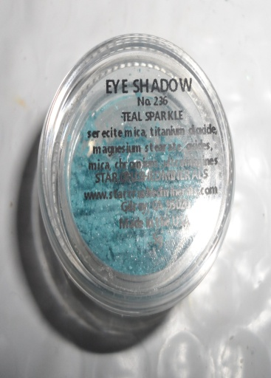
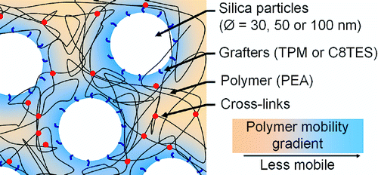
Susceptibility of organisms
1.Hydroxy benzoates active against moulds, fungi and yeasts, less active towards bacteria
2. Chlorobutanol active against bacteria
3. Phenyl mercuric nitrate active against all
Interference by ingredients of cosmetics
Tween 80, polyethylene glycol interfere by exerting protective effect on micro organisms
Soaps and anionic surfactants in lower concentration promote growth of gram negative bacteria
Influence of Solid Particles
Preservatives can be absorbed on the surface of insoluble solid particles
e.g . Kaolin, chalk and zinc oxide

Slide 24
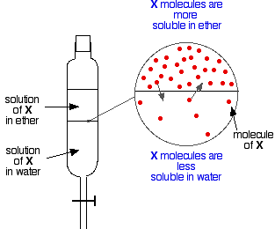
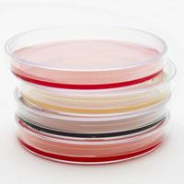
GUIDELINES FOR SELECTING PRESERVATIVES
Identify the material that promote microbial growth
pH of the aqueous phase
Preservative partitioned between two phases depending on the formula of the preparation
Ratio of total to free preservative estimated in presence of macromolecules in formulation
Least toxic

Slide 25
CHALLENGE TEST FOR EFFECTIVENESS OF PRESERVATIVE
PRODUCT INNOCULATED BY SPECIFIED MICRO ORGANISM OF KNOWN CONCENTRATION ( 1X 10⁸ PER ML
BRING THE TOTAL CONCENTRATION TO 1X10⁵ PER ML
INOCULATED PRODUCT INCUBATED AND BACTERIAL COUNT DETERMINED AT 7,14,21 AND 28 DAYS

Slide 26
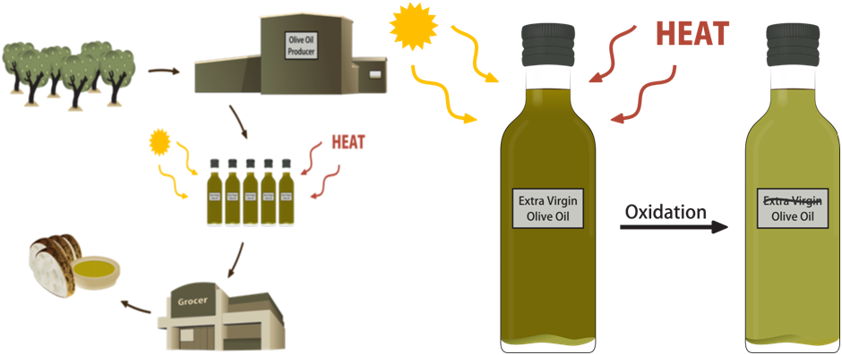
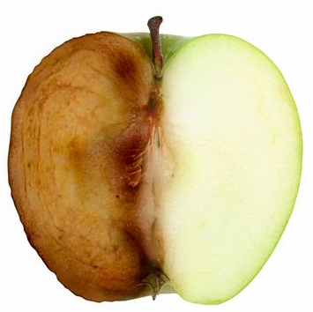
ANTIOXIDANTS
COSMETIC PREPARATIONS CONTAINING FATS AND OILS HAVING UNSATURATED LINKAGE ARE SUSCEPTIBLE TO OXIDATIVE DETERIORATION
RANCID IS WHEN DETERIORATION CAN BE DETECTED BY ORGANOLETIC TESTS

Slide 27
FACTORS AFFECTING RANCIDITY
PRESENCE OF PRO-OXIDANTS
OXIDISING ENZYMES KNOWN AS OXIDASES BECOME FAVOURABLE IN PRESENCE OF MOISTURE, LIGHT AND OXYGEN AND CAUSE RANCIDITY
2. OXYGEN
PEROXIDES FORMED CAUSING AUTOCATALYTIC EFFECTS, DETERIORATION FAST CAUSING FORMATION OF ALDEHYDES, ALCOHOLS ETC
3. MOISTURE
MOISTURE ATTACK GLYCEROL ESTERS ACCELERATE AUTO-OXIDATION
4. LIGHT
DOES NOT CAUSE OXIDATION BUT ACTS AS AN ACCELERATOR ONCE PROCESS IS STARED
5. HEAT
REACTION IN OXIDATION WHICH IS ACCELERATED IS HYDROLYSIS
6. EXTERNAL PRO- OXIDANTS
MICRO- ORGANISMS CAUSES GLYCERIDES TO SPILT INTO GLYCEROL AND FATTY ACIDS

Slide 28
CLASSIFICATION OF ANTI-OXIDANTS
PHENOLIC TYPE
GALLIC ACID
QUINONE TYPE
TOCOPHEROLS
METHYL GALLATE
BUTYL p- HYDROXY BENZOATE
HYDROXY CHROMANS
HYDROXY COUMARONES
AMINE TYPE
ORGANIC ACIDS, ALCOHOLS AND ESTERS
INORGANIC ACIDS AND THEIR SALTS
LECITHIN
ETHANOLAMINE
GLUTAMIC ACID
ASCORBIC ACID
CITRIC ACID
OXALIC ACID
MALIC ACID
SORBITOL
SODIUM SULPHITE
SODIUM METABISULPHITE

Slide 29
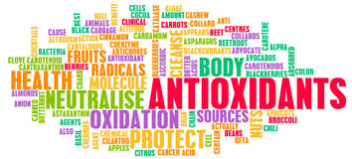
CHOICE OF ANTI-OXIDANT/ SELECTION DEPENDS ON
NATURE OF FAT OR OIL PRESENT AS INGREDIENT
PHYSICAL FORM OF COSMETIC
PH OF COSMETIC
INTENDED USE OF COSMETIC
EXPECTED SHELF LIFE OF COSMETIC
CONDITIONS OF STORAGE OF COSMETICS

