Slide 1
Minerals as co-ezymes
Dr. Shariq Syed

Slide 2
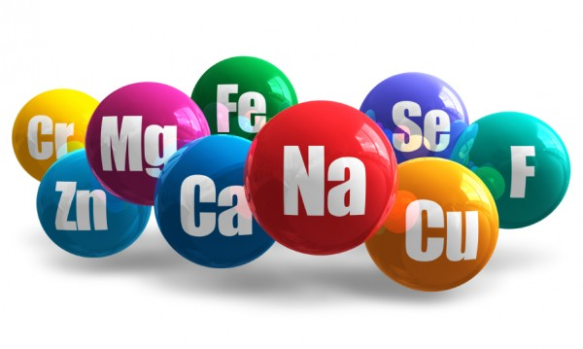
Role of Minerals
Minerals act as cofactors for enzyme reactions
Maintain pH balance within body
Facilitate transfer of nutrients across cell membranes
Maintain proper nerve conduction
Help contract, relax muscles
Regulate body tissue growth
Structural, functional support for body

Slide 3
Role of Minerals
Minerals divided in 2 category based on amount needed in body
Major Minerals (Macro-minerals)
Needed in greater amount in diets, body
Micro Minerals (Trace-minerals)
Needed in small quantities

Slide 4
Composition of Minerals in body

Slide 5
Copper
Copper (Cu) is an essential trace element
shifts between the cuprous (Cu¹⁺) and cupric (Cu²⁺) forms
The ability of copper to easily accept and donate electrons explains its important role in
oxidation-reduction (redox) reactions
Capturing free radicals

Slide 6
Copper
Copper enzymes (cuproenzymes) regulate various physiologic pathways
energy production
iron metabolism
connective tissue maturation
neurotransmission

Slide 7
Copper
Energy production:
Copper-dependent enzyme, cytochrome c oxidase, plays a critical role in cellular energy production
Connective tissue formation:
lysyl oxidase, is required for the cross-linking of collagen and elastin
which are essential for the formation of strong and flexible connective tissue

Slide 8
Copper
Iron Metabolism:
Four copper-containing enzymes (multi-copper oxidases (MCO) or ferroxidases)
These enzymes have capacity to oxidize ferrous iron (Fe2+) to ferric iron (Fe3+)
Ferric iron can be loaded onto the protein transferrin for transport to the site of red blood cell formation

Slide 9
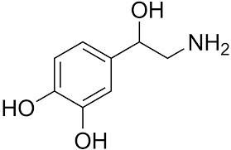
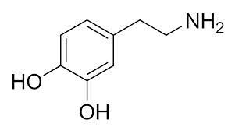
Copper
CNS Functioning:
A number of reactions essential to normal function of the brain and nervous system are catalyzed by cuproenzymes
Neurotransmitter synthesis:
Dopamine b-hyroxylase
Dopamine
Norepinephrine

Slide 10
Iron (Fe)
longest and best described history among all the micronutrients
In humans, iron is an essential component of hundreds of proteins and enzymes
key element in the metabolism

Slide 11
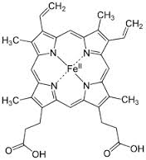
Biological role of Iron (Fe)
Oxygen transport and storage:
Heme is an iron-containing compound
Hemoglobin and myoglobin are heme-containing proteins that are involved in the transport and storage of oxygen
Electron transport and energy metabolism:
Cytochromes are heme-containing compounds serve as electron carriers during the synthesis of ATP
Cytochrome P450 is a family of enzymes important role in the metabolism
Heme
Notes:
Hemoglobin is the primary protein found in red blood cells and represents about two thirds of the body's iron. The vital role of hemoglobin in transporting oxygen from the lungs to the rest of the body is derived from its unique ability to acquire oxygen rapidly during the short time it spends in contact with the lungs and to release oxygen as needed during its circulation through the tissues. Myoglobin functions in the transport and short-term storage of oxygen in muscle cells, helping to match the supply of oxygen to the demand of working muscles
The heme group is a highly-conjugated ring system (which allows its electrons to be very mobile) surrounding a metal ion, which readily interconverts between the oxidation states. For many cytochromes, the metal ion present is that of iron, which interconverts between Fe²⁺ (reduced) and Fe³⁺ (oxidized) states (electron-transfer processes) or between Fe²⁺ (reduced) and Fe³⁺(formal, oxidized) states (oxidative processes). Cytochromes are, thus, capable of performing oxidation and reduction. Because the cytochromes (as well as other complexes) are held within membranes in an organized way, the redox reactions are carried out in the proper sequence for maximum efficiency.
In the process of oxidative phosphorylation, which is the principal energy-generating process undertaken by organisms, other membrane-bound and -soluble complexes and cofactors are involved in the chain of redox reactions, with the additional net effect that protons (H⁺) are transported across the mitochondrial inner membrane. The resulting transmembrane proton gradient([protonmotive force]) is used to generate ATP, which is the universal chemical energy currency of life. ATP is consumed to drive cellular processes that require energy (such as synthesis of macromolecules, active transport of molecules across the membrane, and assembly of flagella).

Slide 12
Biological role of Iron (Fe)
Antioxidant functions:
Catalase and peroxidases are heme-containing enzymes
They protect cells against the accumulation of hydrogen peroxide, a potentially damaging reactive oxygen species (ROS)
The enzyme catalyze a reaction that converts hydrogen peroxide to water and oxygen

Slide 13
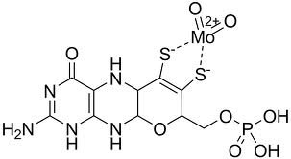
Molybdenum
The molybdenum atom is part of the molybdenum cofactor in the active site of four enzymes in humans:
sulfite oxidase
xanthine oxidase
aldehyde oxidase
mitochondrial amidoxime reducing component
Molybdenum Cofactor

Slide 14
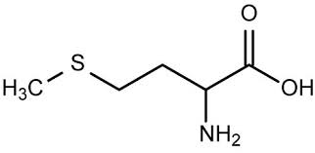
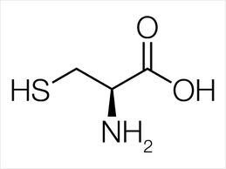
Biological role of Molybdenum
Sulfite oxidase:
catalyzes the transformation of sulfite to sulfate
Necessary reaction for the metabolism of sulfur-containing amino acids (methionine and cysteine)
Xanthine oxidase:
catalyzes the breakdown of nucleotides (precursors to DNA and RNA) to form uric acid
Uric acid contributes to the plasma antioxidant capacity of the blood
methionine
cysteine

Slide 15
Selenium
Selenium is a trace element that is essential in small amounts, but like all essential elements, it is toxic at high levels
Humans require selenium for the function of a number of selenium-dependent enzymes, also known as selenoproteins
At least 25 selenoproteins have been identified, but the metabolic functions have been identified for only about one-half of them

Slide 16
Biological role of Selenium
Glutathione Peroxidases
Anti-oxidant enzymes that reduce reactive oxygen species
Selenoprotein P
transport protein for selenium
Anti-oxidant enzyme
Selenophosphate synthetase
Incorporation of selenocysteine into selenoproteins is directed by enzyme selenophosphate synthetase

Slide 17
Zinc
Zinc-dependent enzymes can be found in all known classes of enzymes
Over 300 different enzymes depend on zinc for their ability to catalyze vital chemical reactions
cellular metabolism reactions are zinc-dependent
Zinc plays important roles in growth and development, the immune response, neurological function, and reproduction
On the cellular level, the function of zinc can be divided into three categories: 1) catalytic, 2) structural, and 3) regulatory

Slide 18
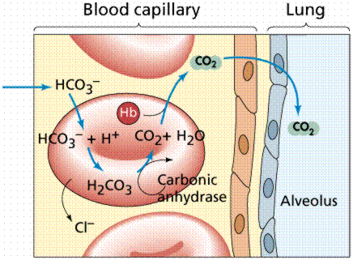
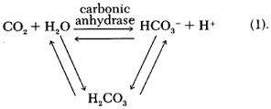
Biological role of Zinc
Two examples of zinc-containing enzymes are carbonic anhydrase and carboxypeptidase, which are vital to the processes of carbon dioxide (CO₂) regulation and digestion of proteins
Carbonic anhydrase converts CO₂ into bicarbonate and the same enzyme transforms the bicarbonate back into CO₂ for exhalation through the lungs
Carboxypeptidase cleaves peptide linkages during digestion of proteins

