Slide 1
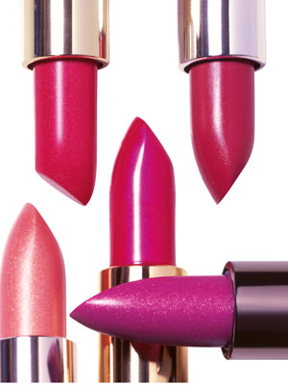

Slide 2
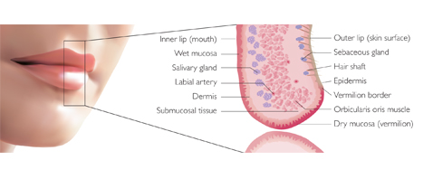
ANATOMY OF LIPS

Slide 12
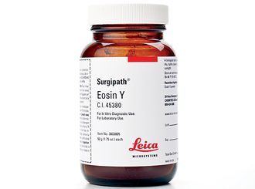
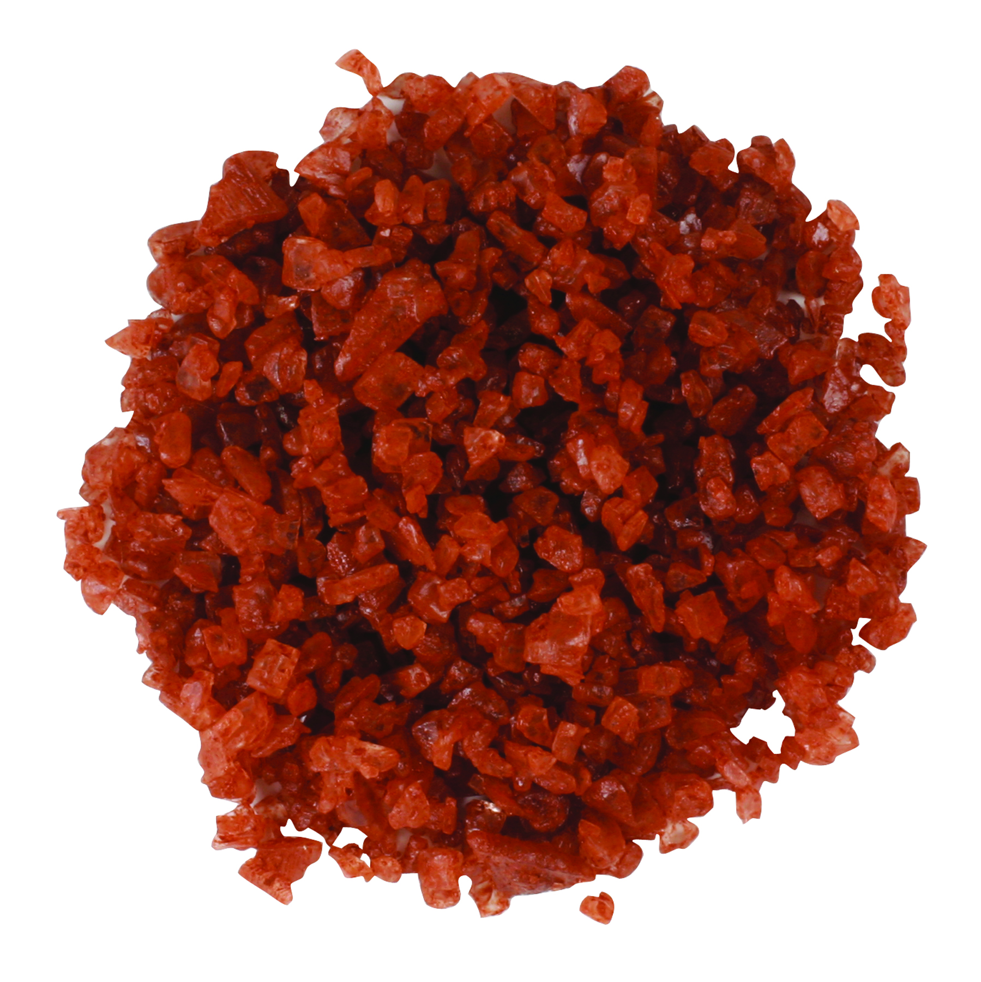
INSOLUBLE ORANGE COMPOUND
INTENSE RED COLOUR WHEN pH CHANGES TO LESS THAN 4
EOSIN

Slide 16
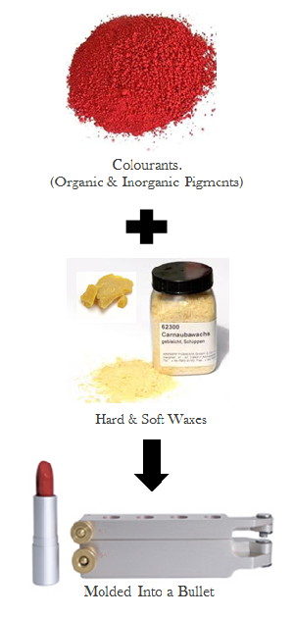

Slide 20
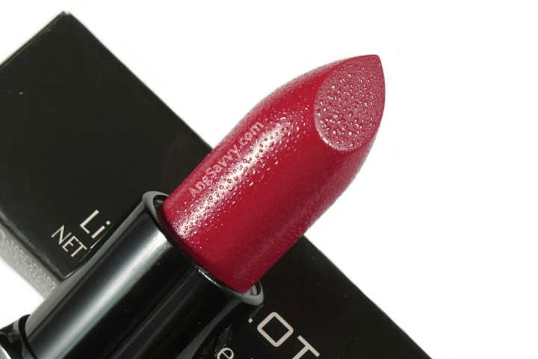

Slide 21
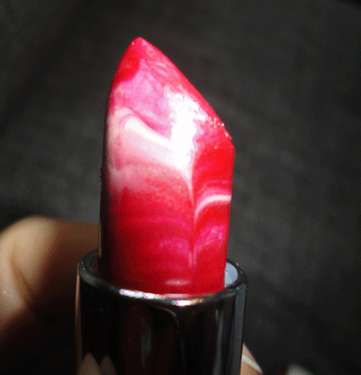

Slide 22
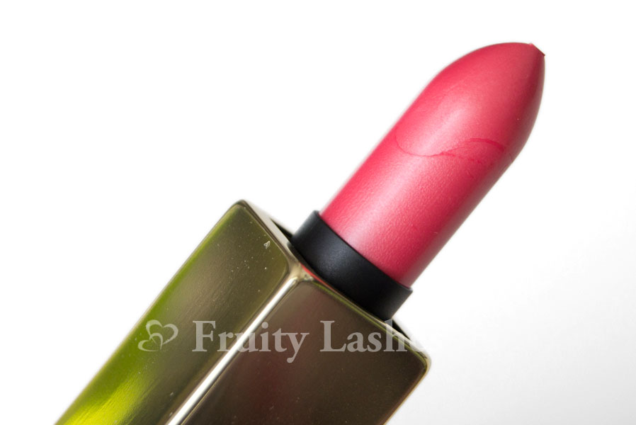

Slide 25
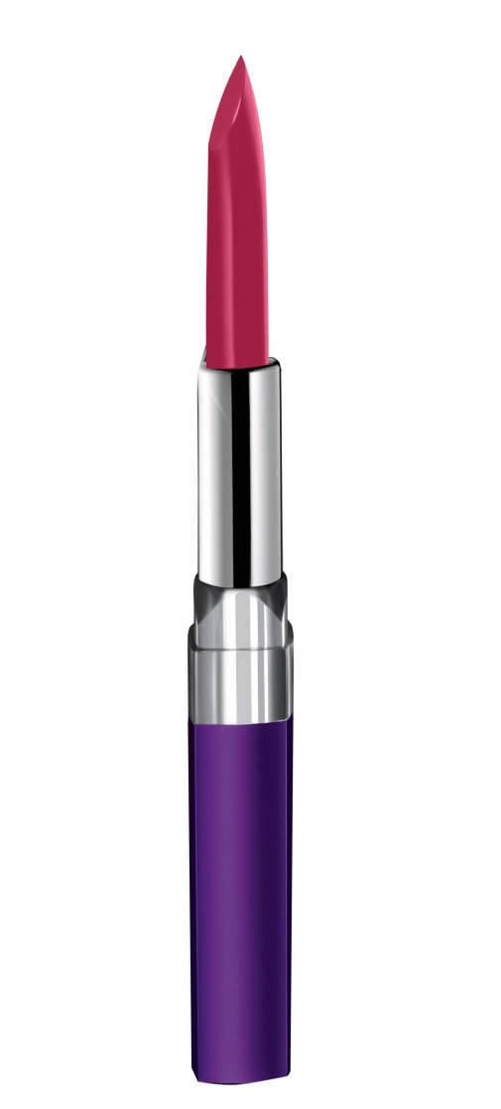

Slide 28
Quality control tests

Slide 36
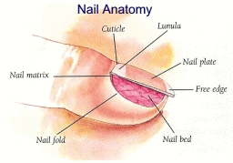
CUTICLE SOFTENERS
NAIL WHITE

Slide 37
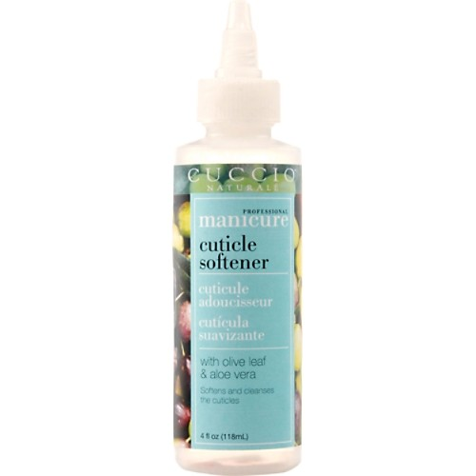
CUTICLE SOFTENERS
DEFINATION : CUTICLE ARE CREAMS THAT SOFTEN THE CUTICLE AS WELL AS PREVENT NAILS FROM BECOMING BRITTLE AND RIBBED
FORMULATION CONSIDERATION:
QUATERNARY AMMONIUM COMPOUNDS ARE PROMINENT IN THIS CLASS
MECHANISM OF ACTION: SOFTENING ACTION DUE TO INCREASE AFFINITY FOR PROTEIN AND INCREASES WITH INCREASING MOLECULAR WEIGHT
2. CETYL PYRIDINIUM CHLORIDE AND STEARYL DIMETHYL BENZYL AMMONIUM CHLORIDE ARE ALSO USED AT 3-5% AND BACTERICIDAL ACTION
UREA ADDED TO PROMOTE SWELLING OF KERATIN AND ENHANCE CUTICLE SOFTENING
LANOLIN AND ISOPROPYL MYRISTATE WILLL CONFER IMPROVED EMOLLIENCY.
NONIONIC THICKENING AGENTS SUCH AS METHYLCELLULOSE WILL INCREASE VISCOSITY

Slide 38
NAIL BLEACHES
DEFINATION: SOLUTIONS OR CREAMS USED FOR THE REMOVAL OF INK OR TOBOCCO STAINS FROM THE NAILS.
NAIL BLEACHES
OXIDATION
REDUCTION
USE OF SULPHITES WITH DILUTE ACID
HYDROGEN PEROXIDES EITHER AT 20 VOLS OR DILUTED 1:4 BY CHLORINE COMPOUNDS
AQUEOUS SOLUTIONS OR ORGANIC ACIDS SUCH AS CITRIC OR TARTARIC ACIDS OR 4% HCL IN GYCERIN OR WATER HAS BEEN RECOMMENDED

Slide 39
FORMULATION
HYDROGEN PEROXIDE | 73.5%
AMMONIA | 0.5%
ROSE WATER | 25%
PRESERVATIVE | 1%

Slide 40
BEESWAX | 10 %
PARAFFIN WAX | 5%
MINERAL OIL | 46%
PUMICE POWDER | 8%
BORAX | 0.5%
WATER | 30%
PERFUME | 0.5%

Slide 41
NAIL STRENGTHENER
DEFINATION: TO PREVENT DRY FINGERNAILS FROM BREAKING AND TO ENHANCE APPERANCE TO ELIMINATE BRITTLENESS AND DRYNESS
FORMULATION
WATER SOLUBLE METALLIC ASTRINGENT SALTS SUCH AS ALUMINIUM SULPHATE, POTASSIUM, SODIUM ALUMS,ZINC ACETATE
DIPPING THE NAILS IN 1-5% SOLUTION FOR 5-10 MINS IF EXCEEDING 5-10 MINS NAILS BECOMES DRY AND WRINKLED
5-20% OF GLYCERIN AS HUMECTANT TO RETARD EVAPORATION OF WTER AND ENHANCED PENETRATION
PARTIALLY POLYMERIZED FORMALDEHYDE SOLUTION USED ASCROSS LINKING AGENTS AS CROSS LINKING AGENTS IN NAIL HARDENING PREPARATIONS

Slide 42
POTASH ALUM | 3 %
GLYCERIN | 10%
FORMALDEHYDE | 0.01%
MENTHOL | 0.001%
WATER | 100 QS

Slide 43
NAIL WHITES
Nail whites are preparations used to produce an even white edge to the nails.
RAW MATERIALS
1. They are based on an inert white pigment such as zinc oxide , titanium dioxide, KAOLIN
2. Pigment forms 20-30% by white forms a stiff base

Slide 44
TITANIUM DIOXIDE | 38%
PETROLEUM JELLY | 62%
BEESWAX | 55%
HYDROGENATED COTTON SEED OIL | 9%
COCOA BUTTER | 9%
CASTOR OIL | 8 %
LANOLIN BASE | 9%
TITANIUM DIOXIDE | 10 %

