Slide 1


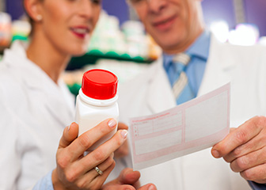
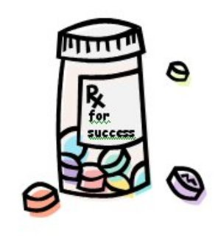

CAREER PROSPECTS
IN PHARMACY
BY-
PROF LAL MARIA AHMED
Assistant Professor
Pharmaceutics dept
AIKTC- SOP

Slide 2
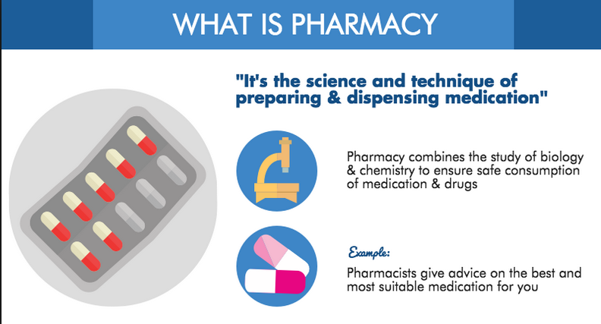

Slide 3
What Pharmacists Do?
Manufacture Medicines
Educate patients
Purity and safety
Monitor side effects

Slide 4



Goals of Pharmaceutical Care
Cure disease
Eliminate or reduce symptoms
Suitable medicine to improve the health of a patient with minimal risk

Slide 5

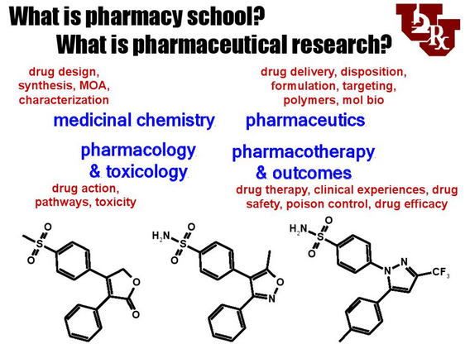


Slide 6
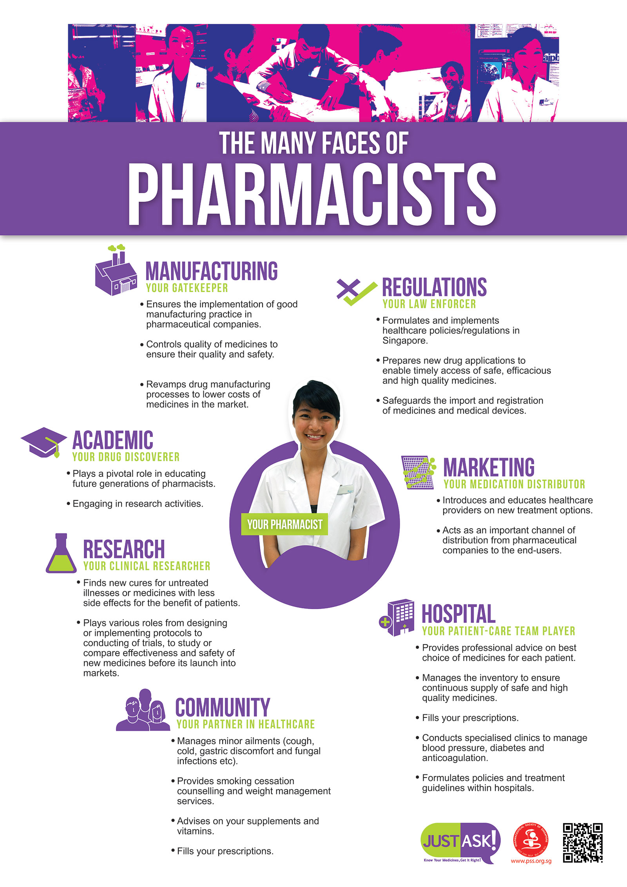


Slide 7
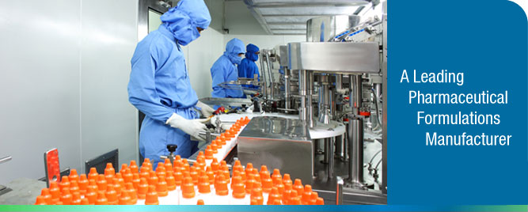
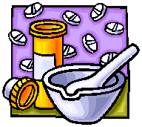
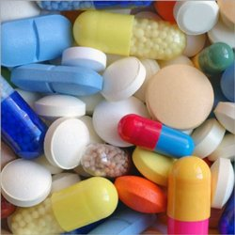
Manufacturing
Manufacturing medicines like tablets, capsules and syrups .
The Pharmacist can have his own manufacturing industry or can start on Loan License

Slide 8




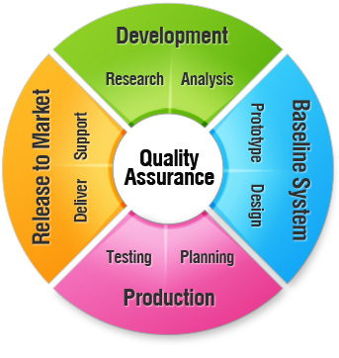
Practicing Pharmacist
Hospital Pharmacist / Community Pharmacist
Health professionals most accessible to the public. They supply medicines in accordance with a prescription or, when legally permitted, sell them without a prescription.
Quality Assurance AND QUALITY CONTROL
Ensure quality of medicines

Slide 9

Teaching as a career
B Pharm. are eligible to teach as lecturers in the
D. Pharm program.
M. Pharm can get a lecturer’s job in pharmacy degree colleges.

Slide 10


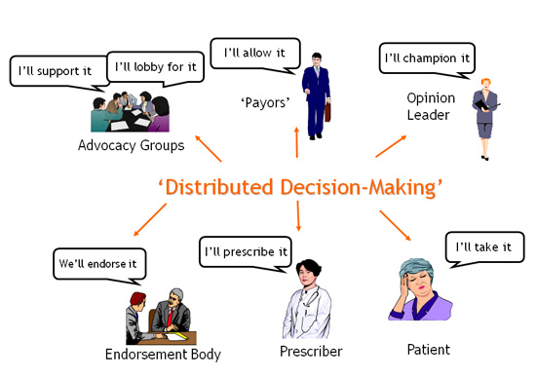

PHARMACEUTICAL MANAGEMENT AND MARKETING
Imparts entrepreneurship and leadership skills required for pharmaceutical market growth

Slide 11
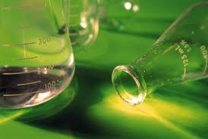


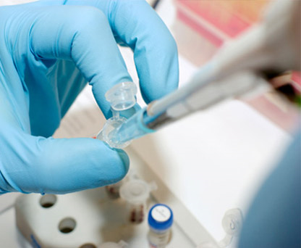

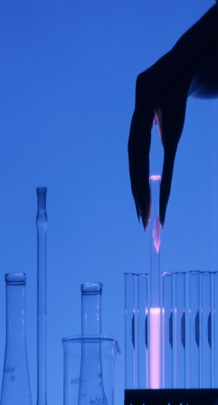
Clinical Research
From Bench side to Bedside
Effects of drugs on human body

Slide 12

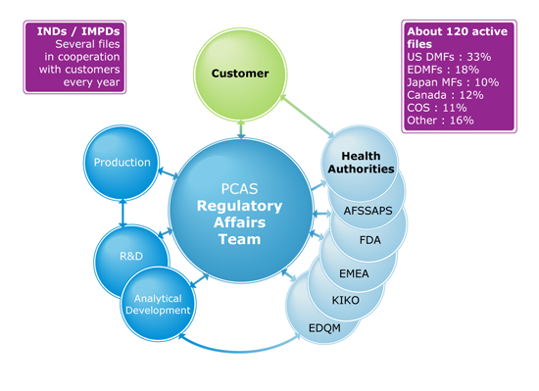
Regulatory Affairs
Authentication of each and every step right from manufacturing to marketing by FDA in global market

Slide 13


PUBLIC SERVICE
Department of Public Health watching out for the health care of citizens and the Food and Drug Administration

Slide 14



Slide 15


