Slide 1
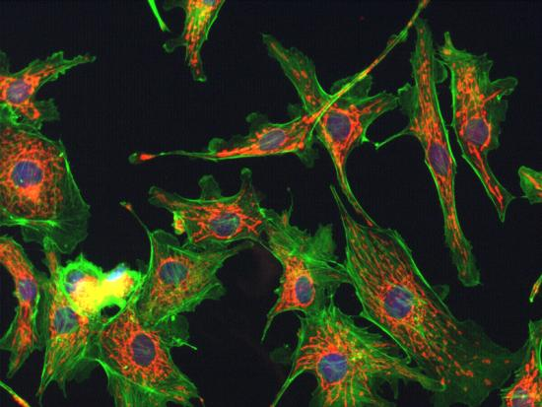
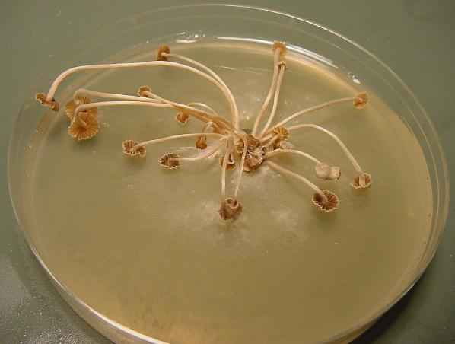
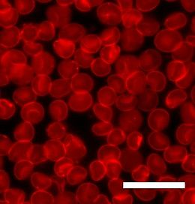
Introduction, History & Pharmaceutical Application Of Microbiology
Prepared by: Shaikh Abusufyan

Slide 2
Introduction
Microbiology is the study of living organism of microscopic size which include bacteria, fungi, algae, protozoa and viruses.
This term was introduced by a French Chemist Louis Pasteur
Father of microbiology.

Slide 3
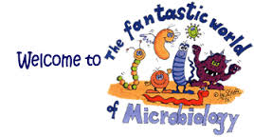
History
Existence of microbial world was known only after the invention of microscope

Slide 4
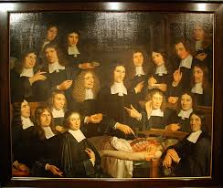
CONTRIBUTION OF SCIENTIST

Slide 5
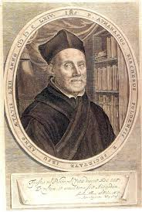
Athanasius Kircher (1602-1680)
Examine the blood of patients suffering from plague under microscope
observed countless masses of small worms.
causative agent of plague

Slide 6
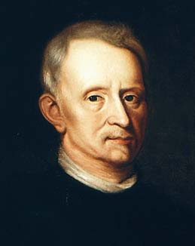
Robert Hook (1635-1703)
Developed a compound microscope with multiple lenses and described the world of microbes.

Slide 7
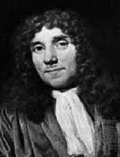
Antony Van Leeuwehoek (1632-1723)
He was the 1st to observe and accurately describe the shape of human RBCs
He also observed and measured a large number of minute living organisms including bacteria and protozoa.

Slide 8
Spontaneous generation (abiogenesis)
Scientist and philosophers were in deep disagreement over controversial concept of spontaneous generation.
Many people living in the seventeenth and eighteenth centuries believed in
the ability of living creature to arise from non-living matter such as dead animals, meats or broth.

Slide 9
Experiment to prove and disapprove abiogenesis
Francesco Redii (1629-1679)-Disapprove
John Needham (1713-1781)- Support
Louis pasteur (1822-1895)- Strongly disapprove

Slide 10
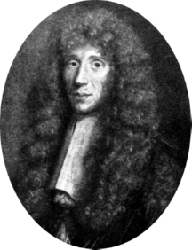
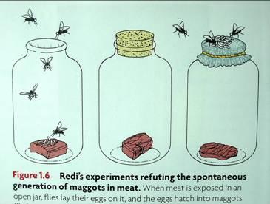
Francesco Redii (1629-1679)-Disapprove
He made 1st attempt to disapprove the theory of spontaneous generation.
Meat is placed in a jars.
One jar was covered with fine gauze.
While other was kept open.
Flies developed only in the open jar and not in the jar, covered with gauze.
concluded that maggots had developed from the flies and not from the non living meats.

Slide 11
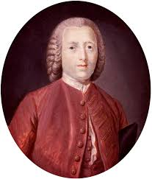
John Needham (1713-1781)- Support
He was the greatest supporter of the theory of spontaneous generation.
Experiment performed by him gave conflicting results. i.e
- life was developed in the Needham heated closed flasks containing chicken gravy as well as in open unheated one.

Slide 12
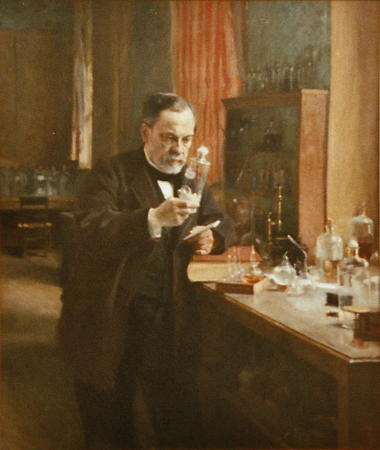
Louis pasteur (1822-1895)- Strongly disapprove
The credit for providing foundation to bacteriology as a science goes to Louis Pasteur, the French organic chemist.
He was 1st to demonstrate that air contain microscopically observable organized structures.

Slide 13
Louis Pasteur experiment 1 GUN COTTON EXPERIMENT
He passed large qty of air through the tube that contained a plug of guncotton to serve as filter.
Guncotton then removed and dissolved in the mixture of alcohol-ether
and sediment was examined microscopically.
He found that this sediment contained not only organic matter but also a large number of small microorganism.

Slide 14
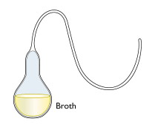
Several swan-neck flasks
He performed a series of experiments to prove that “although microorganism were present in the air they were not spontaneously produced”.
He took boiled meat and infused it in several swan-neck flasks.
The flask opening were freely open to air but curved so that gravity would cause the any air born dust particles to deposit in the lower part of the neck.

Slide 15
The flask was heated to sterilize the broth and then incubated.
No growth occurred even the content of the flasks were exposed to the air.
Pasture pointed out that no growth took place because dust and germs had been tripped in the walls of the curved necks

Slide 16
This experiment finally resolved the controversy of spontaneous generation verses biogenesis
And proved that microorganisms are not spontaneously generated from inanimate matter.

Slide 17
Louis Pasteur experiment 2
MO are not evenly distributed in the atmosphere
and their number varies from place to place.
Pasteur opened few sealed and sterilized flask containing broth at various place and resealed them
Out of 20 flask which he opened and resealed on a dusty road, 8 showed spoilage
While out of 20 that he opened on the top of mountain, only 5 showed spoilage.

Slide 18
Exp No 3: Pasture study on beer and wine fermentation Pasteurization????
Pasteur found that wine spoilage was caused by the growth of undesirable contaminating MO.
After some experimentation, he showed that wine did not undergo spoilage if it was held for few minutes at 50-60º C.
This gave rise to the new process of preserving wine, fruit juice, milk etc. and was called as pasteurization.

Slide 19
Exp No 4: Aerobic, anaerobic and facultative anaerobics
Existence of life in the absence of oxygen
He study that oxygen was inhibitory to the growth of butyric acid bacteria.
Pasteur also found that many other MO including yeast could grow either in presence or in the absence of oxygen.
He designated life in the presence of oxygen as aerobic, in the absence of oxygen as anaerobic
and in presence or absence of oxygen as facultative anaerobics.

Slide 20
Opening of field of sterilization by the Pasteur
Pasteur initially assume that boiling render the fluid sterile.
But he soon found that ordinary water had some MO even after boiling.
Pasteur established the practice of heating fluid material to 120ºc under pressure of sterilization (autoclave- wet heat sterilization)
He also introduced the practice of sterilizing glass ware by dry heat at 170ºc (Dry heat sterilization)

Slide 21
Tyndallisation
Tyndall observed that the actively growing bacteria were easily destroyed by boiling.
whereas in the inactive phase, they were comparatively resistant.
He introduced the method of sterilization by repeated heating with appropriate intervals.
This method is known as tyndallisation.

Slide 22
Principal of immunization demonstrated by Pasteur Learn from failure
In 1880, Pasteur isolated the bacterium responsible for chicken cholera and grew it in pure culture.
But on the day of his public demonstration he failed to repeat his experimental result.
i.e chicken survived after injecting the isolated bacterial culture and this result surprise him.
On subsequent experiments he came to the conclusion that on long preservation or sub culturing
The virulent power of pathogenic bacteria is destroyed.

Slide 23
Such microbial culture with decreased virulence was referred to as attenuated culture.
does not cause infection but induces immunity in host.

Slide 24
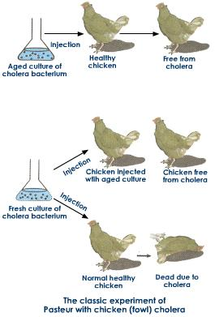

Slide 25
BEST FROM WEST:
Pasteur further introduced a vaccine for rabies.
He knew that the causative agent of rabies attacked the brain and spinal cord.
He took spinal cords from rabbits which died from the disease and suspended these cord in dry air.
In this way rabies MO in the nervous tissue lost their virulence and emulsion of spinal cord was used as vaccine.

Slide 26
Robert Koch and Anthrax
The first to demonstrate the role of bacteria in causing disease.
He isolated Bacilus anthracis, the causative agent of anthrax.
He first time prepare, fix and stained bacteria using aniline dyes which open new area in bacteriological technique.

Slide 27
He also described
Method of preparing cultures on solid media
And the isolation of pure strains of bacteria from single colonies.
He establish the causal relationship between a MO and specific disease by applying set of criteria referred to as Koch’s postulates

Slide 28
Koch’s Postulates are
The MO must be present in every case of disease.
The MO must be isolated from the diseased animals and grown in pure culture.
The disease must be reproduced when a pure culture of the MO is inoculated into the susceptible host.
The same MO must be re-isolated from the experimentally infected host.

Slide 29
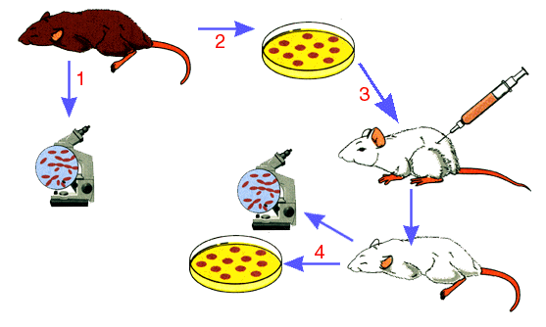
Koch’s Postulates

Slide 30
Germ theory of disease
Pasteur investigated silkworm disease and proved that the disease was due to a protozoan parasite.
Lord joseph lister, a famous English surgeon in 1867, introduced antiseptics for the prevention and cure of wound infection.
He developed antiseptic surgery to prevent MO from entering wounds by the application of phenol on surgical dressing.

Slide 31
Joseph lister was the first to introduce aseptic techniques for control of microbes by the use of physical and chemical agent.
Lister is known as the father of antiseptic surgery.

Slide 32
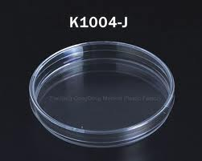
The confirm evidence that MO actually caused disease , came from experiment perform by Robert Koch.
And proof which support the germ theory of disease became Koch postulate.
Richard petri, Koch’s assistant designed a special plate to hold solid culture media.
This plate has great significance in the microbiology and is referred as petri plate

Slide 33
Discovery of chemotherapeutic agents
Paul Ehrlich in 1904 found that the dye Trypan red was active against trypanosome - cause African sleeping sickness.
This dye with antimicrobial activity was referred to as magic bullet.
Subsequently, Ehrlich in collaboration with sakahiro hata, a Japanese physician, introduced the drug salvarsan as a treatment of syphillis caused by treponema pallidum.

Slide 34
Gerhardt domagk found that prontosil, an azo dye derived from para-aminobenzene sulphonamide was active against specific bacteria.
Sir Alexander Fleming accidentally discovered a substance produced by fungus penicillium notatum.
He extracted from the fungus a compound which he called penicillin that could destroyed several pathogenic bacteria.

Slide 35
S. A. Waksman at Rutgers university, USA discovered another antibiotic streptomycin, produced by two strains of actinomycetes streptomyces griseus.
Major contribution in the search for MO producing antibiotics came from waksman, who showed that actinomycetes are prolific producers of variety of antibiotics.

Slide 36
Pharmaceutical Application of microbiology
Production of antibiotics:
Today’s 2/3rd of antibiotics are produced from MO. Eg. Penicillin from penicillium species,
Streptomycin from streptomyces griseus, Tetracycline from streptomyces aureofaciens, chloramphenicol from streptomyces venezuelae
2. Production of enzymes, vaccines, bio surfactants,
alcohol and other pharmaceutical product.

Slide 37
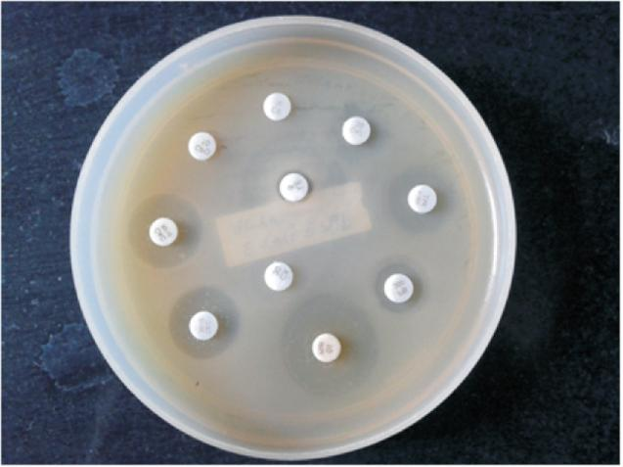
3. Diagnosis of disease and treatment
Antibiotic susceptibility testing is mainly used for selection of antibiotic for treatment of microbial infection.
4. Sterile product preparation
It deal with preparation of :
-Sterile room
-Aseptic technics
-detection of microbes by sampling and sterility testing
- Settle plates, contact plates and air sampling techniques are used for detection of MO in sterile room

Slide 38
5. Sterilization
-Dry heat sterilization
-Wet heat sterilization
-Membrane filtration
-Gaseous sterilization
-Chemical sterilization
All the sterilization process are validated using biological indicators.

Slide 39
Biological indicators:
Wet heat sterilization- Bacillus stearothermophilus
Dry heat sterilization- Bacillus subtilus
Radiation sterilization- Bacillus pumilis
Membrane filtration- Pseudomonas diminuta etc.

Slide 40
6. Steroid biotransformation:
- Imp steroids can e produced by microbiological
transformation of naturally occurring steroids

Slide 41
7. Identification of MO
- MO are isolated and identified by
- Morphological
- Biochemical
- Cultural
-Microscopic characteristic and genetic
study.

Slide 42
8. Testing of Pharmaceutical
- Microbiological assay of antibiotics- Compared test antibiotics with standard
- Evaluation of disinfectant- Compared test disinfectant with standard
- Antimicrobial preservative efficacy testing- Compared test preservative with standard one
-Endotoxin or Pyrogens testing
-Test for support of the sterility assurance system.
e.g. Bio burden testing- Determination of No of MO in product
------Pre-sterilization count
------post-sterilization count

Slide 43
Reference:
Dr. Chandrakant Kokare. Pharmaceuitical microbiology. Principal and applications. Page No-1.7 to 1.11 and 2.1 to 2.12.

