Slide 1
LARGE SCALE MANUFACTURING OF SHAMPOOS
FUNCTIONAL INGREDIENTS ARE INERT TOWARDS EACH OTHER
Main detergent, foam booster are mixed with gentle stirring to minimize frothing
SOME OF THE COMPONENTS DIFFICULT TO SOLUBILIZE
Dissolve main detergent in water
HEAT IS NEEDED TO OBTAIN A SOLUTION
Mix by propeller stirring all additives
CITRIC ACID ADDED TO ADJUST pH
Viscosity adjuster added till desired thickening obtained
When moderately stirred add rest of the additive
Adjust pH with citric acid
Adjust the viscosity
Add detergent to half of formulation water
Add 2 to mixture 1
Opacifiers and other difficult to dissolve substances heated together in remainder of water and added to above mixture

Slide 3
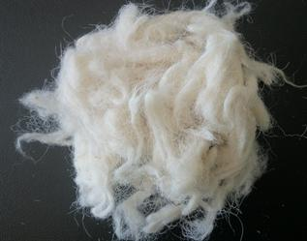
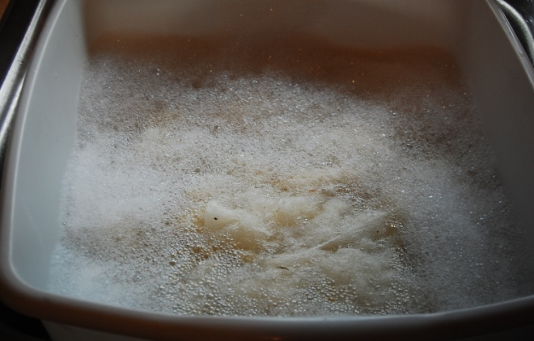
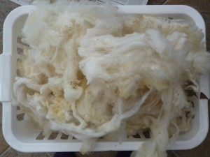
Detergency and cleansing action
Place in 200 ml water( 1 gm of shampoo) contained flask and temp of water 35 C
5 gms of Wool yarn in grease
Shake flask for four minutes at the rate of 50 times a minute
Dry the wool yarn and weigh it.
Calculate the amount of soil removed

Slide 6
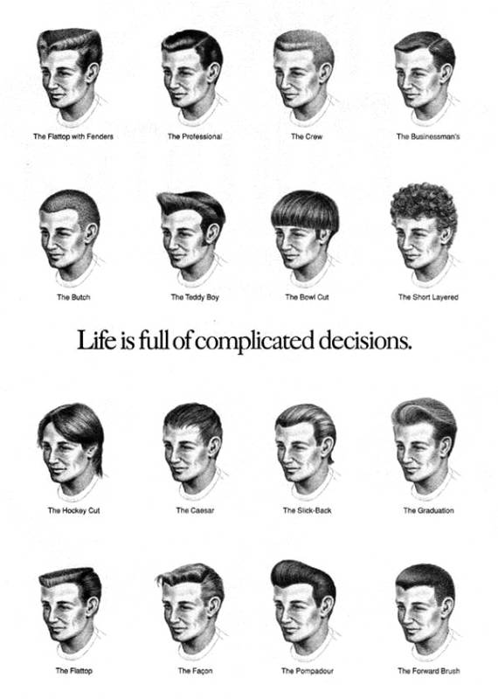
Hair grooming preparations

Slide 7
INTRODUCTION
1.NATURAL FUNCTION OF HAIR IS TO PROVIDE PROTECTION BUT IMPART ATTRACTIVE FEATURE TO MEN AND WOMEN
2. SCALP SECRETES SEBUM , LUBRICATES AND PREVENT MOISTURE LOSS
3. IF BELOW NORMAL HAIR EXPOSED TO HARSH CHEMICALS, CAUSES SPILT AND BREAK OF HAIR
4. IDEAL PREPARATION SHOULD BE SUCH THAT THE WATER ABSORBED BY HAIR IS NOT EVAPORATED THUS REDUCING BRITTLENESS

Slide 8
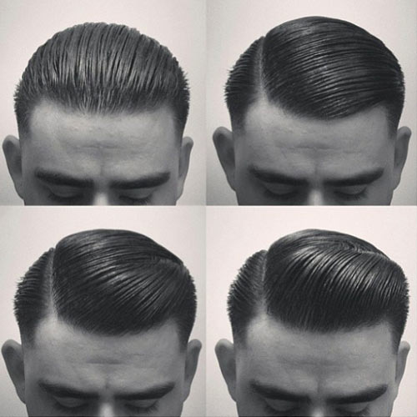
IDEAL PROPERTIES OF GOOD HAIR DRESSINGS
NATURAL, HEALTHY APPEARANCE
GOOD GROOMING, LUSTRE LESS CONDITIONING
ATTACHED TO HAIR SHAFT, GOOD COHESION POWER
ADEQUATE LUBRICATION
MOISTURIZATION
SCALP SKIN SOFT AND LESS IRRITATION

Slide 9
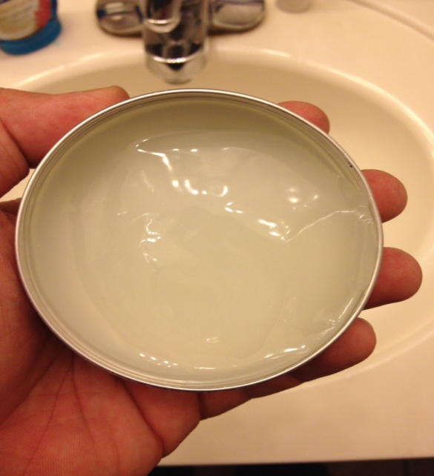
TYPES OF HAIR GROOMING
BRILLIANTINES
ALCOHOLIC SOLUTIONS
TWO LAYER SOLUTION
O/W AND W/O EMULSIONS

Slide 10
POMADES
SOLID BRITTIANES STIFFENED BY INCORPORATION OF CRESIN, MICROCRYSTALLINE WAXES
POMADE CONSIST OF SOFT PETROLEUM JELLY
PARAFFIN WAX CAN BE ADDED BUT DRAWBACKS ARE CRYSTALLIZATION AND OIL EXUDATION
OILS SUCH AS MINERAL OIL, VEGATABLE OIL
( SURFACTANTS USED SOME TIMES TO DISSOLVE PERFUME OILS )

Slide 11
Oil-in-water emulsions
Gums increase fixative , viscosity and stability of emulsions
Petroleum jelly used to increase the body of the solution
Mineral oil of low viscosity generally used
Good pouring, spreading and attractive cream like consistency

Slide 12
Conditioners

Slide 13
Does hair need conditioner?
Conditioners are formulated to impart conditioning to hair, for example; improve combing, softness, and manageability, in addition to the usual cleaning benefits.
Physical damaging effect:
♦ Wind, weather, ultraviolet radiation, brushing and combing.
Chemical damaging effects:
Shampoos which remove natural lipids
Dyeing require preliminary bleaching
Bleaching with alkaline hydrogen peroxide
Drastic treatment which cause severe weakening of the hair fibers and loss of elasticity
4. Permanent waving
Where peroxide and thioglycollate attack the disulphide and peptide bonds of keratin.

Slide 14
Conditioning term is difficult to define
The process of conditioning involves at least four functions:
Rendering the hair manageable, easy to comb and set.
Preserve its natural appearance and luster.
Exerting a softening effect.
Giving “BODY” to the hair.

Slide 15
Conditioners ingredients
Emollients
Compounds containing positively charged nitrogen
Acids
Proteins

Slide 16
Emollients
Oil adheres to hair fibers → body + luster + lubrication
Excessive greasiness can be overcome by applying the lipid in the form of diluted O/W emulsion and by using high melting point lipids, such as cetostearyl alcohol.
Vegetable oil, lanolin and its soluble derivatives (POE or quaternaries), synthetic esters, sebum substitutes, Octyl stearates and Squalene
Silicones have high refractive indices, and are therefore good luster producing compounds.

Slide 17
Compounds containing positively charged nitrogen
Keratin contains more acid groups than basic groups, and therefore tend to attract positively charged molecules and ions.
Cationic compounds (quaternary ammonium compounds), a typical example → cetrimide
Amidoamides (tertiary amines).a typical example → stearamidopropyl dimethylamine lactate
Alkanolamide, example → Coconut diethanolamides
Ampholytes, example → N- alkylbetaines as anti irritant.
Polyvinylpyrolidone (PVP).

Slide 18
Protection of hair treated by protein
Its recommended that protein hydrolsates are used before, with or after the chemical process.
Cosmetic process | without protein | with protein
Bleaching | Cuticle removed | Cuticle intact
Waving | Extensive damage | Swelling, but no damage

Slide 19
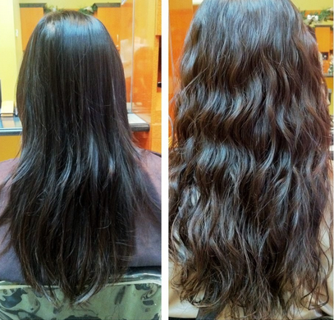
HAIR WAVING PREPARATIONS
WAVING, CURLING AND PERMING OF HAIR MEANS SETTING AND DOES NOT CHANGE EVEN AFTER WASHING AND DRYING.
PERMANENT HAIR WAVING IS NOT PERMANENT OWING TO THE FACT THAT HAIR IS CONTINOUSLY GROWING.

Slide 20
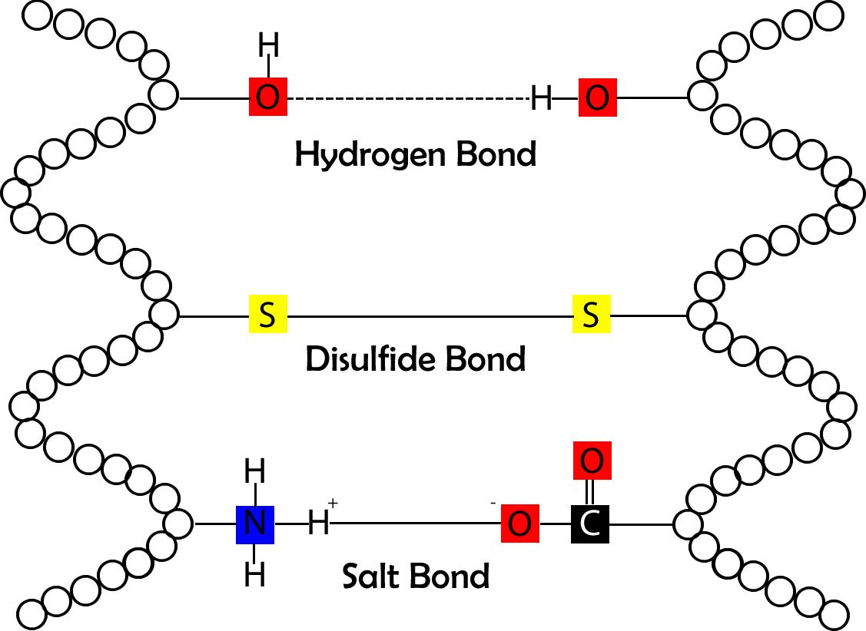
HAIR CHEMISTRY
Responsible for the ability of the hair to be stretched elasticity and return back to its original shape
Responsible for the hairs toughness or abrasion resistance

Slide 21
CHEMISTRY OF HAIR WAVING
HAIR IS BOTH STRONG AND ELASTIC AND ANY PROCESS FOR CHANGING ITS SHAPE DEPENDS UPON SOFETENING AND PLASTICIZING THE KERATIN
ALKALINE AGENTS
REDUCING AGENTS
RE- OXIDATION STEP
Obsolete method
DISRUPTION AND TRANSFORMATION OF KERATIN DISULPHIDE LINKAGES BY ACTION OF HYDROXYL IONS
REDUCTION OF HAIR SULPHIDE BONDS BY AGENTS SUCH AS SULPHITE AND THIOGLYCOLIC ACID
OXIDATION AFTER REDUCING AGENTS NECESSARY IN HARDENING THE STRUCTURE INTO THE NEW IMPOSED STRUCTURE

Slide 22
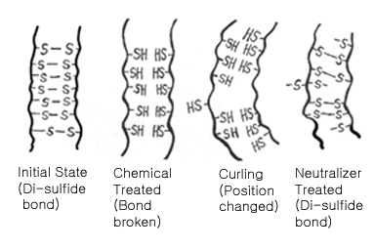
CURLY HAIR !!!!

Slide 23
Factors affecting efficacy of the product:
Processing time
Processing temperatures
Concentration of reducing agents
Ratio of lotion to hair quantities
Penetration of the lotion
Ph
Nature and condition of untreated hair.

Slide 24
Raw materials in hair waving preparations
TYPE | INGREDIENTS
Reducing agents | Thioglycolic acids, thiolactic acid, sodium sulfite
Wetting agents | Sodium lauryl sulphate
Buffer | Ammonium carbonate
Protein derives conditioners | Keratin hydrolysate
Antioxidants | Tocopherol
Neutralizers( oxidising agents ) | Hydrogen peroxide, sodium perborate.

Slide 27
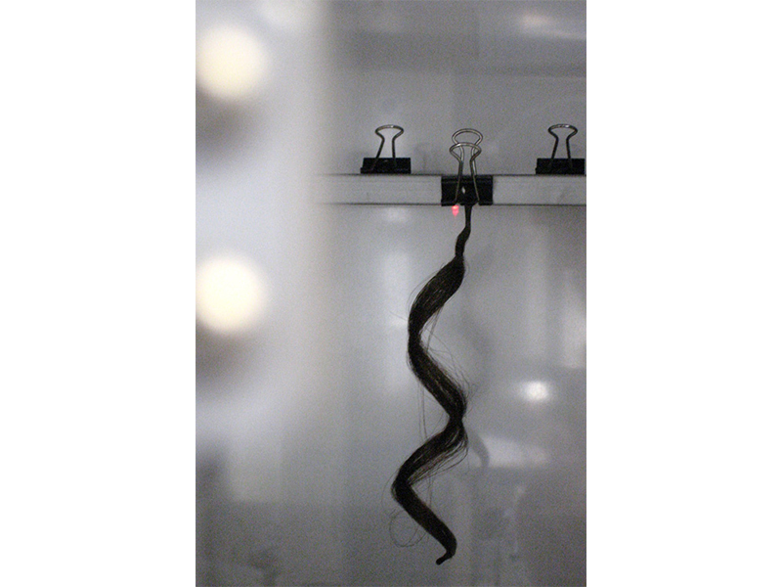
HAIR CURL
I HOUR
50 GM WEIGHT

Slide 28
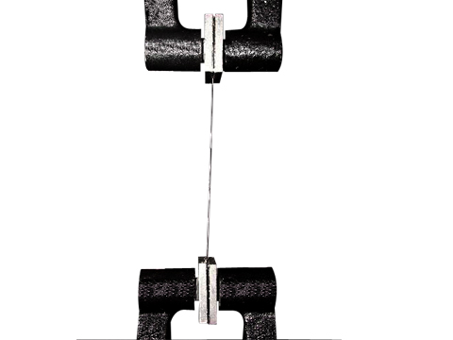
TENSILE STRENGHT MEASUREMENT
TIME AT WHICH IT BREAKS FROM CENTRE

Slide 29
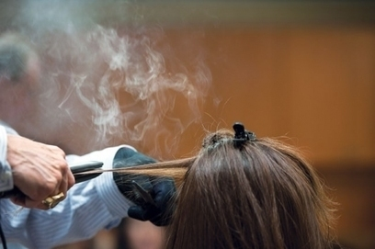
HAIR STRAINGHTENERS
USE FOR STRAINGHTENING OF HAIRS
MECHANISM OF ACTION
1.ACTS BY BREAKING THE HYDROGEN BOND WITH The HELP OF ALKALINE MATERIAL SUCH AS SODIUM HYDROXIDE
2. VISCOSITY OF THE PREPARATION SHOULD BE HIGHER

Slide 30
PRECAUTIONS TO BE TAKEN DURING LARGE SCALE MANUFACTURING
CONTAMINATION BY METALS SHOULD BE AVOIDED
CONTAMINATION BY IRON CAN CAUSE PURPLE COLOURATION
GLASS LINED CONTAINER SHOULD BE USED
CONCENTRATION OF MERCAPTAN, FREE ALKALI AND pH SHOULD BE DETERMINED IN EACH BATCH
STAINLESS STEEL EQUIPMENT TO BE USED AND INITIALLY TREATED WITH 5% NITRIC ACID

