Slide 1
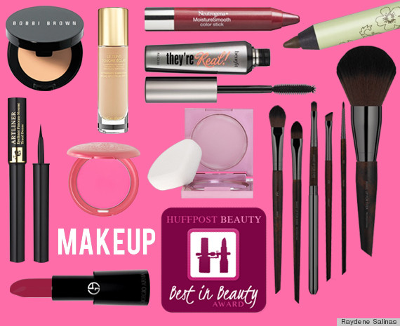
EYE MAKE UP PREPARATION
EYESHADOW
MASCARA
EYEBROW PENCIL
EYE LINER

Slide 2
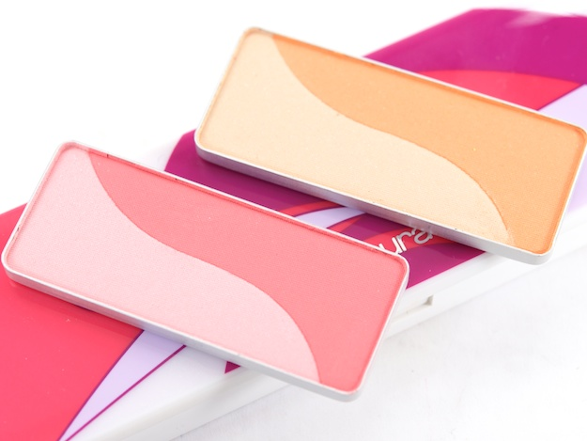
RAW MATERIALS IN EYE PREPARATIONS
PIGMENTS
FATS AND WAXES
GUMS
PRESERVATIVES
PERFUME

Slide 3
PIGMENTS
PIGMENTS ARE USED TO ACCENTUATE THE COLOR OF A PARTICULAR EYE AREA .
SPECIFIED COLOURS ARE USED IN EYE PREPARATION ACCORDING TO IS:4707 STANDARDS
THE TABLE HAS THE FOLLOWING COLUMNS:
COLOUR INDEX NUMBER OR DENOMINATION
COLOUR
FIELD OF APPLICATION
LIMITATIONS AND REQUIREMENTS.

Slide 4
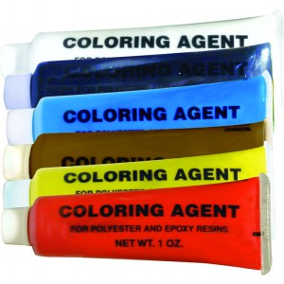
THE MAIN COLOURING AGENTS ARE :
BLACK COLOUR: CARBON BLACK
BLUE: ULTRA MARINE
GREEN : CHROMIUM OXIDE
BROWN : IRON OXIDES
YELLOW: IRON OXIDE
RED: CARMINE

Slide 5
FATS AND WAXES
PETROLEUM JELLY
CERESIN WAX
CARNAUBA WAX
BEESWAX
LANOLIN
STEARIC ACID
ISOPROPYL MYRISTATE
GUMS
1. TRAGACANTH AND METHYL CELLULOSE

Slide 6
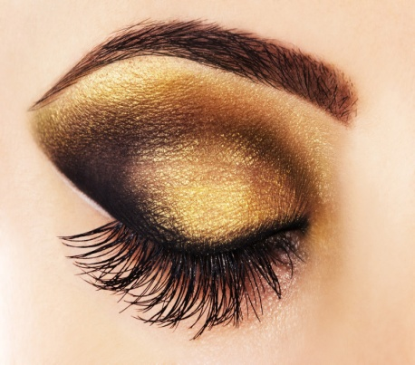
EYE SHADOWS
GIVES BACKGROUND COLOUR TO THE EYES
QUALITY CHARACTERISTICS FOR EYE SHADOW
GOOD ADHESION AND EASY TO APPLY
NOT SHOW OILY LUSTRE AFTER APPLICATION
NOT SMUDGED BY SWEAT OR SEBUM
NON IRRITANT AND SAFE

Slide 7
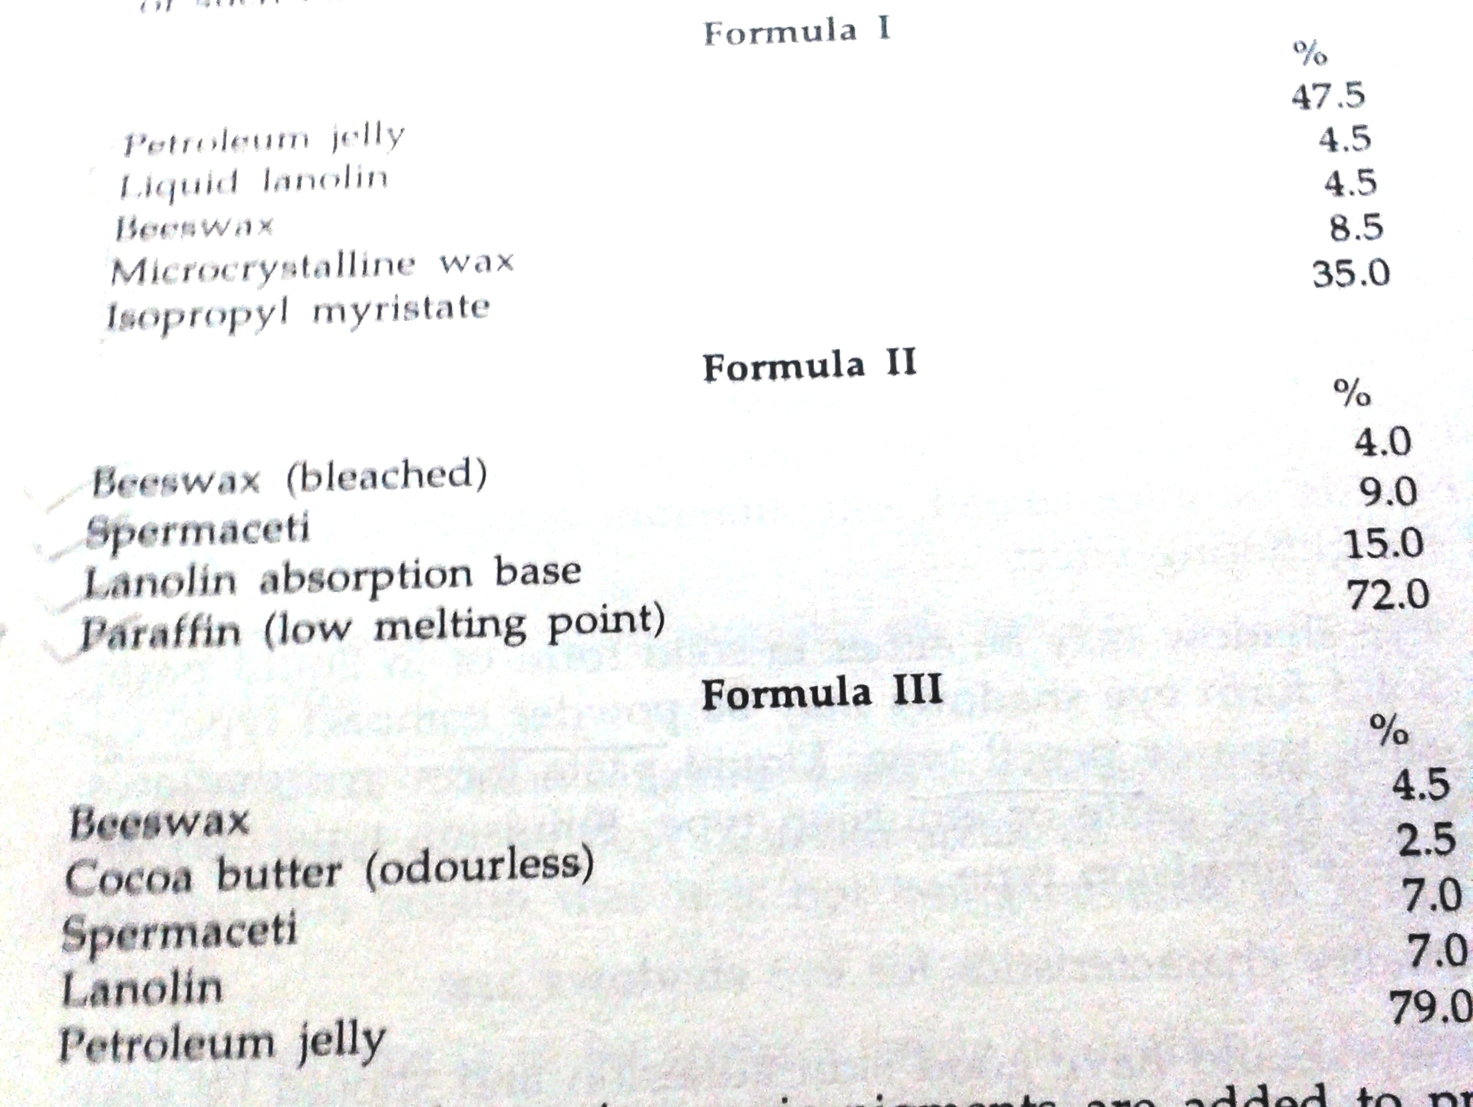
CREAM EYE SHADOW

Slide 8
EYE LINERS
APPLIED TO THE UPPER EYE LIDS CLOSE TO THE EYELASHES TO ACCENTUATE THE EXPRESSIVENESS OF THE EYES
QUALITY / CHARACTERISTICS
1.ABSOLUTELY NON IRRITANT AS THEY ARE APPLIED TO THE EDGES OF THE EYES
2. DRY QUICKLY
3.EASY TO APPLY
4. FILM SHOULD HAVE FLEXIBILITY AND ATTRACTIVE
5. LAST LONG, NO PEEL OFF SMUDGE OR CRACK
6. NOT SPOILED AND SHOULD NOT COME OFF WITH SWEAT
7. NO PRECIPITATION OF PIGMENT AND LESS MICROBIAL CONTAMINATION

Slide 9
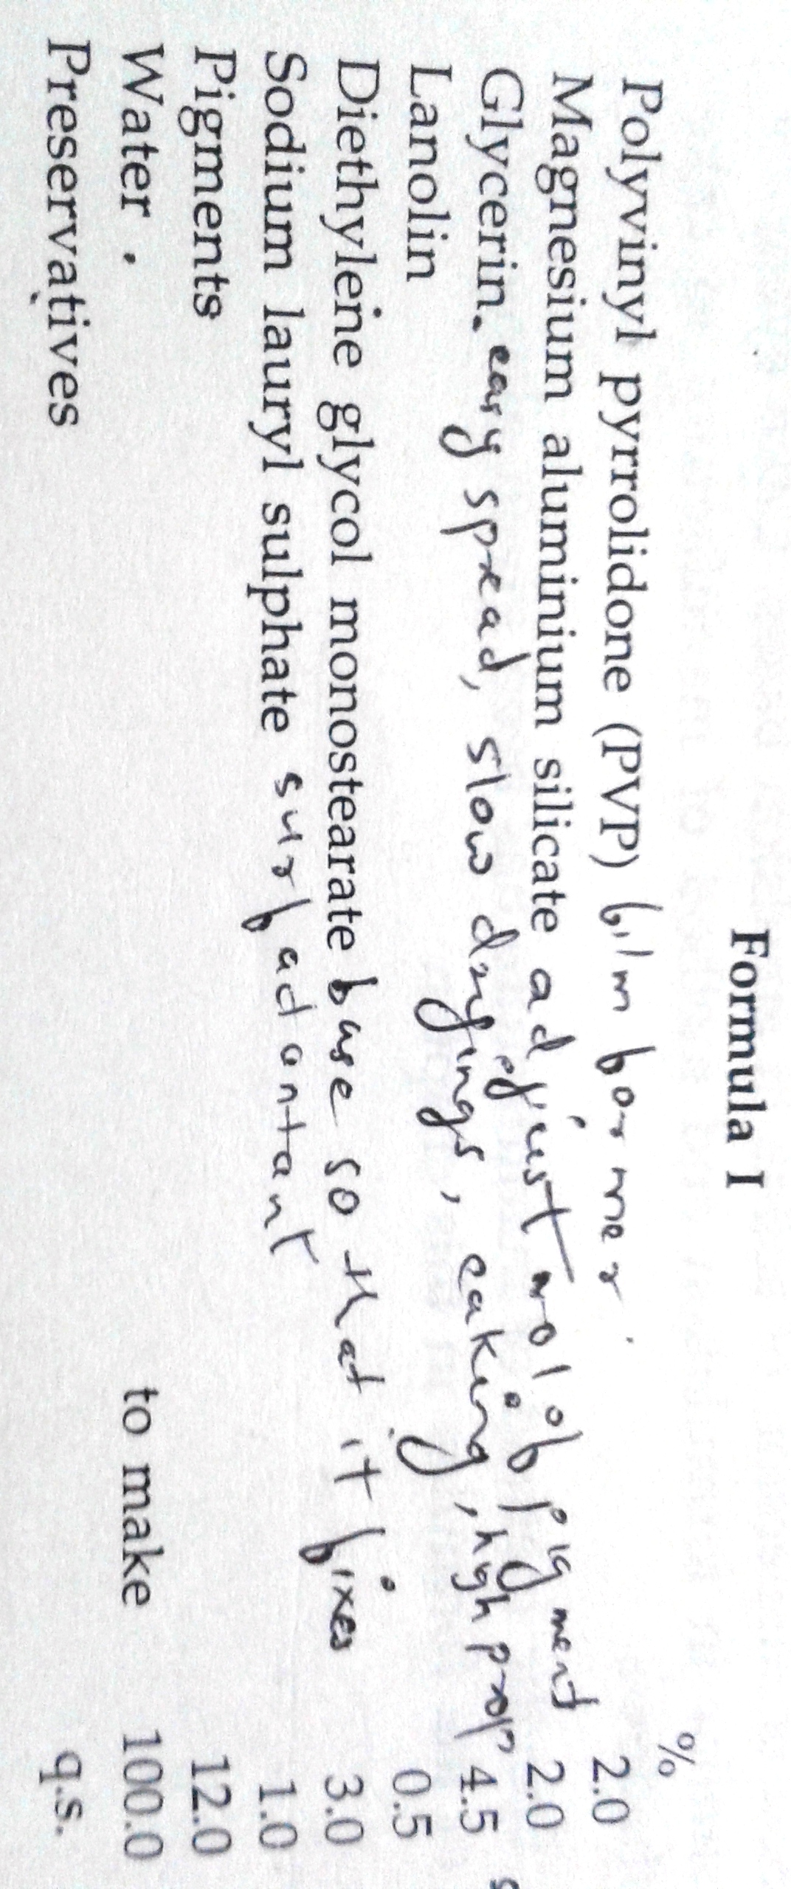

Slide 10
EYEBROW PENCILS
EYEBROW PENCILS USED TO MAKE EYEBROWS DARKER AND MODIFY ITS SHAPE AFTER PLUCKING
IDEAL PROPERTIES
FEEL SOFT ON SKIN AND GO ON EVENLY
LINE DRAWN SHOULD BE THIN AND CLEAR
LAST WELL AND STABLE
NO SWEATING, BLOOMING AND CRACKING

Slide 11
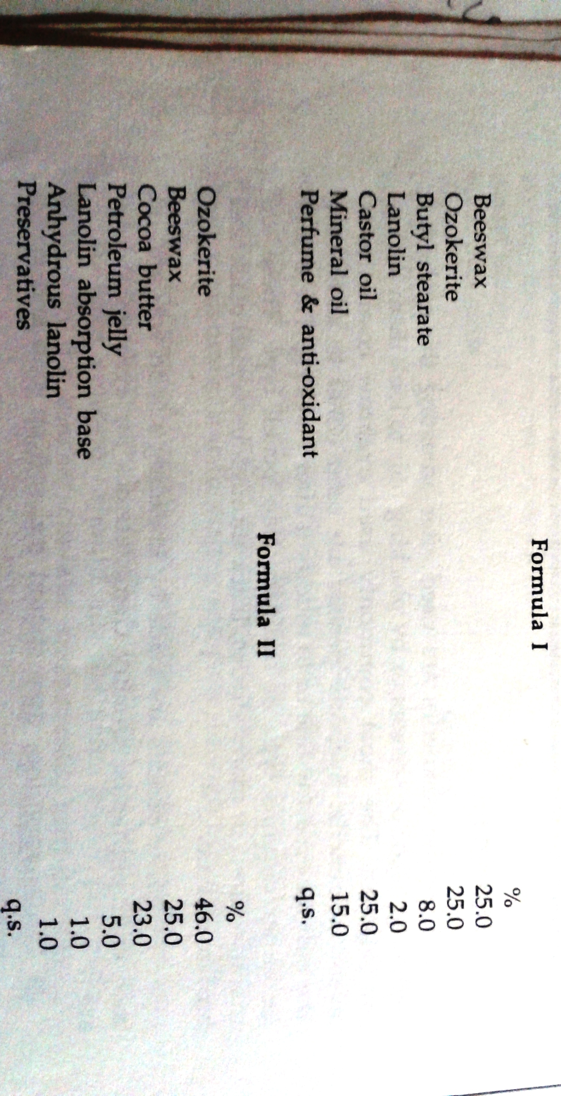

Slide 12
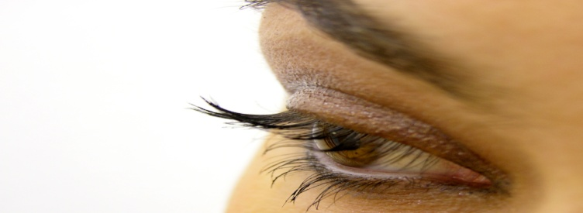
MASCARA
BLACK PIGMENTED PREPARATIONS FOR APPLYING TO EYELASHES AND GIVES ILLUSION OF GREATER DENSITY
IDEAL PROPERTIES
EASY TO APPLY AND NOT CAUSE SMUDGING
SHOULD NOT CAKE AND CAUSE EYELASHES TO SMUDGE TOGETHER
DRY RAPIDLY
NON TOXIC AND NON IRRITANT AND EASY TO REMOVE

Slide 13
MASCARA

