Slide 1
Digestive system
Presented by—
Mirza Salman Baig
Faculty of Pharmacy
School of Pharmacy
AIKTC, New Panvel

Slide 2
THE DIGESTIVE SYSTEM
The digestive system is the collective name used to describe the alimentary canal, some accessory organs and a variety of digestive processes which take place at different levels in the canal to prepare food eaten in the diet for absorption.
Alimentary canal begins at the mouth, passes through the thorax, abdomen and pelvis and ends at the anus.

Slide 3
organs of the digestive system.

Slide 4
FUNCTION OF DIGESTIVE SYSTEM
Ingestion. This is the process of taking food into the alimentary tract.
Propulsion. This moves the contents along the alimentary tract.
Digestion.
• mechanical breakdown of food by, e.g. mastication (chewing)
•chemical digestion of food by enzymes present in secretions produced by glands and accessory organs of digestive system
Absorption. This is the process by which digested food substances pass through the walls of some organs of the alimentary canal into the blood and lymph capillaries for circulation round the body.
Elimination. Food substances which have been eaten but cannot be digested and absorbed are excreted by the bowel as faeces.

Slide 5
General structure of the alimentary canal

Slide 6
Peritoneal cavity

Slide 7
Peritoneum(1) Outer
The peritoneum is the largest serous membrane of the body
It consists of a closed sac, containing a small amount of serous fluid, within the abdominal cavity.
It is richly supplied with blood and lymph vessels & lymph nodes.
It provides a physical barrier to local spread of infection.

Slide 8
Other layers(3)
Muscle layer two layers of smooth (involuntary) muscle
Submucosa loose areolar connective tissue containing collagen.
Mucosa
• Mucous membrane formed by columnar epithelium (some part also by stratified columnar epithelium)
Functions: protection, secretion and absorption
• Lamina propria consisting of loose connective tissue, which supports the blood vessels that nourish the inner epithelial layer, and varying amounts of Lymphoid tissue that has a protective function
• Muscularis mucosa, a thin outer layer of smooth muscle
that provides involutions of the mucosa layer,
e.g. gastric glands, villi.

Slide 9
Mucous membrane
Mucus lubricates the walls of the tract and protects them from digestive enzymes
The surface in the regions lined with columnar epithelium are collections of specialised cells, or glands, which pour their secretions into the lumen of the tract--
saliva from the salivary glands
gastric juice from the gastric glands
intestinal juice from the intestinal glands
pancreatic juice from the pancreas
bile from the liver.

Slide 10
NERVE SUPPLY TO GIT
The parasympathetic supply.
This supply to most of the alimentary tract is provided by one pair of cranial nerves, the vagus nerves.
Stimulation causes smooth muscle contraction and the secretion of digestive juices.
The most distal part of the tract is supplied by sacral nerves
The sympathetic supply.
This is provided by numerous nerves which emerge from the spinal cord in the thoracic and lumbar regions

Slide 11
BLOOD SUPPLY TO GIT
Arterial Blood supply
Venous drainage

Slide 12
Arterial Blood supply
In the thorax. The oesophagus is supplied by paired oesophageal arteries, branches from the thoracic aorta.
In the abdomen and pelvis. The alimentary tract, pancreas, liver and biliary tract are supplied by the unpaired branches from the aorta: the coeliac artery and the superior and inferior mesenteric arteries

Slide 13
The coeliac artery & the organs they supply

Slide 14
Blood supply to the small and large intestines

Slide 15
Venous drainage
In the thorax. Venous blood from the oesophagus passes in the oesophageal veins to the azygos and hemiazygos veins, hemiazygos joins the left brachiocephalic vein
In the abdomen and pelvis. The veins that drain blood from the lower part of the oesophagus, the stomach, pancreas, small intestine, large intestine and most of the rectum join to form the portal vein

Slide 16
Venous drainage from the abdominal organs

Slide 17
TONGUE

Slide 18
The tongue is a voluntary muscular structure which occupies the floor of the mouth.
It is attached by its base to the hyoid bone and by a fold of its mucous membrane covering, called the frenulum, to the floor of the mouth.

Slide 19
Structures seen in the widely open mouth.

Slide 20
Blood supply
The main arterial blood supply to the tongue is by the lingual branch of the external carotid artery.
Venous drainage is by the lingual vein which joins the internal jugular vein

Slide 21
Nerve supply
• The hypoglossal nerves (12th cranial nerves) which
supply the voluntary muscle tissue
• The lingual branch of the mandibular nerves which are the nerves of somatic (ordinary) sensation, i.e. pain, temperature and touch
• The facial and glossophanryngeal nerves (7th and 9th
cranial nerves) which are the nerves of the special
sensation of taste.

Slide 22
Functions of the tongue
The tongue plays an important part in--
• Mastication (chewing)
• Deglutition (swallowing)
• Speech
• Taste

Slide 23
TEETH

Slide 24
The teeth are embedded in the alveoli (sockets) of the mandible and the maxilla.
Functions of the teeth
The incisor and canine teeth are the cutting teeth and are used for biting off pieces of food,
The premolar and molar teeth, with broad, flat surfaces, are used for grinding
Two dentitions,
the temporary or deciduous teeth (20)
the permanent teeth (32)

Slide 25
Different shapes of the permanent teeth

Slide 26
Structure of a tooth
The crown — the part which protrudes from the gum
The root — the part embedded in the bone
The neck — the slightly narrowed region where the crown merges with the root.

Slide 28
Blood supply to Teeth
The arterial blood supply to the teeth is by branches of the maxillary arteries
The venous drainage is by a number of veins which empty into the internal jugular veins.

Slide 29
SALIVARY GLANDS

Slide 30
Parotid glands
Submandibular glands
Sublingual glands

Slide 32
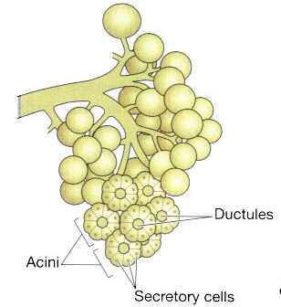
Structure of the salivary glands
They consist of a number of lobules made up of small acini lined with secretory cells.
Secretions are poured into
ductules which join up to
form larger ducts
leading into the mouth.

Slide 33
Composition of saliva
About 1.5 litres of saliva is produced daily and it consists of
water
mineral salts
enzyme: salivary amylase
mucus
lysozyme
immunoglobulins
blood-clotting factors.

Slide 34
Secretion of saliva
Parasympathetic stimulation causes vasodilatation and profuse secretion of watery saliva with a relatively low content of enzymes.
Sympathetic stimulation causes vasoconstriction and secretion of small amounts of saliva rich in organic material.

Slide 35
Functions of saliva
Chemical digestion of polysaccharides
Cleansing and lubricating-to prevent damage to the mucous membrane by rough or abrasive foodstuffs
Non-specific defence- Lysozyme, immunoglobulins and clotting factors combat invading microbes.
Taste- The taste buds are stimulated only by chemical substances in solution.

Slide 36
PHARYNX

Slide 37
nasopharynx,
oropharynx
laryngopharynx

Slide 39
lining membrane (mucosa) is stratified squamous
middle layer consists of fibrous tissue
outer layer consists of a number of involuntary constrictor muscles

Slide 40
OESOPHAGUS

Slide 41
Oesophgus
The oesophagus is about 25 cm long and about 2 cm in diameter and lies in the median plane in the thorax in front of the vertebral column behind the trachea and the heart.
It is continuous with the pharynx above and just below the diaphragm it joins the stomach
The upper cricopharyngeal sphincter prevents air passing into the oesophagus during inspiration and the aspiration of oesophageal contents.
The cardiac or lower oesophageal sphincter prevents the reflux of acid gastric contents into the oesophagus.

Slide 43
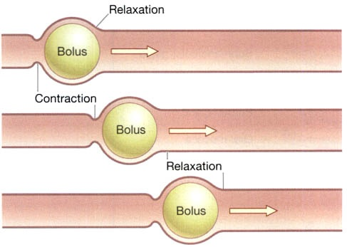
Function of Oesophgus
The presence of the bolus in the pharynx stimulates a wave of peristalsis which propels the bolus through the oesophagus to the stomach
Movement of a bolus by peristalsis

Slide 44
Thank You

