Slide 1
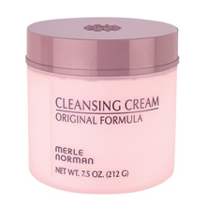
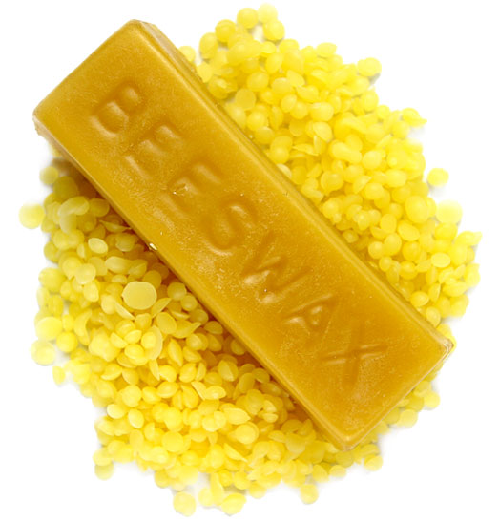
Cleansing creams
Cleansing creams remove dirt from the skin by binding to the dirt, suspending them and subsequently wiped out gently with a cotton fabric

Slide 2
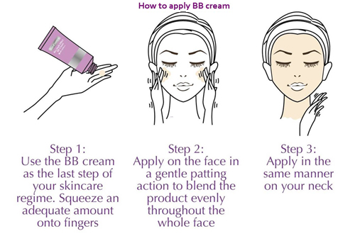
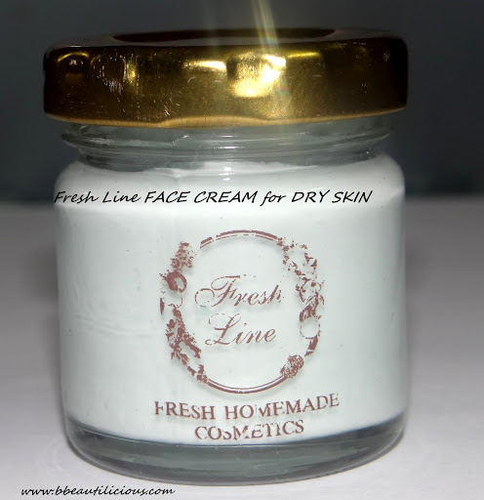
Ideal properties of cleansing cream
Liquefy easily at body temperatures
Viscosity should be low enough to permit easy spreading but high enough to retain in suspension particles of dirt
Penetrate the epidermis ( via natural openings)
Emulsion type with a small percentage of water
Leave skin smooth, relaxed , non greasy and clean
Contain no chemical that is quickly absorbed by skin

Slide 3
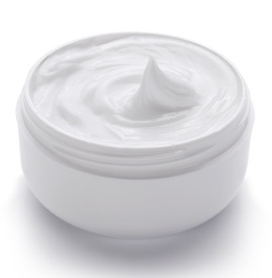
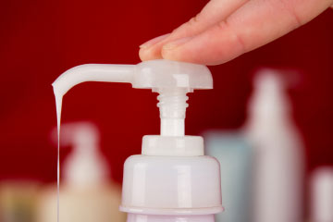
Cleansing creams
Liquefying creams
Emulsified creams

Slide 4
Liquefied creams
Definition: Simple form in which components melted together till homogeneous and poured to set in containers
1.Product must be solid but must liquefy on application
2.Should not be too liquid to flow off the skin
RAW MATERIALS REQUIRED:
Oily phase: mineral oil, vegetable oil, paraffin wax, stearic acid
Purified water: distilled or decomposed
Emulsifying agents:
Non- ionic emulsifiers-spans and tweens( 2%)
Triethanolamine stearate ( 2%)
Lanolins ( 2%)

Slide 5
For acidic creams :
Glyceryl stearate
Cetyl alcohol
Sodium cetyl sulphate
Thickeners
waxes: beeswax, paraffin wax, ozokerite, cellulose derivatives like soidium alginate
Detergents
Sodium cetyl alcohol
Perfumes
Preservatives
Antioxidants

Slide 6
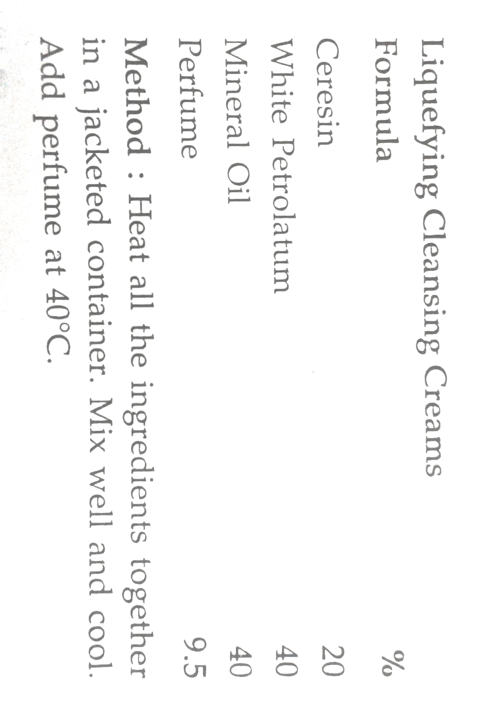
Formulation consideration
Leaking of oil can be assured by carnauba wax
Translucent product can be assured by paraffin, petroleum and mineral oil
White opaque results from use of ceresin , beeswax or zinc oxidant paraffin
Mineral oil can be solidified by the addition of sufficient paraffin which decreases bleeding.
Consistency may be varied hard and soft by increasing or decreasing the wax content

Slide 7
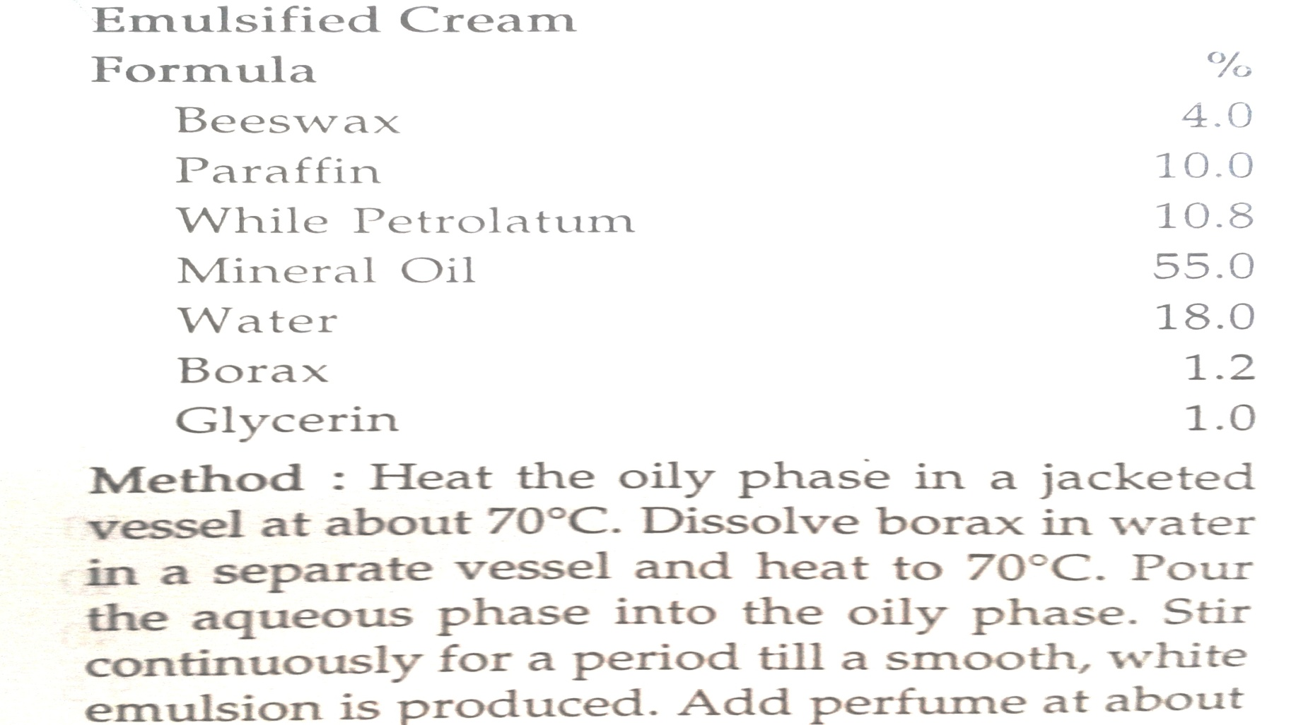
Emulsified creams
Basically beeswax – borax type of creams
Absorption bases recommended that hold almost five times their weight of water to have a stable, white and fined textured cream

Slide 8
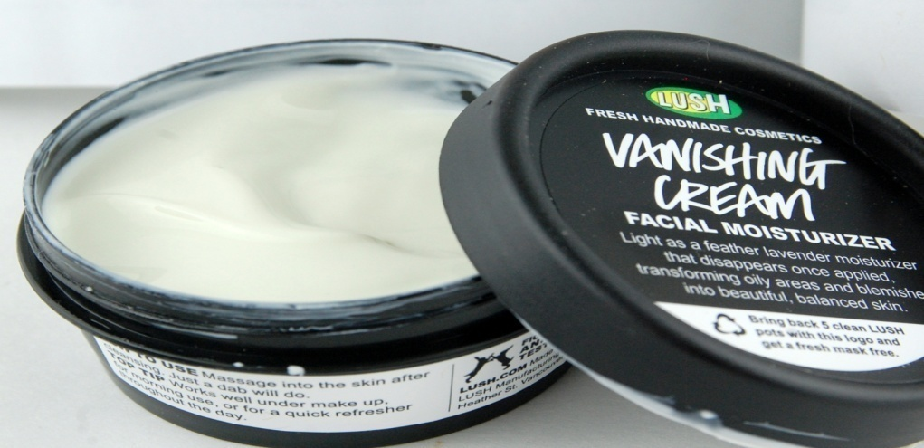
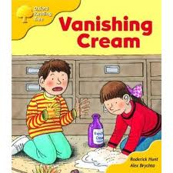
VANISHING CREAM
Cream that disappear, when rubbed on skin
Also know as SNOW
Oil in water emulsions
Applied as foundation creams to hold face powder and improve adhesion

Slide 9
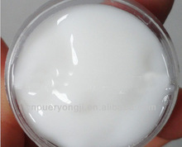
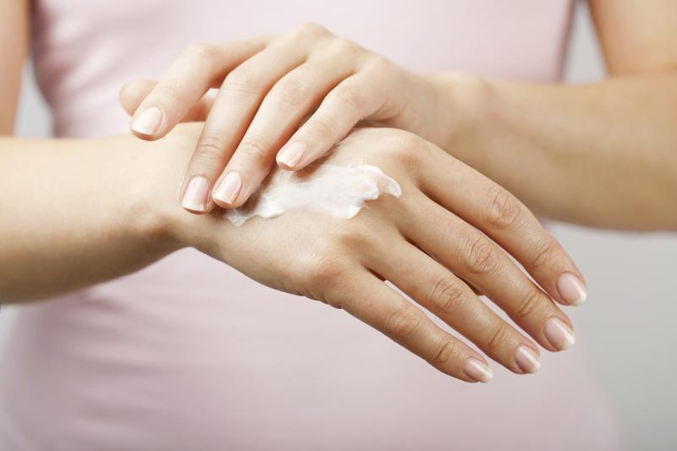
Ideal properties of vanishing creams
High melting point
Pure whiteness
Very little odor and low iodine number
Rubbed easily on the skin without roll-on effect

Slide 10
Raw materials
Stearic acid is the major component of vanishing cream-
( good quality triple pressed must be selected)
excess stearic acid, water and soap are basic constituents of stearate based creams
Soap formed in-situ by the reaction between a suitable alkali and stearic acid ( determines hardness of the cream)
b. Humectants
Glycerin most favored followed by sorbitol and propylene glycol
2. Prevents excessive drying out of cream, due to o/w type product
3. Product of water, stearic acid and soap will roll badly when rubbed

Slide 11
c. Alkali
Potassium hydroxide , sodium hydroxide , potassium hydroxide, sodium carbonate, triethanolamine and borax
Potassium hydroxide is mostly used since makes a cream of fine texture without excessive harshness
Sodium or potassium hydroxide when used alone forms hard cream hence always in combination
Carbonates not favoured , liberates CO2 and creams become spongy
Borax used in combination with potassium hydroxide or triethanolamine to form white emulsion

Slide 12
Stearic acid provides oil phase and 20-30% of free acid neutralized by alkali
Emulsifier as soap from KOH ( IN SITU )
VANISHING CREAM in which oil phase melts above body temp and crystallizes as invisible form to give a non greasy and shiny layer on skin

Slide 13
FORMULATION OF VANISHING CREAM
Ideal formula:
Ingredients | Quantity | Category
Oil Phase
Stearic acid | 20.0 g
Cetyl alcohol | 0.50 g
TriethanolamiNE | 1.20 g | Alkali
Aqueous Phase
NaOH/KOH | 0.36 g | Alkali
Glycerine | 8.0 g | Emollient
Water | 69.94 g | Vehicle
Perfume | q.s. | Fragrance
Preservative | q.s. | Antimicrobial

Slide 14
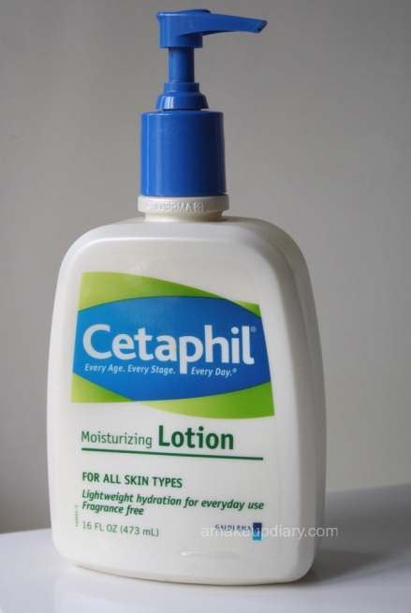
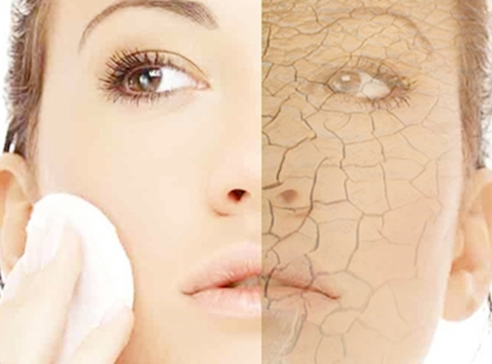
MOISTURIZING CREAMS AND LOTIONS
DRY SKIN RESULTS FROM:
PROLONGED EXPOSURE TO LOW HUMIDITY OR AIR MOVEMENT
PHYSICAL AND CHEMICAL CHANGES IN SKIN DUE TO AGING PROCESS
WHEN WATER IS LOST MORE RAPIDLY THAN IT IS RECEIVED FROM LOWER LAYERS OF SKIN, IT BECOMES DEHYDRATED MAKING IT ROUGH
THOSE CREAMS WHICH RESTORE WATER( MOISTURE) TO THE STRATUM CORNEUM ARE CALLED MOISTURISING CREAMS.

Slide 15
APPROACH TO RESTORE WATER TO DRY SKIN
OCCLUSION
HUMECTANCY
RESTORATION OF DEFICIENT MATERIAL
OCCLUSION RESULTS IN AN IMMEDIATE DECREASE IN THE RATE OF WATER LOSS THROUGH THE EPIDERMIS
HUMECTANTS ATTRACTS MOISTURE TO THE SKIN
FACILE ADDITION OF WATER TO SKIN DOES NOT SUFFICE TO PLASTICIZE IT
AGING LEADS TO CHANGES IN LIPID COMPOSITION OF CELLULAR MEMBRANE . HENCE SUCH PRODUCTS SHOULD BE RICH IN PHOSPHOLIPIDS , AMINO ACIDS AND ESSENTIAL HORMONAL FACTORS

Slide 16
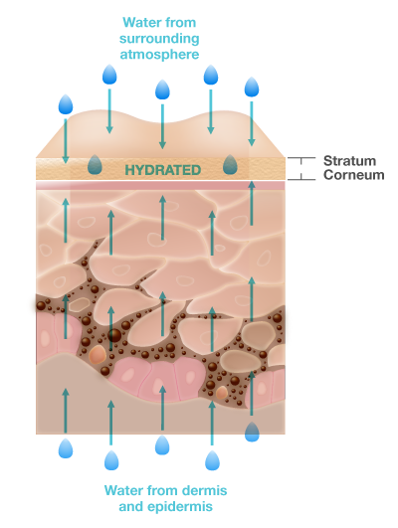
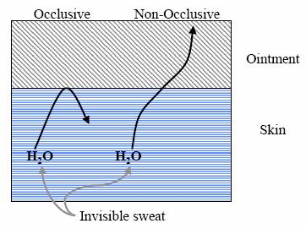
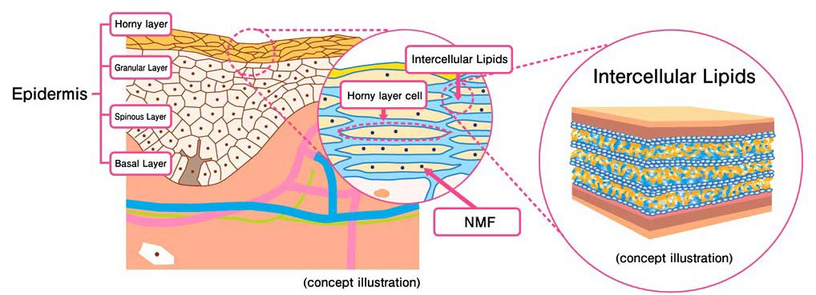

Slide 17
RAW MATERIALS
COMPOUNDS PROVIDING OCCLUSION: NON PERMEABLE SUBSTANCES CAN BE USED MINERAL AND VEGETABLE OILS, LANOLINS AND SILICONES
FILM FORMING AGENTS: ALBUMIN, GELATIN
HUMECTANTS: GLYCEROL, ETHYLENE GLYCOL, PROPYLENE GLYCOL AND SORBITOL
EMOLIENTS : IMPARTS SENSE OF WELL BEING TO THE SKIN BY CAUSING FLATTENING OF SURFACE CONTOURS
Many humectants also have emollient properties, while not all emollients are humectants. The best moisturizers have a combination of emollients and humectants.

Slide 18
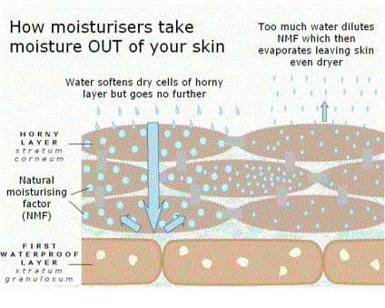
NATURAL MOISTURIZING FACTOR
( NMF )
THERE IS A NATURAL MOISTURIZING FACTOR IN THE SKIN WHICH IS REMOVED BY MEANS OF WATER AND DETERGENTS SOLUTIONS AND APPEARS TO BE AMINO LIPID NATURE
E.G. UREA, PYRROLIDONE CARBOXYLIC ACID, AMMONIUM, URATES.

Slide 19
UREA USED IN SKIN CREAMS
UREA IS A COMPONENT OF HYDROLIPID EMULSION OF SKIN SURFACE
SAFELY USED BETWEEN CONCENTRATION
2-8%
IN W/O EMULSIONS MOISTURIZING EFFECT DEVELOPS MORE SLOWLY BUT LASTS LONGER THAN OIL-IN – WATER EMULSIONS

Slide 20
ADVANTAGES :
UREA LACKS ANY SENSITIZING OR PHOTODYNAMIC ACTIVITIES
DOES NOT STAIN , COLORLESS AND ODORLESS
MOISTURIZING ACTION (GOOD BINDING CAPACITY)
BINDS WATER BY INCLUDING IN ITS CRYSTAL STRUCTURE
4. DESQUAMATING ACTION
5. ANTIMICROBIAL ACTION
6. ENHANCE OF THE PENETRATION
7. ANTI-INFLAMMATORY ACTION

Slide 21
DISADVANTAGES:
DEGRADATION WITH PROGRESSIVE ALKANIZATION, DEVELOPMENT OF UNPLEASANT ODOUR OR RECRYSTALLIZATION MAKE UREA DIFFICULT TO INCORPORATE INTO STABLE PREPARATION
2. UREA IS TOLERATED DIFFRENTLY BY SLIGHTLY INFLAMMED, DAMAGES SKIN

Slide 22
FORMULA | PERCENTAGE
UREA | 10
STEARIC ACID | 5
WHITE SOFT PETROLATUM | 4
ISOPROPYL MYRISTATE | 3
EMULSIFIERS | 5
ALCOHOL | 7
CARBOPOL 934 | 0.25
TRIETHANOLAMINE | 0.1
PRESERVATIVE | Q.S
WATER | Q.S to 100

Slide 23
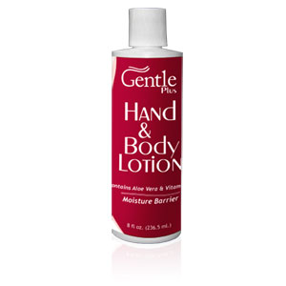
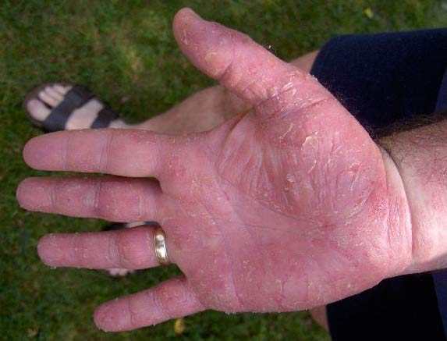
HAND AND BODY CREAMS
HANDS MAY BE EXPOSED TO WATER , WATER SOAP, WATER DETERGENT SEVERAL TIMES A DAY WHICH RESULTS IN REMOVAL OF LIPIDS AND OTHER SECRETIONS OF CELLS
WATER PREVENTS HANDS FROM CHAPPING BUT EVAPORATES RAPIDLY LEAVING SKIN DRY AND IMMERSED FOR LONGER PERIOD LEADS TO ABNORMAL DEGREE OF HYDRATION
HENCE FORMULATIONS MEANT FOR HAND ARE CENTERED AROUND EMMOLLIENTS LIKE LANOLIN,STEROLS,PHOSPHOLIPIDS AND HYDROCARBONS

Slide 24
IDEAL PROPERTIES
SHOULD SOFTEN HANDS EASILY
SHOLD APPLY EASILY
SHOULD NOT LEAVE A TACKY FILM
NON INTERFERENCE WITH NORMAL PERSPIRATION OF SKIN
SHOULD HAVE PLEASANT SMELL
SHOULD HAVE AN APPEALING COLOUR.

Slide 25
FORMULATION OF HAND LOTIONS OFFER TWO PROBLEMS
LOTION EXHIBITS GELLING PROPERTY
VISCOSITY OF LOTION MAY BE LOW SO THAT IT RUN OUT OF CONTAINER
STEARATE TYPE ARE MORE SUSCEPTIBLE TO GELATION AND SHEAR ACTION
FORMULATION CONSIDERATIONS
1.EXCESSIVE POLYOL FATTY ACID ESTERS OR FATTY ALCOHOL SHOULD NOT BE USED IN HAND LOTIONS
2. DISPERSED WAX PHASE BE PLASTICIZED WITH MINERAL OIL
3. SMALL AMOUNTS OF SODIUM LAURYL SULPHATE BE INCORPORATED IN FORMULATION( 0.1-0.5%)

Slide 26
DEVELOPMENT OF FORMULATIONS OD HAND CREAMS WILL REQUIRE EMMOLLIENTS, VANISHING CREAM BASE, A COMBINATION OF WAXES,OILS AND HUMECTANTS
INGREDIENTS | PERCENTAGE
CETYL ALCOHOL | 2
LANOLIN | 1
MINERAL OIL | 2
STEARIC ACID | 15
GLYCERIN | 10
POTASSIUM HYDROXIDE | 1
WATER | 100
PERFUME, PRESERVATIVE AND COLOUR | Q.S

Slide 27
IN SOME PREPARATIONS, DIMETHICONE IS ADDED TO PROTECT SKIN FROM IRRITANTS
FORMULA | PERCENT
GLYCERYL STEARATE | 2.5
CETYL ALCOHOL | 3
DIMETHICONE | 1.5
LANOLIN | 2
PETROLATUM | 2
SODIUM LAURYL SULPHATE | 0.3
WATER | TO MAKE 100

