Slide 1
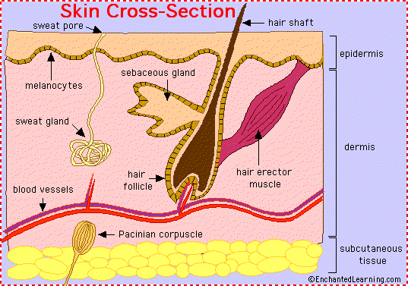

Slide 2
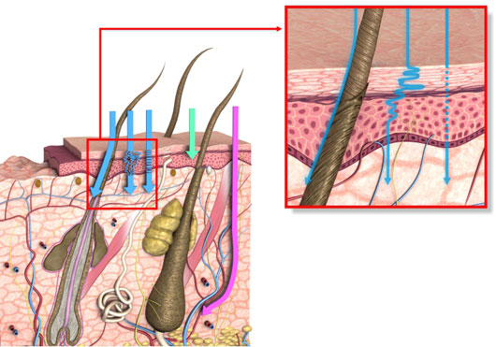
Penetration (blue arrows) is the entry of a substance into a particular layer or structure such as the entrance of a compound into the stratum corneum.
2. Permeation (green arrow) is the penetration through one layer into another, which is both functionally and structurally different from the first layer.
3. Reabsorption( Pink arrow)- uptake of system into the vascular system

Slide 3
Skin creams classified as:
Make up creams( o/w) emulsion- vanishing creams
Cleansing creams-( w/o) emulsion
Creams for winter ( w/o emulsion )- cold cream
Creams for dry skin
All purpose cream
Night cream
Skin protective and hand creams

Slide 4
Basic raw materials used in skin creams
Water
Oils, fats and waxes
Hydrocarbons derived from petroleum
Humectants
Emulsifying agents

Slide 5
Pond’s Type o/w Face Cream
Ingredient | Wt. %
Beeswax | 8.00
Mineral oil (paraffinum liquidum) | 50.00
Lanolin | 3.00
Borax | 0.20
Water (aqua) | qs 100.00

