Slide 1
COAGULANT AND ANTICOAGULANTS
Prepared by:
Mirza Anwar Baig

Slide 2
Learning outcomes
Classification of drugs
Detail pharmacology
Mechanism of action
Therapeutic uses
Adverse effects

Slide 3
Classification of Coagulants
1. Agents acting locally eg: Thrombin
2. Transfusional agents
Human fibrinogn
Anti haemophilic globulin
Plasma or blood
3. Non transfusional agents
Vitamin K
Epsilon Amino Caproic Acid (EACA)
Tranexamic Acid
Ethamsylate
Aprotinin
Desmopressin

Slide 4
1. Agents acting locally
a. Thrombin
Source: bovine/human plasma
Properties: stable as dry powder, stored between 2 to 8 C.
Inactive below pH 5.
Uses: restricted to local application in oozing of blood.
b. Thromboplastin:
Source: Prepared from acetone extracts of brain/lung tissue of killed rabbits.
Use: To dertermine prothombin time
As a local haemostatic in surgery.

Slide 5
c. Fibrin:
Source: obtained from human plasma
Uses:
It is used in dehydrated form as sheet to cover bleeding surface.
Used in combination with thrombin to hold it over bleeding area.
d.Gel foam :
It is porous, pressed form of gelatin sponge
Used in conjunction with thrombin to control oozing of blood.
Completely absorbed may be left in place after suturing of wounds.
Available as cones,packs, sponges and powders.

Slide 6
e. Oxidized cellulose:
It is surgical gauze treated with nitrogen dioxide.
It promote clotting by a reaction between haemoglobulin and cellulosic acid.
It becomes sticky when mixed with tissue juice and exert its haemostatic action.
Absorbed within 2 to 10 days interfere with bone regeneration.
f. Microfibrillar collagen:
Source: Prepared from bovine collagen.
Use: when applied to bleeding surface ,attracts platelets to form plug followed by natural clot.
Used in capillary bleeding.
It is non allergic but can promote local infection and abscess formation.
It is inactivated by autoclaving and hence should not be sterilized.

Slide 7
2. Transfusional agents:
Human fibrinogn
Anti haemophilic globulin
Plasma or blood

Slide 8
a. Human fibrinogen:
Source: Human plasma
It is used for restoring normal fibrinogen levels in haemorrhagic complications caused by acute afibrinogenemia.
Fibrinogen and thrombin may be employed together for local haemostasis.
b. Antihaemophilic globulin (AHG)
Haemophilia A and B (Christmas disease) are two commonest hereditary haemorrhagic states. Due to deficiency of specific clotting factor VIII and IX respectively.
Antihemophilic globulin or concentrate factor VIII is highly effective in treatment of hemophilia A.
It is now prepared by DNA recombinant technique.
Half life is 12 hours.
Desmopressin increases AHG blood level by increasing its release.
Are very expensive and may be associated with greater risk of inducing IgG antibodies to factor VIII.
Probably act locally at the site of tissue injury.
Treatment should be guided by the physician experienced in the case of hemophilia.

Slide 9
Christmas disease: fresh or stored plasma infusion is indicated to replenish the factor IX which is stable on storage.
c. Plasma or Blood
Fresh frozen plasma is used in coagulation disorders as it provides all clotting factors.
Concentrated of factor VIII or preparation containing factors II,VII,IX,X are also available for specific deficiencies.
Whole blood transfusion is not preferable as it carries risk of transfusion reactions.

Slide 10
3. Non-Transfusional agents:
Vitamin K
Epsilon Amino Caproic Acid (EACA)
Tranexamic Acid
Ethamsylate
Aprotinin
Desmopressin

Slide 11
a. Vitamin K:
It comprises of 3 distinct fat soluable, naphthoquinone compounds
Participate in biosynthesis of several clotting factors.
Vitamin K1 is found in several foods. fat-soluable,Phytonadione (Phylloquinone)
Vitamin K2 is produced by bacteria in the GI T.
Vitamin K3 is synthetic compound.
Fat soluable: Menadione,Acetomenaphtone
Water soluable: Mendione sod.bisulfite. Menadione sod.Diphosphate.
Pharmacological actions:
Participate in carboxylation of the glutamic acid residues of prothrombin and factors VII,IX,X in the final stage of synthesis.
Also involve in electron transport (Coenzyme) and oxidative phosphorylation.

Slide 12
Absorption, fate and excretion:
Produced by the flora of human intestine.
Fat soluable vitamin K1 and K2 are absorbed in presence of bile salts while water soluable K3 (Menadione) absorbed even in their absence.
Adverse reactions:
Rare after oral adminstration.
Serious anaphylactoid reactions after IV use.
Large doses of synthetic menadione produce haemolytic anemia, hyper-bilirubinemia, kernicterus in new born.
Menadione competes with bile salts for glucuronide detoxification causing accumulation of bile salts in blood result in Juandice.

Slide 13
Therapeutic uses:
Adult vitamin K deficiency: produced by
Malabsorption b. obstructive juandice
Prolonged malnutrition. Menadione used
Vitamin K deficiency in infants:
during acute diarrhoea.
Neonatal vitamin K deficiency:
Bleeding state during oral anticoagulant therapy
Vitamin K generally given orally but require bile salt for absorption.
Menadione preparation are NOT used. May cause adverse reactions in neonates with vitamin K deficiency. Should be avoided in pregnancy to avoid haemorrhagic disease.

Slide 14
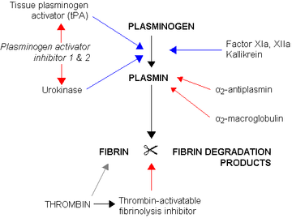
b. Epsilon amino caproic acid
Water soluble analogue of lysine.
Mechanism of action:
Inhibits plasminogen activation.
It is reversibly occupying lysine binding
Site on plasminogen.
Activation of plasminogen to plasmin is
Inhibited.
Result in inhibition of fibrin binding to
Plasminogen.
Hence inhibit fibrinolysis and stabilize the clot.

Slide 15
ADME:
Orally absorbed
60-90% excreted in urine.
A blood level of 13mg/100 ml of blood required for plasminogen inhibition.
130 mg/100 ml of blood required for inhibition of plasmin activity.
ADVERSE EFFECTS:
Nasal stiffness, abdominal discomfort, dyspepsia, hypotension, skin rashes etc.

Slide 16
Therapeutic uses:
Used in prevention of hyper plasminaemic bleeding state due to damage of tissues rich in plasminogen activator.
For example
Primary menorrhagia
During prostatic surgery: contraindicated in hematuria (risk of ureteral occlusion by un lysed clot)
Upper GI bleeding
Bleeding after dental extraction.
Bleeding associated with thrombocytopenia, postpartum hemorrhage.

Slide 17
c. Tranexamic acid (TA):
Derivative of lysine,10 time more potent & longer duration of action than EACA .
Indications are similar to EACA.
Adverse effects are mild inlcude nausea,diarrhoea,hypotension.
Both EACA and TA are contraindicated in patients with subarachnoid bleeding because they may induce vasospasm and ischemic stroke.
d. ETHAMSYLATE:
Used for similier indication as EACA and TA.
Probably act by correcting abnormal platelet aggregation ,does not stabilize fibrin.

Slide 18
e. Aprotinin:
It is polypeptide obtained from bovine lungs.
Mechanism of action:
It inhibits the action of several proteases like plasmin,trypsin, chymotrypsin, kallikrein by forming reversible enzyme-inhibitor complex.
Hence inhibit initiation of both coagulation and fibrinolysis.
Was used in cardiac surgery to reduce blood loss.
Withdrawn from Market
Because of cardiovascular toxicity,stroke and renal toxicity.

Slide 19
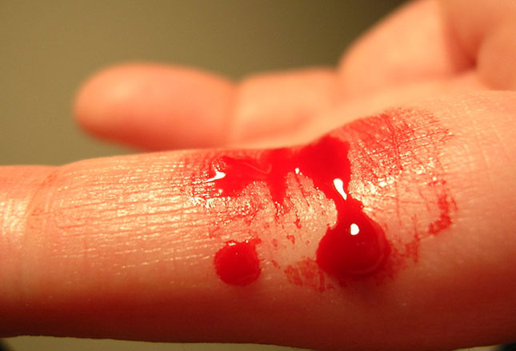
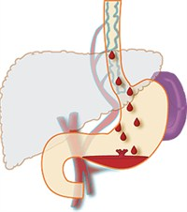
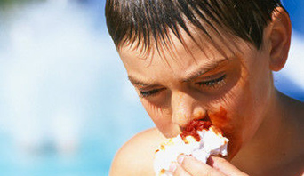
f. Desmopressin:
Analogue of arginine Vasopressin. (antidiuretic,vasocontrictor,analgesic)
Increases for short time plasma concentration of factor VIII in hemophiliacs and von willebrand factor (required for platelet adhesion) in von Willebrand disease. (Treatment of choice)
Therapeutic uses:
It shortens or normalize bleeding time in patients with congenital defects of platelets.
Acquired bleeding during uremia or use of aspirin.
Acute variceal bleeding

Slide 20
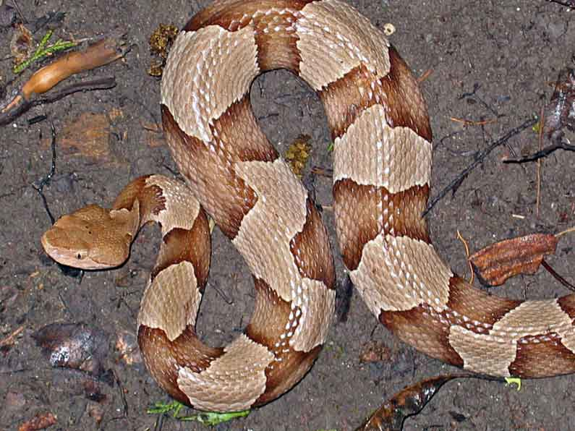
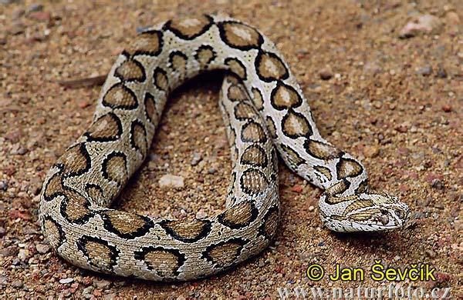
g.Conjugated estrogen:
It improves platelets functions,shorten the prolonged bleeding time.
Compared to desmpressin it has a delayed onset but much longer duration of action.
Can be combined with desmopressin for synergestic effect.
h. Vitamin C:
Specifically control bleeding due to scruvey.
i. Snake venome: (copper head and russel viper)
Enhances coagulation by stimulating thrombokinase.

Slide 21
ANTICOAGULANTS
CLASSIFICATION
1. Used in in vivo
A. Parenteral anticoagulants (Fast acting):
Eg; Heparin,Bivalirudin,Dabigatran, Heparinoids
B. Oral anticoagulants (Slow acting)
i. Coumarin derivatives eg. Bishydroxycoumarin etc
ii. Indandione derivative eg. Phenindione
2. Used in in vitro
A. Heparin
B. Calcium complexing agent eg. Sodium citrate

Slide 22
A. Parenteral anticoagulants (Fast acting): Heparin
Heparin was discovered in 1916 by Mclean, a medical student.
It is naturally occurring anticoagulant, mole.wt is 5000-3000 daltons.
Found in granules of mast cells, abundant in liver and in lungs.
Commercial heparin is obtained from lungs and intestinal mucosa of pigs and cattle.
It composed of mucopolysaccharides composed of number of sulfated D-glucosamine and D-glucuronic acid linked together through oxygen bridge.
The high content of esterifies sulfuric acid makes heparin strongly electronegative compound.
Anticoagulant activity is attributed to its strong electronegative charge.

Slide 23
Pharmacology of heparin:
1. Blood coagulation:
Prevent clotting of blood in vitro and invivo.
Act on all the three stages of coagulation.
It activates antithrombin III which then inactivate
IXa and Xa & thrombin.
AT-Heparin complex is 1000 time
Active inhibitor than AT alone.
The binding of heparin with AT
Changes the confirmation of AT
Thus AT-Heparin complex easily
Bind to serine protease of Xa.
(atleast 5 saccharide of heparin are
essential)

Slide 24
Attachment of heparin antithrombin complex to thrombin requires at least 18 saccharide units.
Formation of fibrin thus prevented.
Small dose of heparin have much less antithrombin activity but inhibit factor Xa (a critical moiety of coagulation).
Small dose is used s.c for prophylaxis.
Prolong clotting time 2 to 2.5 times.
2.Effect of lipoprotein lipase:
Activate the lipoprotein lipase and abolishes the cloudiness of the hyper lipemic plasma (Tyndall effect).
3.Antiplatelet:
Inhibit platelet aggregation and prolong the bleeding time.
4.Miscellaneous actions:
Inhibits aldosterone secretion and causes hyperkalemia.
Have some antiinflammatory actions.

Slide 25
ADME:
Poorly absorbed orally.
Well absorbed after SC injection.
When given exogenously taken up by mast cell and act like a storage depot.
Metabolized by liver by heparinase.
Heparin does not cross placental barrier and is not secreted in milk.
Adverse reactions:
Rare anaphylactic reactions
Bleeding: avoid aspirin during heparin therapy
Thrombocytopenia: due to platelet aggregation and formation of heparin dependent antiplatelet antibodies. Improves after discontinuation of therapy, platelet counting before the start of therapy and during the therapy is recommended ,Stop the therapy if platelet count is below 100000/cmm

Slide 26
Low molecular weight heparins
Obtained by fractionation of native heparin.
Molecular weight between 4000-65000.
Advantages over native heparin are:
Absorbed more uniformly than native heparin
Have longer duration of action t1/2= 4
Selectively inactivate factro Xa: their activity for thrombin is minimal.
Have predictable anticoagulant effect
Interact relatively less with platelets: fewer bleeding episodes.
Less antigenic: less frequently causes thrombocytopenia & osteoporosis.

Slide 27
Disadvantages :
Are expensive
LMW heparins vary in their pharmacokinetic properties.
Examples:
Enoxaparin, dlateparin,tinzaparin,pamaparin,reviparin.
Native heparin still remains the parenteral anticoagulant of choice in ICU,operation theatre,patients with renal impairment.
Fondaparinux:
Synthetic polysaccharide,binds to antithrombin.
Enhances inactivation of factor Xa.
T1/2 is 17 hrs
Small doses of heparin given SC for prophylaxis,have to monitored whole blood clotting time & activated partial prothromboplastin time .
No blood sample monitoring for LMW Heparin

Slide 28
Heparin antagonist:
HA is a strongly basic compounds which reacts with strongly acidic groups of heparin. Thereby abolishing anticoagulant activity.
Protamine Sulfate:
Mixture of simple,low molecular weight polypeptide
Found in fish sperm.
Binds firmly to heparin and inactivate it.
1mg of protamine neutralizes 100 units of heparin activity.
After protamine injection patient should be observed for recurrence of bleeding as protamine sulfate is also a anticoagulant.
Protamine IV may cause fall in BP,bradycardia,dyspnoea.
It partially neutralizes LMWH.

Slide 29
Other Factor Xa inhibitors: Rivaroxaban:
It is orally active,direct selective factror Xa inhibitor.
Used for prevention and treatment of arterial and venous thromboembolism.
Does not require monitoring.
Danaparoid:
Obtained from porcine intestinal mucosa.
Given SC twice a day, for prophylaxis.
Does not cause thrombocytopenia,has no antidote.
Used as heparin substitute to prevent postoperative DVT.

Slide 30
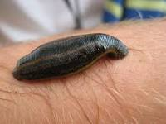
Hirudine (Direct acting thrombin inhibitor)
Potent antithrombin polypeptide
Obtained from leech hirudo medicinalis
Now been synthesized by recombinant DNA technique.
Unlike heparin, it binds irreversibly to thrombin.
It inactivates free as well as fibrin-bound thrombin.
It doesn’t require antithrombin or other co-factor.
It not only prevents conversion of fibrinogen to fibrin but also blocks thrombin catalyzed platelet aggregation and activation of other clotting factors.
Its activity is monitored by same tests as of heparin.
No antidote available.

Slide 31
Bivalirudin:
Analogue of hirudin, with rapid onset and offset (due to reversible).
Safer than latter.
Argatroban:
Reversible direct thrombin inhibitor
Alternative to hirudin.
Dabigatran:
It is prodrug (Dabigatran etexilate), orally active, direct inhibitor,
As effectvie as enoxaparin,ADR are same as enoxaparin.
Major adv: orally active without the need of coagulation monitoring.
All direct thrombin inhibitors are used in patients with or at risk of developing heparin induced thrombocytopenia.

Slide 32
Human antithrombin concentrate:
Prepared from human plasma.
It is used alone or in combination with heparin to treat patients with rare hereditary disorder antithrombin III deficiency.
COUMARIN DERIVATIVES (SLOW ACTING)
Effective orally (contrast to heparin)
Bis hydroxy coumarin or dicumaral (first coumarin compound)
Most commonly used drug is WARFARIN SODIUM
Anticoagulant action:
Vitamin K epoxide (inactive) convert to vitamin K reduced (active)
By vitamin K epoxide reductase.
Vitamin K (active) carboxylate the clotting factors II,VII,IX,X (active)
Oral anticoagulant competes with vitamin K and inhibit vitamin K epoxide reductase.
Slow acting: becz of long half life of clotting factors.
Increase plasma antithrombin level

Slide 33
ADME
Slow oral absorption, crosses placenta and secreted in milk.
Action is slow, because they prevent the formation of essential clotting factors by liver but do not destroy the already circulating factors.
Adverse effects:
Bleeding:
Fetal toxicity
Cutaneous gangrene

Slide 34
Warfarin sodium:
It is employed as RAT POISON.
It is racemic mixture.
Its advantages over coumarin (dicumaral /Bis hydroxycoumarin) are
It is almost 99% orally absorbed
Rapid onset of action
Adverse effects are few, may inculde alopecia, urticaria, dermatitis.
Can cross placenta but not secreted in milk (long term warfarin use should be avoided in pregnancy).
Major drawback is multiple drug interactions.

Slide 35
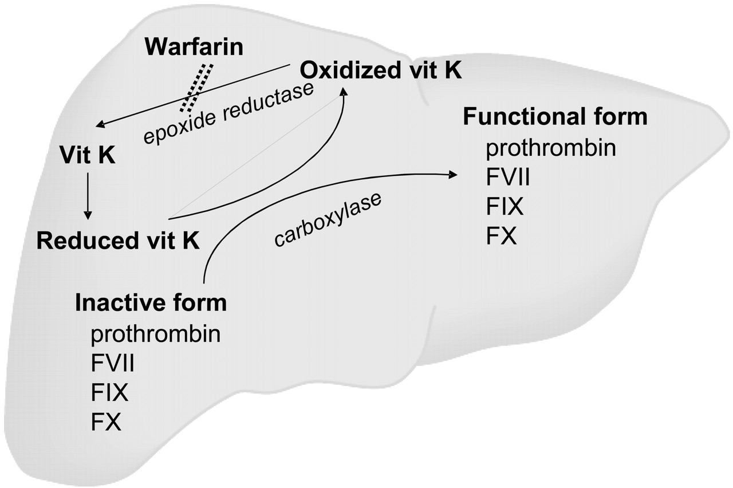
Mechanism of action: Warfarin

Slide 36
Drug interactions:
Inhibiting the platelet functions (aspirin,NSAID)
Stimulating hepatic microsomal catabolism of warfarin (Barbiturates,rifampicin,carbamazepine).
Displacing warfarin from protein binding (Sulfonamides,phenylbutazone,chlorpropamide etc)
Inhibiting metabolic clearance of warfarin (cimetidine,omeprazole,amiodarone)

Slide 37
Indandione derivatives:
These examples are PHENINDIONE,ANISINODIONE.
Anticoagulant activity is similar to coumarin compounds.
They are now OBSOLETE because of toxicity.
IN VITRO ANTICOAGULANTS
Physical methods:
By cooling the blood
Use of Paraffin,collodion or silicone coated Pan for collection
Calcium complexing agents:
Oxalates and Citrates: Potassium oxalate precipitate serum calcium as calcium oxalate and form calcium sodium citrate.
The anticoagulant solution (B.P) contains 2.5 % sodium citrate in 0.9% saline.
Potassium oxalate produces convulsions hence not used in vivo.

Slide 38
EDTA: (Ethylene di amine tetra acetic acid)
Chelating agent having greater affinity for calcium.
Its sodium salt is used.
Heparin: Discussed earlier

Slide 39
Thrombolytics or Fibrinolytics
Streptokinase
Recombinant tissue type plasminogen activator
Urokinase
Acylated plasminogen-streptokinase activator

Slide 40
Mechanism of Fibrinolysis:
All thrombolytic agents are directly or indirectly plasminogen activator.

Slide 41
Fibrin specific thrombolytic agents
Alteplase,Reteplase,Tenecteplase
Fibrin non-specific thrombolytic agents
Streptokinase, Anistreplase, Urokinase.
All are directly acting thrombolytic agent except Steptokinase.
Pharmacokinetic profile,patients tolerance and disease state will be consider to select the thrombolytic agent.
Streptokinase:
Obtained from Beta haemolytic Steptococci group C.
It is inactive as such: BUT when combines with plasminogen,the plaminogien-STC complex is ACTIVE.
Causes conversion of plasminogen to plasmin.
Antistreptococcal antibodies of past infection inactivate it.
It may cause hypersensitivity reactions and anaphylaxis.
Fever,hypotension and arrhythmias are reported.
Used in DVT, due to availability of other fibrinolytics it is not used in developed countries.
Being least expensive still widely used in developing countries.

Slide 42
Urokinase:
Obtained from human urine.
Now obtained from cultured human renal cells
Potent direct plasminogen activator
It is non-antigenic,non-pyrogenic,non -allergic. (differ from STK).
Lacks fibrin specificity and very expensive.
Its use is followed by heparin and latter oral anticoagulants.
Used to lyse fibrin or blood deposit in anterior chamber of eye.
Used in patient in whom STK has been used for an earlier episodes.
Limited use because of availability of newer fibrinolytics.

