Slide 1
Cardiovascular System

Slide 2
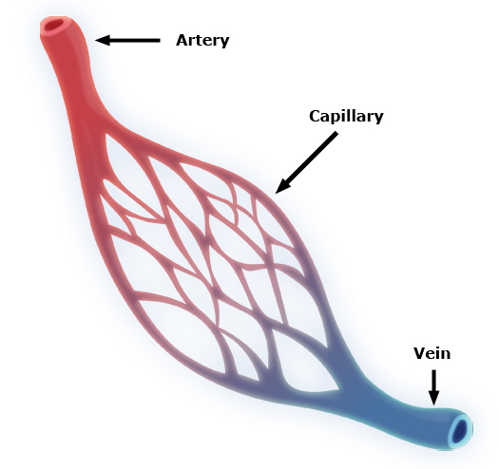
Blood Vessels
Artery
Carries blood AWAY from the heart
High velocity
Vein
Carries blood TO the heart
Medium velocity
Capillary
Intermediate between arteries
and veins
Extremely thin walls
Site of gas exchange

Slide 3
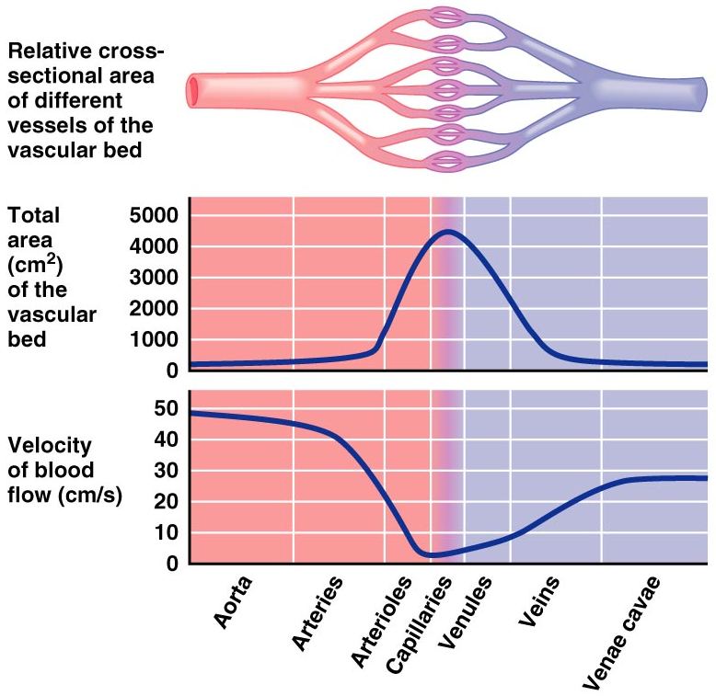
Things to think about…
Velocity of Blood Flow
What do you notice about the velocity of the arteries and veins versus capillaries?
Why would capillary velocity need to remain low?

Slide 4
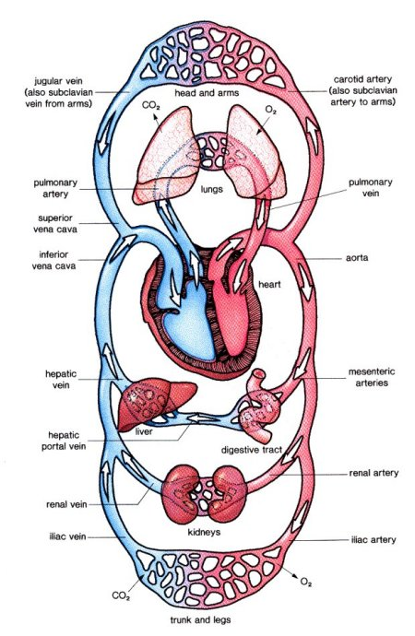
More things to ponder…
Blood Flow
What does the blue color represent?
What does the red color represent?
So, that means the right and left side of the heart are different, but how?

Slide 5
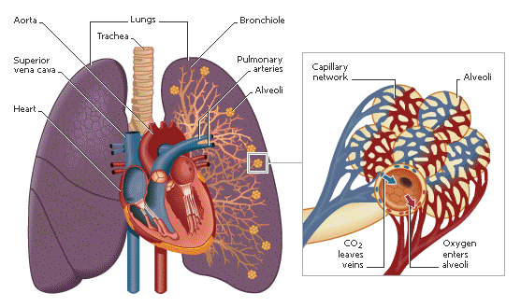
Where do we get the oxygen?

Slide 6
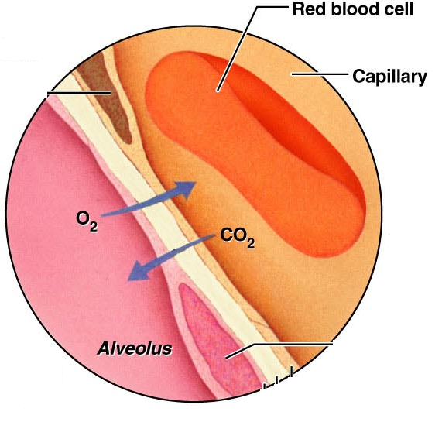
Oxygen from alveoli is exchanged for CO2
Capillaries wrapped Tightly around alveoli

Slide 7
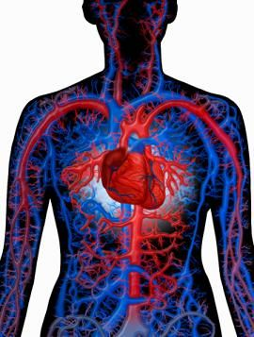
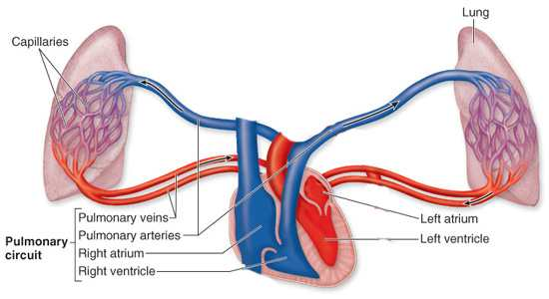
Circulatory Pathways
Pulmonary Circulation
Systemic Circulation
“LUNGS”
Short loop that runs from the heart to the lungs and back to the heart
“BODY”
long loop to all parts of the body and returns to the heart

Slide 8
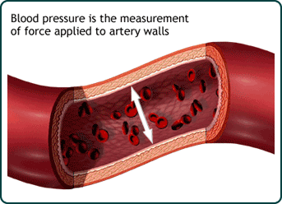
Blood Pressure (BP)
Force exerted on the inside of a blood vessel by blood
Expressed in millimeters of mercury (mm Hg)
Systolic (Heart pumping)
Diastolic (Heart relaxing)
Ex’s: 118 or 123
70 82

Slide 9
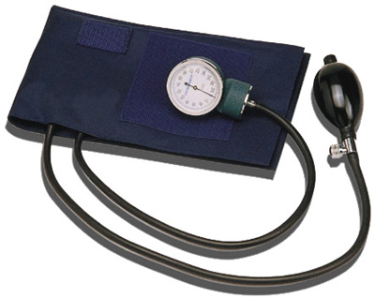
Measuring Blood Pressure
BP is measured with the auscultatory method
A sphygmomanometer is placed on the arm proximal to the elbow

Slide 10
Measuring Blood Pressure
The first sound heard is recorded as the systolic pressure
The pressure when sound disappears is recorded as the diastolic pressure

Slide 11
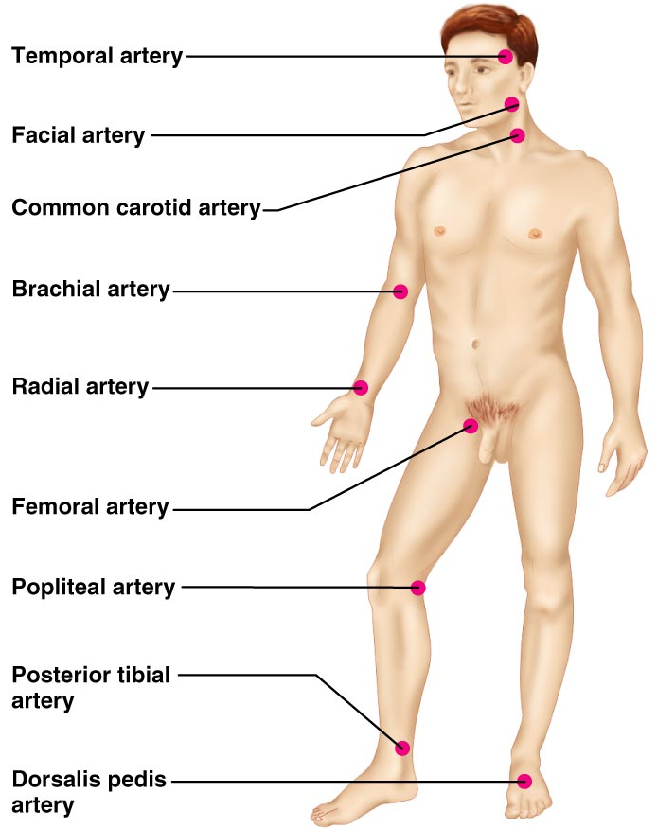
Palpated Pulse

Slide 12
Resistance
Peripheral Resistance – opposition to flow
The three important sources of resistance:
blood viscosity – “stickiness” of the blood
total blood vessel length
blood vessel diameter

Slide 13
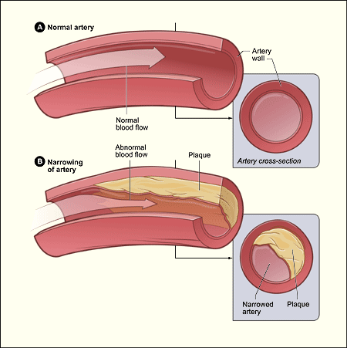
Atherosclerosis
Fatty plaques that
dramatically increase resistance due to blockages

Slide 14
Blood Flow, Blood Pressure, and Resistance
ΔP=pressure
R=resistance
If ΔP increases, blood flow speeds up; if ΔP decreases, blood flow slows
If R increases, blood flow slows

Slide 15
Maintaining Blood Pressure
The main factors influencing blood pressure:
Cardiac output (CO)-amount of blood being pumped out of heart per minute
Peripheral resistance (PR)
Blood volume
Blood pressure = CO x PR
Blood pressures can vary

Slide 16
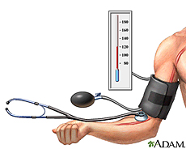
Hypotension
Low blood pressure
Orthostatic hypotension – temporary low BP and dizziness when suddenly rising from a sitting or reclining position
Chronic hypotension – hint of poor nutrition like lack of salt

Slide 17
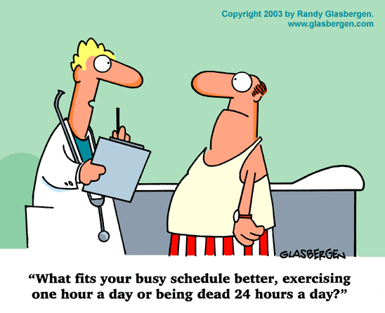
Hypertension
High blood pressure
Primary or essential hypertension – risk factors include diet, obesity, age, race, heredity, stress, and smoking
Secondary hypertension – due to disorders or atherosclerosis

Slide 18
Shock
A person in shock has extremely low blood pressure
Symptoms
Anxiety or agitation/restlessness
Bluish lips and fingernails
Chest Pain
Confusion
Dizziness, lightheadedness, or faintness
Pale, cool, clammy skin
Low or no urine output
Profuse sweating
Rapid but weak pulse
Shallow breathing
Unconsciousness

Slide 19
Circulatory Shock
Three types include:
Hypovolemic shock – results from large-scale blood loss
Vascular shock – poor circulation resulting from extreme vasodilation
Cardiogenic shock – the heart cannot sustain adequate circulation

Slide 20
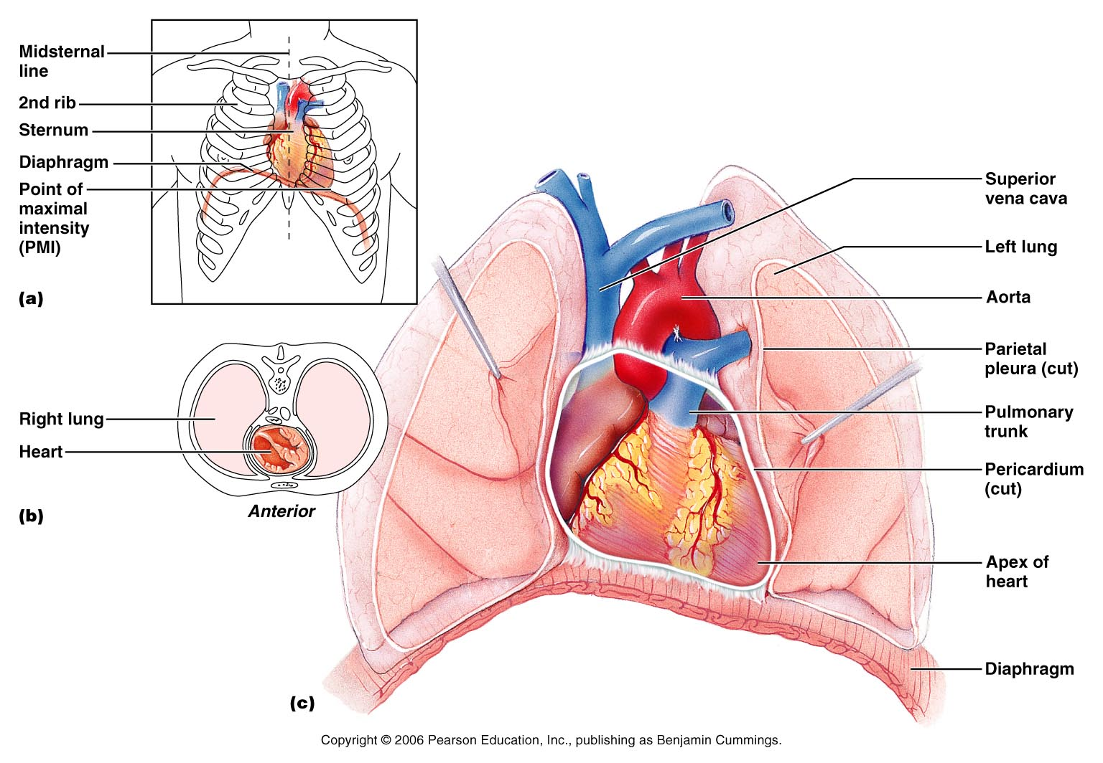
Heart Anatomy

Slide 21
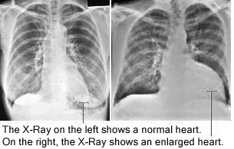
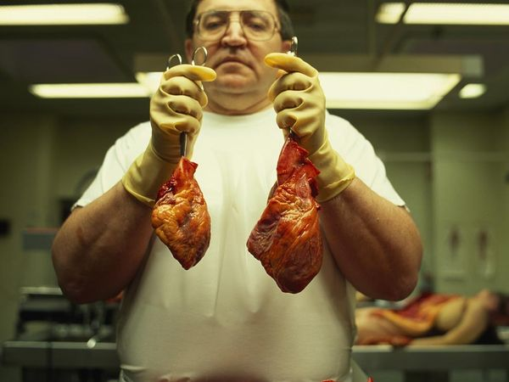
Normal Vs. Enlarged Heart

Slide 22
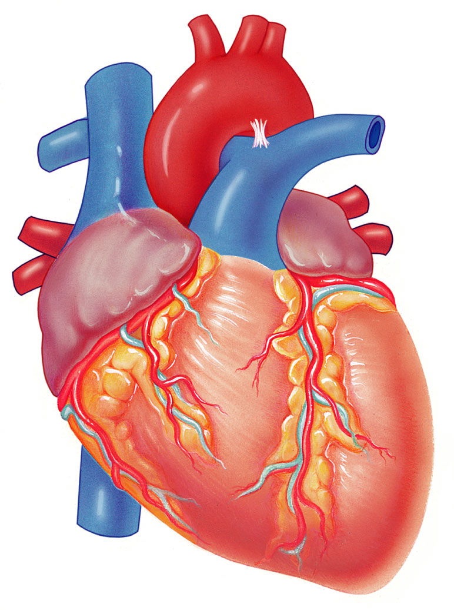
Brachiocephalic
trunk
Left common
carotid artery
Superior
vena cava
Left
subclavian artery
Aortic arch
Right
pulmonary artery
Ligamentum
arteriosum
Ascending
aorta
Left pulmonary artery
Left pulmonary veins
Pulmonary trunk
Left atrium
Right
pulmonary veins
Auricle
Right atrium
Circumflex
artery
Right coronary
artery (in coronary
sulcus)
Left coronary
artery (in coronary
sulcus)
Anterior
cardiac vein
Left ventricle
Right ventricle
Marginal artery
Great cardiac vein
Small cardiac vein
Anterior
interventricular artery
(in anterior
interventricular sulcus)
Inferior
vena cava
(b)
Apex

Slide 23
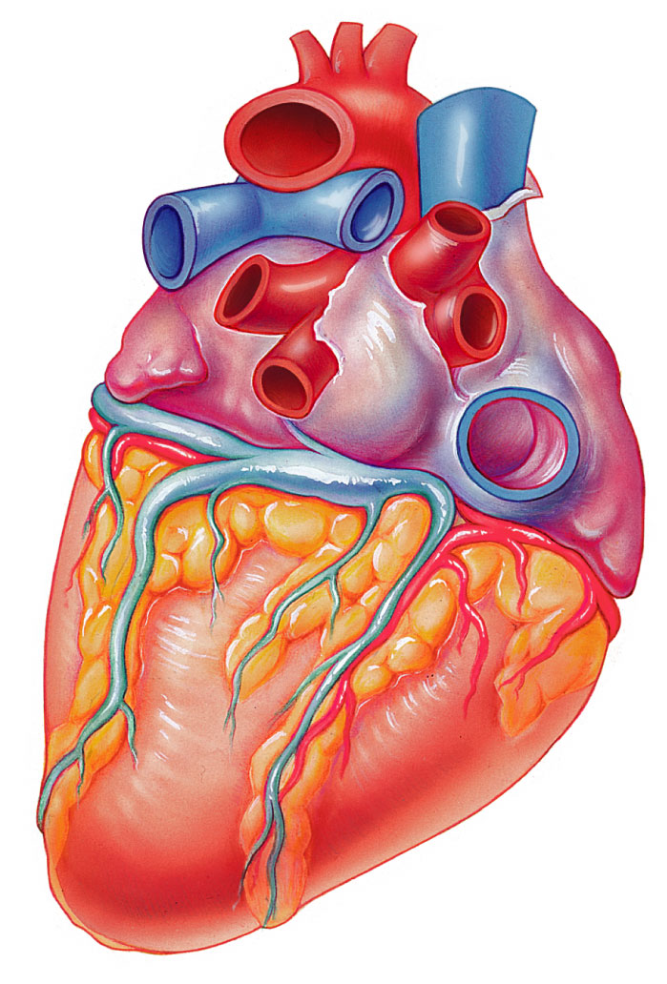
Aorta
Superior
vena cava
Left
pulmonary artery
Right
pulmonary artery
Left
pulmonary veins
Right
pulmonary veins
Auricle
of left atrium
Right atrium
Left atrium
Inferior
vena cava
Great cardiac vein
Right coronary
artery (in coronary
sulcus)
Posterior vein
of left ventricle
Coronary sinus
Posterior
interventricular artery
(in posterior
interventricular sulcus)
Left ventricle
Apex
Middle cardiac vein
(d)
Right ventricle

Slide 24
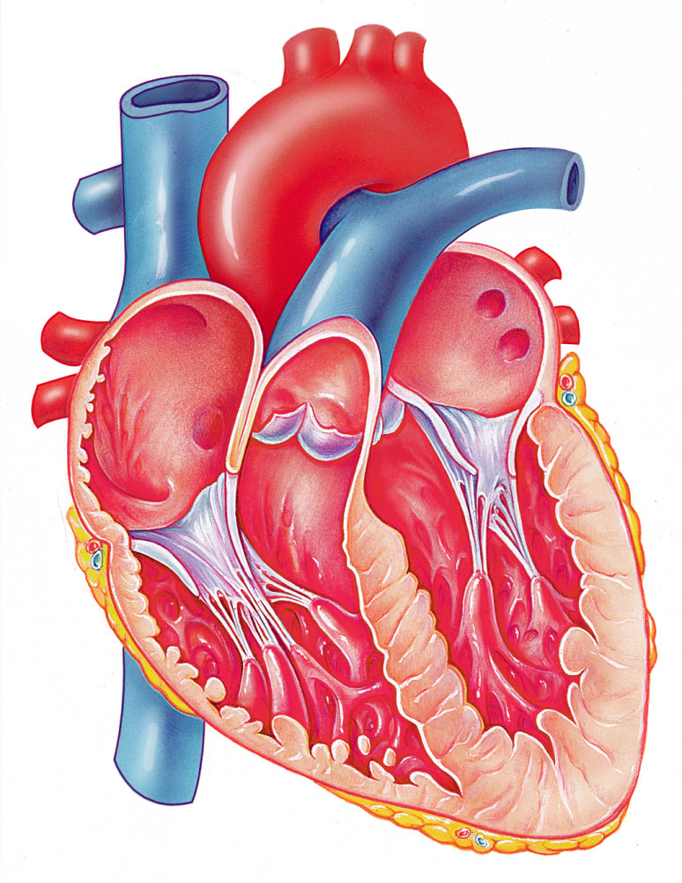
Aorta
Superior vena cava
Right
pulmonary artery
Left
pulmonary artery
Left atrium
Left
pulmonary veins
Right atrium
Right
pulmonary veins
Mitral
(bicuspid) valve
Fossa
ovalis
Aortic
valve
Pectinate
muscles
Pulmonary
Semilunar valve
Tricuspid
valve
Left ventricle
Right ventricle
Papillary
muscle
Chordae
tendineae
Interventricular
septum
Trabeculae
carneae
Myocardium
Visceral
pericardium
Inferior
vena cava
Endocardium
(e)

Slide 25
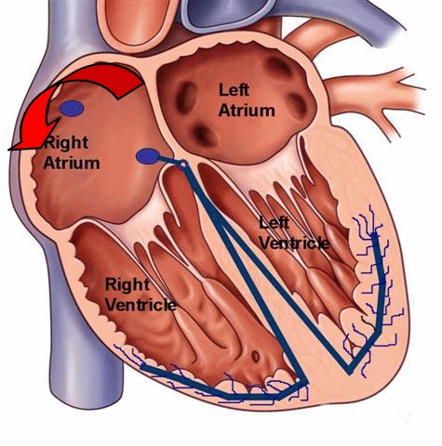
Atria of the Heart
Atria are the receiving chambers of the heart

Slide 26
Ventricles of the Heart
Ventricles are the discharging chambers of the heart

Slide 27
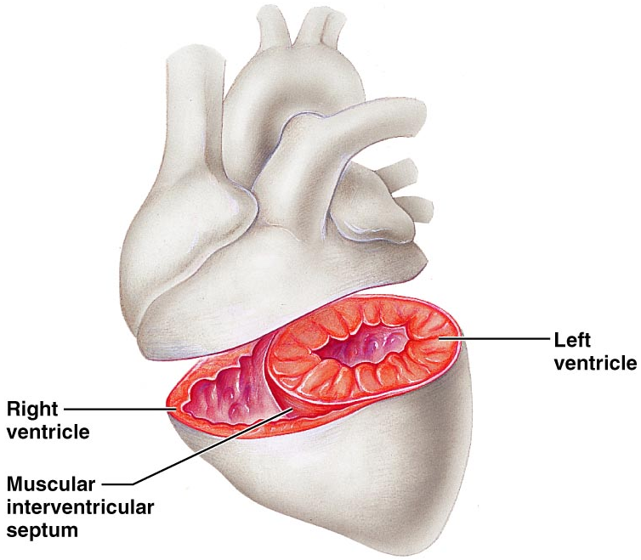
Right & Left Ventricle
What do you notice about the size of the left vs. the right?
Why do you suppose the heart is structured this way?
Figure 18.6

Slide 28
Heart pumping
Right Side
Left Side
Pumps blood to the lungs
Drops off carbon dioxide
Picks up oxygen
Returns to heart
Pumps blood to body
Drops off oxygen
Picks up carbon dioxide
Returns to heart
Heart
Lungs
Heart
Body

Slide 29
Pathway of Blood Through the Heart and Lungs KNOW THIS!!!
Right atrium → tricuspid valve → right ventricle → pulmonary semilunar valve → pulmonary arteries → Lungs → pulmonary veins → left atrium → bicuspid valve → left ventricle → aortic semilunar valve → Aorta → systemic circulation
http://www.dnatube.com/video/4817/Heart-Structure--Biology--Anatomy

Slide 30
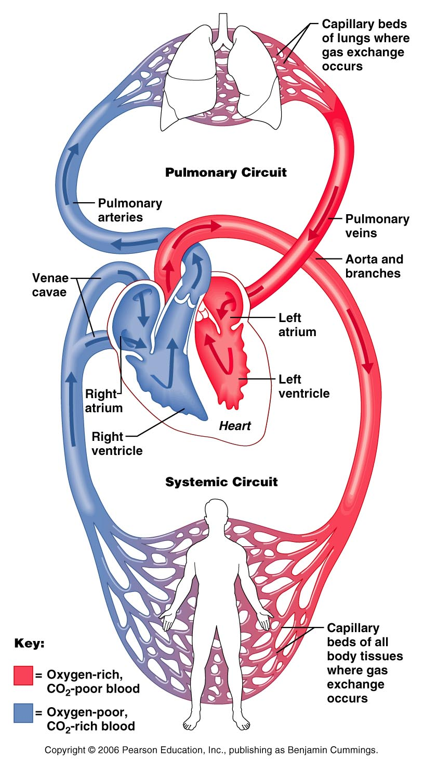
Both Circuits
Blue=deoxygenated
Red=oxygenated
Purple= gas exchange
Pumping Heart

Slide 31
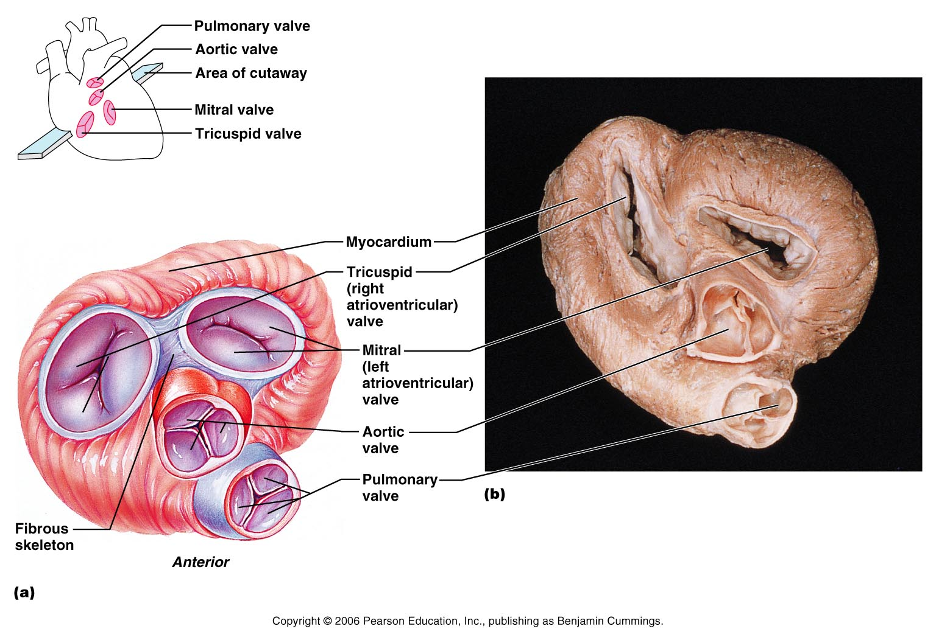
Heart Valves
Heart valves ensure unidirectional blood flow through the heart
Valves prevent backflow

Slide 32
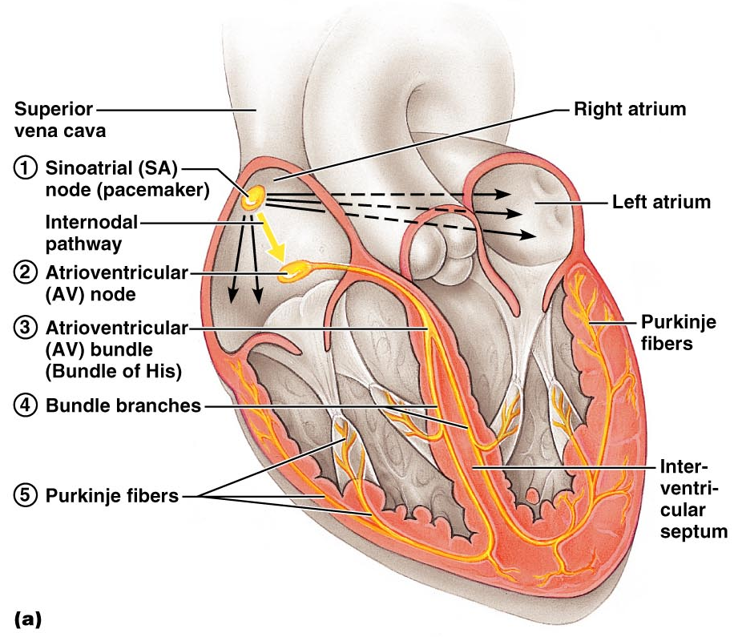
Cardiac Muscle Contraction
Heart muscle:
Is stimulated by nerves and is automatic
Sinoatrial (SA) node (pacemaker) generates impulses
http://www.dnatube.com/video/5996/Conducting-System-Of-The-Heart

Slide 33
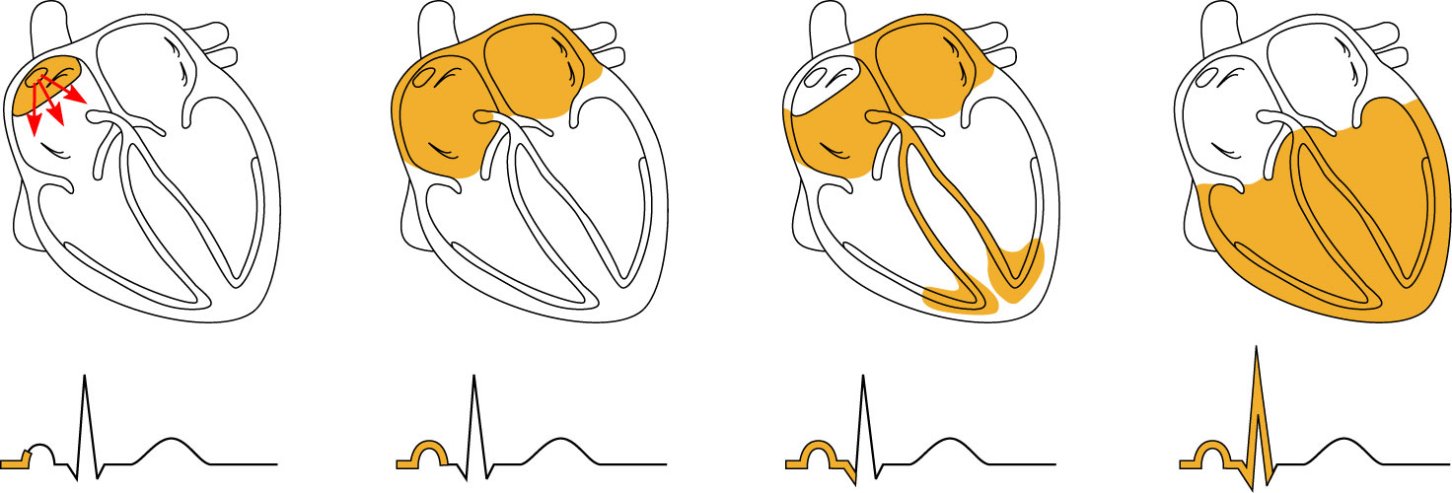
Heart Excitation Related to ECG
SA node generates impulse;
atrial excitation begins
Impulse stimulates
the AV node
Impulse passes to
heart apex; ventricular
excitation begins
Ventricular excitation
complete
SA node
AV node
Bundle
branches
Purkinje
fibers

Slide 34
ECG
Electrocardiogram
Graphic record of the voltage produced by the myocardium during the cardiac cycle
2 Processes
Depolarization:
Excited state of heart tissue
Sodium ions move across the cell membrane causing the inside of the cell to become more + and outside becomes more –
Heart contracts in the process, then repolarizes
Repolarization:
Slow movement of sodium ions back across the cell membrane to restore the polarized state

Slide 35
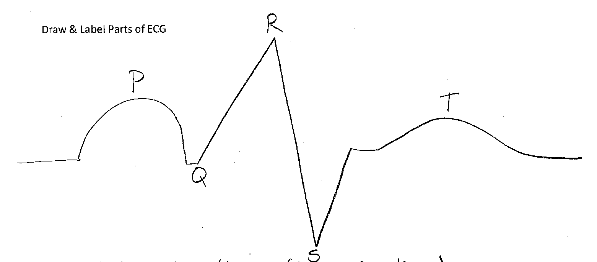
ECG Parts
P= atrial contraction (depolarization)
QRS= atrial repolarization & ventricular contraction (depolarization)
T= ventricular repolarization

Slide 36
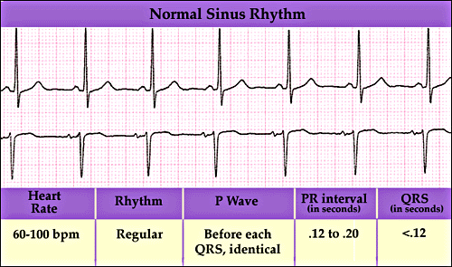
Normal Heart Rate

Slide 37
Heart Rates
Bradycardia→ Slow heart rate, resting HR less than 60 BPM
Tachycardia→ Rapid heart rate, resting HR greater than 100 BPM

Slide 38
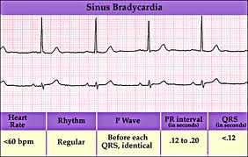
Bradycardia

Slide 39
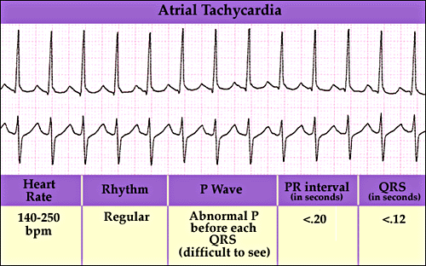
Tachycardia

Slide 40
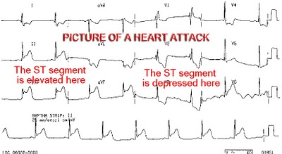
Heart Attacks
http://www.dnatube.com/video/8249/Heart-Attack-3D-Animation

Slide 41
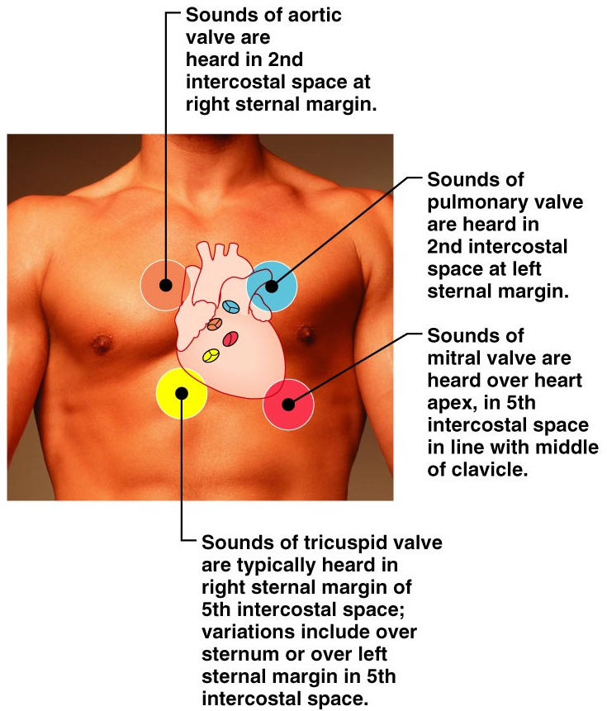
Heart Sounds

Slide 42
Heart Sounds
Heart sounds (lub-dup) are associated with closing of heart valves
First sound occurs as AV valves close
Second sound occurs when SL valves
Guess the BPM (beats per minute)

Slide 43
Cardiac Cycle
Cardiac cycle refers to all events associated with blood flow through the heart
Systole – contraction of heart muscle
Diastole – relaxation of heart muscle

Slide 44
Cardiac Output (CO) and Reserve
Stroke Volume (SV) is the amount of blood pumped out by a ventricle with each beat
Heart Rate (HR) is the number of heart beats per minute
Cardiac Output (CO) is the amount of blood pumped by each ventricle in one minute
CO is the product of (HR) & (SV)

Slide 45
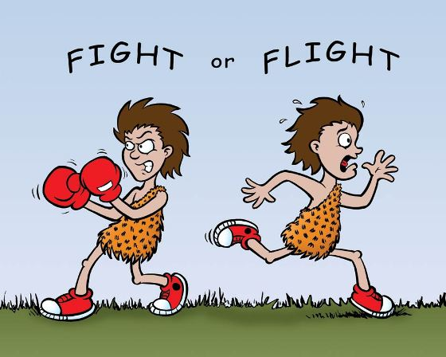
Chemical Regulation of the Heart
The hormone epinephrine (adrenaline):
Increases heart rate
Constricts blood vessels which increases blood pressure
Dilates air passages for increase oxygen intake
Result of fight-or-flight response of sympathetic nervous system

Slide 46
BLOOD
Functions of blood:
1. Transportation
Nutrients, oxygen, wastes, hormones
2. Distribute heat
3. Protection against disease

Slide 47
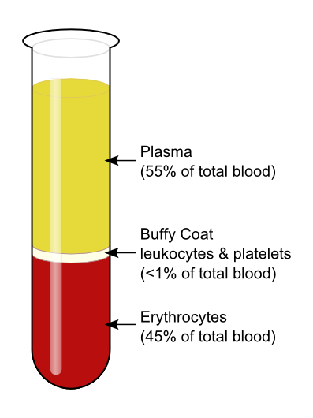
Facts about blood
Connective tissue
Three portions:
1. Plasma
2. “Buffy coat” – WBC and platelets
3. Red Blood Cells
Average blood volume:
5–6 L for males
4–5 L for females

Slide 48
The last two parts make up the solid portion called “formed elements”
45% called hematocrit (HCT) – mostly RBC
55% called plasma – mostly water; some amino acids, proteins, carbs, lipids, hormones, vitamins, wastes, etc.

Slide 49
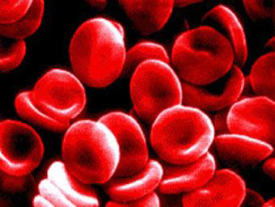
Red Blood Cells (RBC)
AKA erythrocytes
Biconcave discs helps with gas transport
1/3 is protein hemoglobin
Hemoglobin is responsible for carrying oxygen

Slide 50
Other facts…
No nuclei so can not synthesize proteins or divide.
RBC count used to diagnosis disease
Life span of RBC 120 days

Slide 51
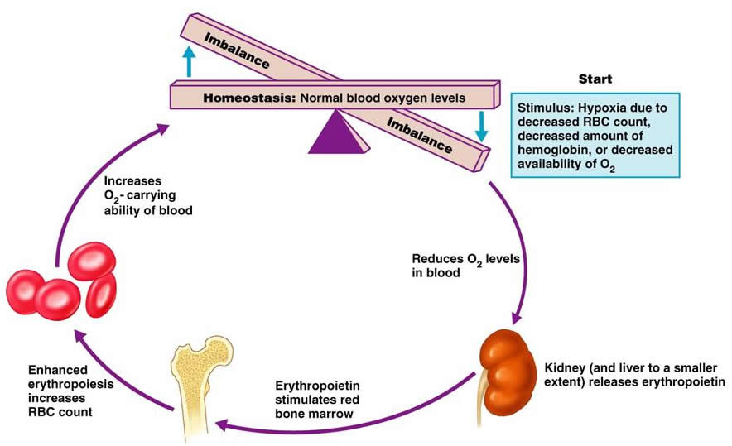
Formation of rbc
Occurs in red bone marrow
Controlled by a negative feedback loop
Erythropoietin – hormone that controls production…decrease blood oxygen level causes increase in production.
Anemia – too few RBC or too little hemoglobin. Decreases oxygen carrying ability; pale and lack energy

Slide 52
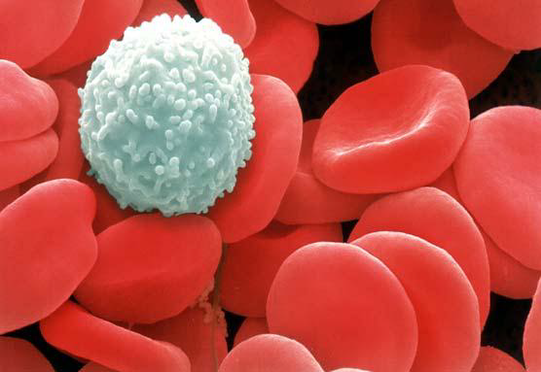
White blood cells (wbc)
AKA leukocytes
Function: protect against disease
No hemoglobin
Five types of WBC

Slide 53
WBC Flip book
10 minutes to complete
Title your Flip Book: White Blood Cells
Label the next 5 tabs with the 5 types of WBC
On the pages you need the following for each type of WBC:
A Drawn Picture
Description
# in blood
Life span
Function
You can get all of your information from textbook pg. 658

Slide 54
Types of wbc
1. Neutrophils –
2x size of RBC; capable of phagocytosis of smaller objects; contain many lysosomes with digestive enzymes.
2. Basophils – 2x size of RBC; contain blood clot inhibiting heparin and histamines that increase blood flow to injured areas.

Slide 55
3. Eosinophils – 2x RBC; attracts and kills parasites; controls inflammation and allergic reactions
4. Monocytes – largest type 2-3 x RBC; capable of phagocytosis of large objects; many lysosomes
5. Lymphocytes – same size as RBC;
important in immunity!
Produces antibodies.

Slide 56
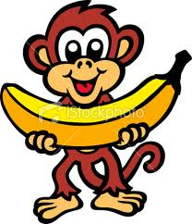
Facts on wbc
WBC count very important in diagnosing diseases
Increase indicates infection
Depending on the disease, different types of WBC will change numbers.
WBC Abundance in the Human Body
Abundant
Rare
Never Let Monkeys Eat Bananas
Monocytes
Basophils
Lymphocytes
Eosinophils
Neutrophils

Slide 57
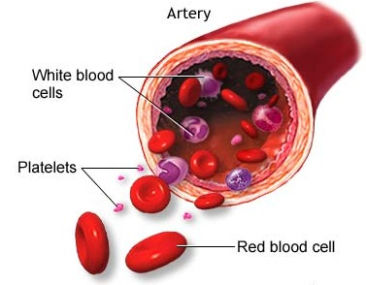
Platelets
AKA thrombocytes
Small sections of cytoplasm
No nucleus
½ size of RBC
Function – close breaks in damaged
Blood vessels and initiate formation
of blood clots.

Slide 58
Blood Group | Antigens on Red blood cell | Antibodies in blood | Drawn Picture | Can receive blood from …
We will fill out chart in class

Slide 59
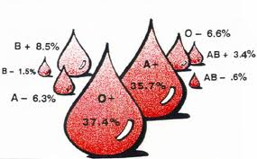
Percent of Population by blood type

Slide 60
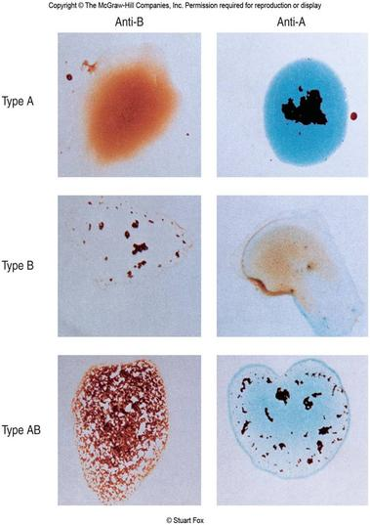
Blood Typing
Blood samples are mixed with anti-A and anti-B serum to check for agglutination (clumping)
Typing for Rh factors is done in the same manner

Slide 61
Rh factor
A marker found on the red blood cells.
If you have the marker you are Rh-positive.
If you are missing the marker, you are Rh-negative.
+or – blood type explained

Slide 62
Hemolytic Disease of the Newborn
Hemolytic disease of the newborn – Rh⁺ antibodies of a sensitized Rh– mother cross the placenta and attack and destroy the RBCs of an Rh⁺ baby
The drug RhoGAM can prevent the Rh– mother from becoming sensitized

Slide 63
Blood clotting
2 major factors
Platelets
Travel through bloodstream
When bleeding happens, chemical reaction occurs to make them “sticky”
They adhere to the vessels of the bleeding site
Within a minute, a “white clot” is formed
Thrombin System
Several proteins become activated
Chemical reactions form fibrin (like a long sticky string)
Fibrin sticks to broken vessel & forms a web
RBC get caught in web & form a “red clot”

Slide 64
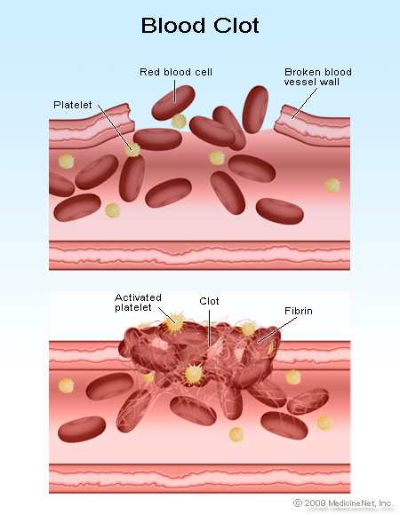

Slide 65
Clotting continued…
Mature clots contain both platelets and fibrin strands making them tight and stable
After about 10 days, the wound is healed & body disintegrates the clot.

Slide 66
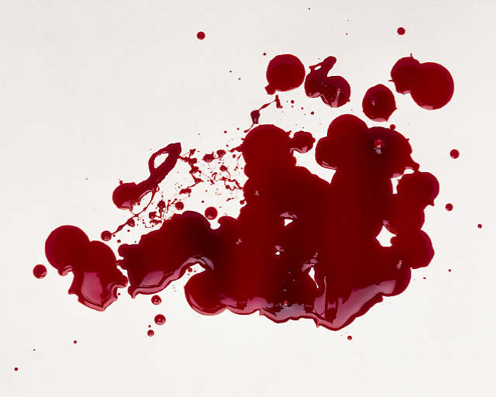
Large losses of blood have serious consequences
Loss of 15% to 30% causes weakness
Loss of over 30% causes shock, which can be fatal

Slide 67
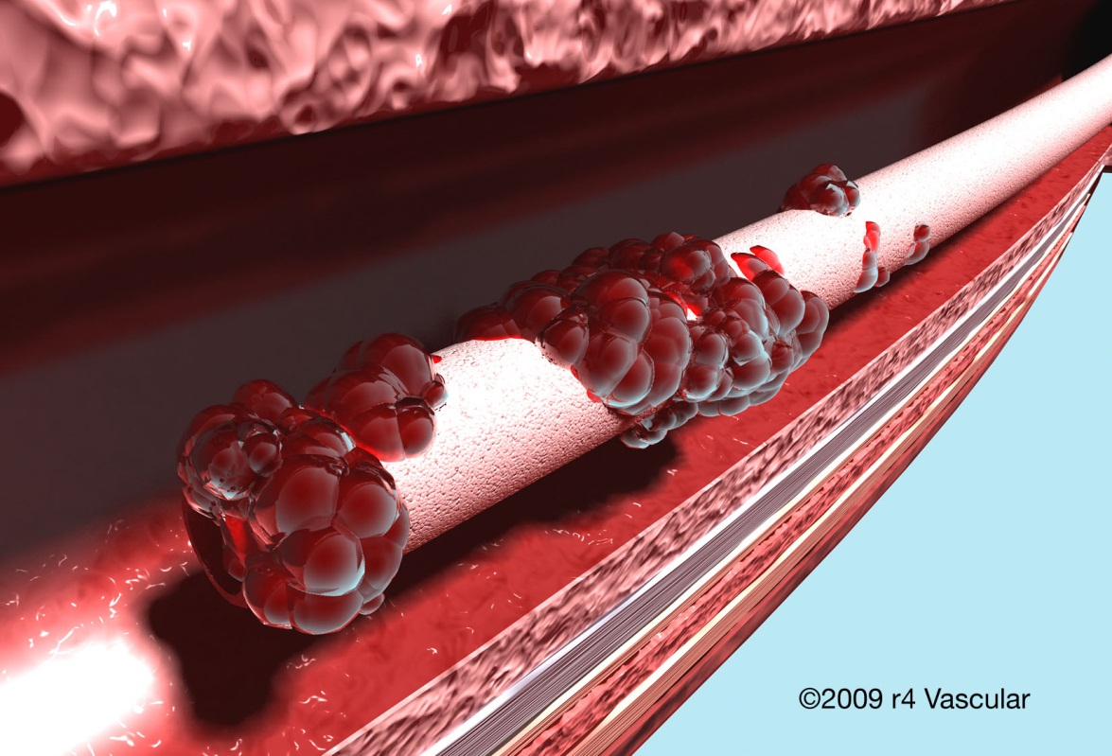
Undesirable Clotting
Thrombus – a clot that develops and persists in an unbroken blood vessel “stationary
Embolus – a thrombus “freely floating” in the blood stream

