Slide 1
BLOOD PRODUCTS
QUESTIONS ASKED IN EXAM
PRESENTED BY NOORUDDIN KHAN

Slide 2
IMPORTANT QUESTION
1.Characteristics of blood donor. 2M
2.Red cell concentrate 3M
Total marks 5M

Slide 3
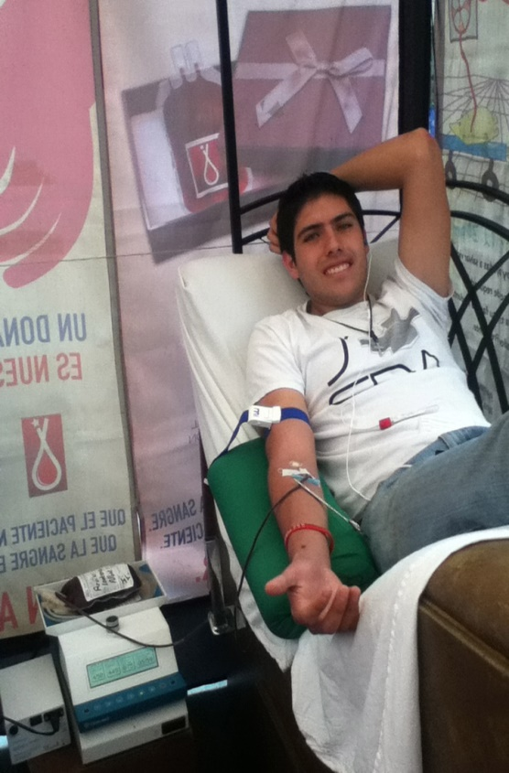
Characteristic of blood donor 2marks
1. BLOOD DONOR SHOULD BE HEALTHY AND , WELL PHYSIOLOGY
2-AGE SHOULD BE IN RANGE OF 18 to 60 yrs old
3-Minimum Weight 50 kg
4-Minimum Hemoglobin Level 12.5%

Slide 4
Characteristic of blood donor 2marks
5-A donor can again donate blood after 3 months of your last donation of blood.
6-Blood Donor should have normal blood pressure
7-Donors should not suffer from Cardiac arrest, hypertension, kidney alignments, epilepsy or diabetics.
8-blood donor should not have disease like HIV , Malaria , Typhoid , or other
Transmissible disease

Slide 5
RED CELL CONCENTRATE 3M
After centrifugation of whole human blood, red cell concentrate is obtain.
What is red cell concentrate?
It is simply isolated RBC
40 % supernatant plasma layer is removed
It should be use in 12 hour after separation

Slide 6
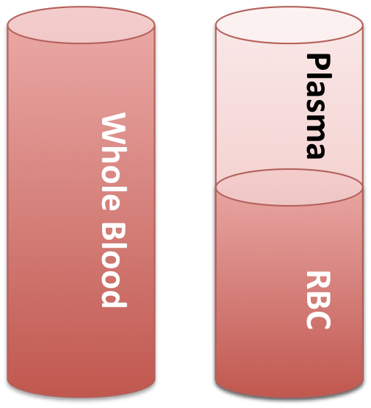
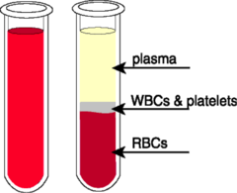
RED CELL CONCENTRATE 3M
Cells are matched with recipients plasma.
Hb content should not be more than15.5 %.

Slide 7
RED CELL CONCENTRATE 3M
In some type of anemia , the RBC count is less than normal , (4.7-6.1 millions per mcL)
WHY RED CELL CONCENTRATE IS
USED?
Hemoglobin is main content of RBC
Less RBC will lead to less oxygen supply to the different body cell
And body demands more oxygen, so that red cell concentrate is used in such type of anemic condition

Slide 8
13PH35

