Slide 1
VITAMINS-3
Shariq Syed

Slide 2
Plan for today
Review last lecture
Get done with fat soluble vitamins :Vitamin K
Start with Water soluble ones : Introduce B-complex, B1
Summarize what’s done
Notes:
Vital Amines: important for growth & thought to be Amines

Slide 3
Pop Quiz !!
Vitamin D undergoes biotransformation in which two organs
Liver & lung
Liver & kidney
Brain & Spleen
I Don’t know, Maybe in my head !
Notes:
Vital Amines: important for growth & thought to be Amines

Slide 4
Pop Quiz !!
Vitamin D has a major role in homeostasis of
K
Na
Ca
I Need a lifeline
Notes:
Vital Amines: important for growth & thought to be Amines

Slide 5
Pop Quiz !!
Vitamin D deficiency leads to
Rickets
cricket
IPL
I don’t remember
Notes:
Vital Amines: important for growth & thought to be Amines

Slide 6
Pop Quiz !!
Vitamin E is a major
Anti-reductant
Anti-oxidant
Anti-AIKTCian
IPL player, I guess !!
Notes:
Vital Amines: important for growth & thought to be Amines

Slide 7
Vitamin K: Introduction
Group of structurally similar fat soluble vitamins
Identified as a result of investigations of hemorrhagic (bleeding) incidents in animals
Important role in blood coagulation & bone formation
Notes:
Vitamin K₁ was identified in 1929 by Danish scientist Henrik Dam when he investigated the role of cholesterol by feeding chickens a cholesterol-depleted diet.^{[3]} After several weeks, the animals developed haemorrhages and started bleeding. These defects could not be restored by adding purified cholesterol to the diet. It appeared that—together with the cholesterol—a second compound had been extracted from the food, and this compound was called the coagulation vitamin. The new vitamin received the letter K because the initial discoveries were reported in a German journal, in which it was designated as Koagulationsvitamin.
Typically we can endure 10 % loss of blood without serious conseq

Slide 8
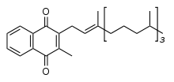
Vitamin K: Structure
Structurally they are 2-methyl-1,4-naphthoquinone (3-) derivatives
Naphthoquinone ring
Aliphatic side chain
Vitamin K1 (Phylloquinone)
Vitamin K2 (menaquinone)

Slide 9
Vitamin K: Structure
Vitamin K1 (Phylloquinone)
Normal dietary source, synthesized by plants
Active form
Animals may convert to Vita K2
Vitamin K2 (menaquinones)
Main storage form in animals, differs in side chain length (isoprenoid units)
Menaquinone-4, most common form synthesized from Vit K1 in animal tissues
Intestinal bacteria can also convert Vit K1 to K2 & other homologues
Notes:
Vit K1= found in leafy vegetables, since directly involved in photosynth
Menaquinone-4 has 4 isoprene units

Slide 10
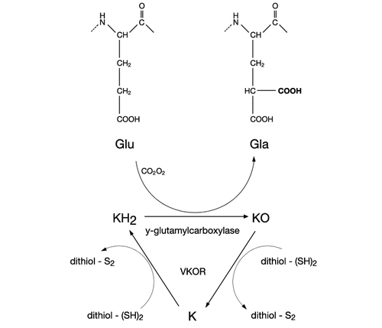
Vitamin K: Role in Clotting
Vitamin K reduced to Vitamin K hydroquinone (Reductase)
Vitamin K hydroquinone is oxidized to epoxide
This activates Glutamate (Glu) residue in protein to carbanion & then to carboxyglutamate (Gla)
Epoxide is reduced back to Vit K by reductase (VKOR)
Notes:
Within the cell, vitamin K undergoes electron reduction to a reduced form called vitamin K hydroquinone by the enzyme vitamin K epoxide reductase (VKOR)
Another enzyme then oxidizes vitamin K hydroquinone to allow carboxylation of Glu to Gla; this enzyme is called the gamma-glutamyl carboxylase
The carboxylation reaction only proceeds if the carboxylase enzyme is able to oxidize vitamin K hydroquinone to vitamin K epoxide at the same time
Vitamin K epoxide is then reconverted to vitamin K by VKOR
Humans are rarely deficient in vitamin K₁ because, in part, vitamin K ₁ is continuously recycled in cells

Slide 11
Vitamin K: Role in Clotting
Prothrombin and several other proteins of blood clotting systems (Factor VII, IX, X..) all have Gla component
Gla chelates Ca⁺ ions, permits binding of blood clotting proteins to membranes
Notes:
the presense of two -COOH (carboxylate) groups on the same carbon in the gamma-carboxyglutamate residue allows it to chelate calcium ion.

Slide 12
Vitamin K: Role in Bone Metabolism
Osteoclasts (Bone forming cells) secrete two proteins responsible for maintaining bone structure
Osteocalcin
Bone matrix Gla protein
Both these proteins contain Vitamin K dependent gamma-carboxylation of three glutamic acid residues
These have important role in bone mineralisation

Slide 13
Vitamin K Deficiency
Deficiency uncommon in adults except those on anti-coagulant drugs, liver damage, disease leading to malabsorption
Primarily affects blood clotting mechanism
More likely to have bruising or bleeding
Affects bone formation, prone to fractures
Notes:
Newborn babies who are exclusively breast-fed are at increased risk of vitamin K deficiency, because human milk is relatively low in vitamin K compared to formula. Newborn infants, in general, have low vitamin K status for the following reasons: 1) vitamin K is not easily transported across the placental barrier; 2) the newborn's intestines are not yet colonized with bacteria that synthesize menaquinones; and 3) the vitamin K cycle may not be fully functional in newborns, especially premature infants

Slide 14
Vitamin K: How much do I need
Infants :
2 – 2.5 ug/day
Children:
30 – 60 ug/day
Adults:
75 – 120 ug/day

Slide 15
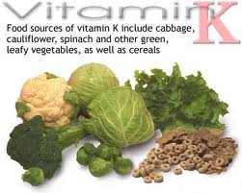
Vitamin K: Food Sources
Notes:
In addition some veg oils (soyabeen, cottonseed, olive) major contributors of Vit K

Slide 16
Vitamin B Complex
Group of water soluble vitamins, chemically distinct
Play an important role in metabolism
B-complex
B1 (Thiamine
B2 (riboflavin)
B3 (Niacin)
B5 (Pantothenic A
B6 (Pyridoxine)
B7 (Biotin)
B9 (Folic Acid)
B12 (Cobalamins)
Notes:
Chemically distinct but similar properties, act in synergy, that’s why clubbed together as B-complex

Slide 17
Vitamin B1 (Thiamine)
Water soluble vitamin
Isolated in early 1930, one of the first organic compounds to be recognized as vitamin
Exists in body as free Thiamine & several phosphorylated forms (Mono, di, tri)

Slide 18
Vitamin B1 Structure
Thiamine converted to Thiamin pyrophosphate (TPP) by enzyme thiamine pyrophosphatase

Slide 19
Vitamin B1 : What’s the role
Vit B1 has a central role in high energy metabolism
Acts as a Co-enzyme for three multi-enzyme complexes that catalyze : Oxidative decarboxylation reaction
Pyruvate dehydrogenase in carbohydrate metabolism
Ketoglutarate dehydrogenase in Citric acid cycle
Keto-acid dehydrogenase in metabolism of leucine, isoleucine and valine

Slide 20
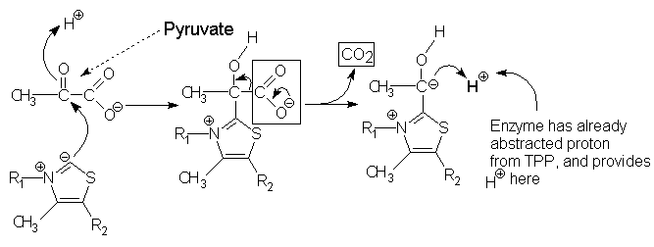
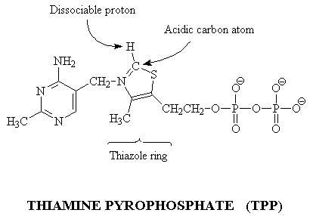
Vitamin B1 : What’s the role
Step 2: This carbanion can then attack the carbonyl group of pyruvate. The positively charged nitrogen atom in the thiazole ring of TPP acts as an electron sink to promote the formation of the carbanion in the thiazole ring, and then to help the decarboxylation reaction and formation of the hydroxyethyl-TPP compound.
Step 1: TPP, has a dissociable proton on the thiazole ring; when this proton is extracted it leaves behind an especially reactive and negatively charged carbon atom (a carbanion) in that ring.

Slide 21
Vitamin B1 : Deficiency
Thiamine deficiency can lead to 3 distinct syndromes
Beriberi
Acute pernicious beriberi
Wernicke encephalopathy
Notes:
Thiamine has a half-life of 18 days and is quickly exhausted, particularly when metabolic demands exceed intake. Thiamine is involved in a variety of glucose metabolism-related and neurological functions
weight loss, emotional disturbances, impaired sensory perception, weakness and pain in the limbs, and periods of irregular heart rate. After modification in the body to a diphosphate form, thiamine is involved in a vast array of functions:
Biochemical lesions in CNS due deficiency leads to ataxia (improper co-ordination), confusion

Slide 22
Vitamin B1 : How much do we need ?
Infants :
0.2 – 0.3 mg/day
Children:
0.5 – 0.9 mg/day
Adults:
1.2 mg/day

Slide 23
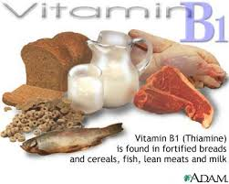
Vitamin B1 : Food Source

