Slide 1
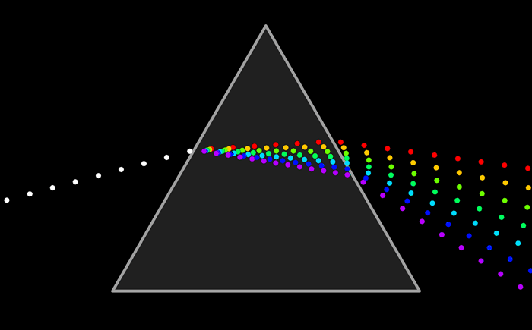
BASIC SPECTROSCOPY
M.ARULSELVAN
Asst Professor

Slide 2
SPECTROSCOPY
The branch of science concerned with the investigation and measurement of spectra produced when matter (Atoms or Molecules) interacts with electromagnetic radiation (EMR).
Atoms and molecules interact with electromagnetic radiation (EMR) and absorb and/or emit Electro Magnetic Radiation.
Absorption of EMR stimulates different types of motion in atoms and/or molecules.
The patterns of absorption (wavelengths absorbed and to what extent) and/or emission (wavelengths emitted and their respective intensities) are called ‘spectra’.

Slide 3
DIFFERENT TYPES OF MOTION
Molecular
Libration
(hindered rotations)
Molecular
vibrations
Electronic
Absorption
Valence band and shallow electronic levels (atoms)
Deep electronic core levels (atoms)
Infrared,
Raman,
EELS
UV absorption
UV photoemission
Electron loss
Microwave,
THz
Visible
Fluorescence
Luminescence
X-ray photoemission
(XPS, ESCA)
Auger Electron (AES)

Slide 4
ELECTROMAGNETIC RADIATION
Electromagnetic Radiation: Kind of energy with wave character that can be characterized by using wavelength (λ), frequency (ν), velocity and amplitude.
Electromagnetic radiation requires no supporting medium for its transmission and passes readily through a vacuum.
Electromagnetic radiation is a stream of discrete particles or wave packets of energy called photons where energy is proportional to the frequency of the radiation.

Slide 5
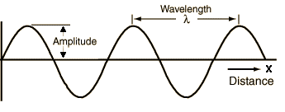
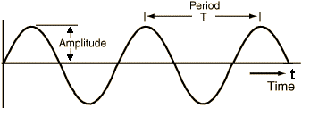
WAVE PARAMETERS
Amplitude (A): Length of the electric vector at a maximum in the wave.
Period (P): The time in seconds required for the passage successive maxima or minima through a fixed point in space.
Frequency (ν): The number of oscillations of the field that occur per second and is equal to 1/Period. (s⁻¹ or Hz).
Wavelength (λ): The linear distance between any two equivalent points on successive waves (successive maxima or minima). (A, nm, etc.).

Slide 6
WAVE PARAMETERS
Wave number (ν): The reciprocal of the wavelength in centimeters (cm⁻¹).
The Electromagnetic Spectrum: The electromagnetic spectrum encompasses an enormous range of wavelength and frequencies. Spectroscopic methods are classified according to the wavelengths or frequencies that are important for analytical purpose.

Slide 7
SPECTROSCOPIC METHODS BASED ON EMR
Type of Spectroscopy | Usual Wavelength Range | Usual Wave number Range, cm⁻¹ | Type of Quantum Transition
Gamma-ray emission | 0.005-1.4 Å | _ | Nuclear
X-ray absorption, emission, fluorescence, and diffraction | 0.1-100 Å | _ | Inner electron
Vacuum ultraviolet absorption | 10-180 nm | 1x10⁶ to 5x10⁴ | Bonding electrons
Ultraviolet visible absorption, emission, fluorescence | 180 -780 nm | 5x10⁴ to 1.3x10⁴ | Bonding electrons
Infrared absorption and Raman scattering | 0.78-300 μm | 1.3x10⁴ to 3.3x10¹ | Rotation/vibration of molecules
Microwave absorption | 0.75-3.75 mm | 13-27 | Rotation of molecules
Electron spin resonance | 3 cm | 0.33 | Spin of electrons in a magnetic field
Nuclear magnetic resonance | 0.6-10 m | 1.7x10⁻² to 1x10³ | Spin of nuclei in a magnetic field

Slide 8
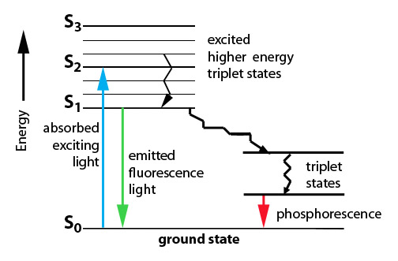
Interactions of Electromagnetic Radiation
Physical Interactions: Not dependent on the characteristic of electromagnetic radiation
1.Reflection 2.Refraction
3.Diffraction 4.Scattering
5.Polarization
Chemical Interaction: Dependent of the characteristics of electromagnetic radiation

Slide 9
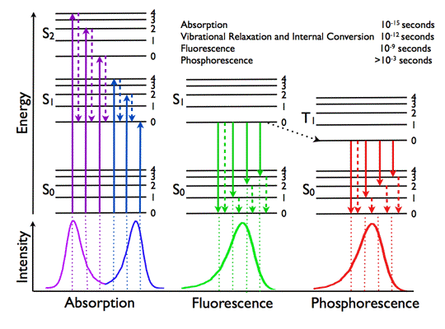

Slide 10
ABSORPTION OF RADIATION
Absorption of Radiation: Absorption occurs only if :-
There is an interaction between the electromagnetic radiation and the material.
The energy of the electromagnetic radiation must exactly corresponds to the energy of transition in the molecule.
I_{o} → Sample → I
I < I_{o} (absorption depends on population and path length)
When material (atoms, ions or molecules) changes its state (from lower to higher energy), it absorbs an amount of energy exactly equal to the energy difference between the states.
E₁ – E_{o} = hν = hc/λ
where, E₁ = energy of the higher state,
E_{o} = energy of the lower state.
The various energy states are called electronic states. The lowest energy state of an atom or molecule is called ground state. Generally at room temperature, chemical species are in their ground state.
Higher energy states are termed excited states.

Slide 11
ABSORPTION OF RADIATION
When radiation passes through a sample certain frequency may be selectively removed by absorption, a process in which electromagnetic energy is transferred to the atoms, ions or molecules.
Absorption promotes these particles from ground state to one or more higher energy states.
The energy of the exciting photon must exactly match the energy difference between the ground state and one of the excited states of the absorbing species. Since these energy differences are unique for each species, a study of the frequencies of absorbed radiation provides a means of characterizing the constituents of a sample of matter.

Slide 12
Absorption of radiation
Atomic Absorption: The passage of polychromatic ultraviolet or visible radiation through a medium that consists of monoatomic particles results the absorption of a few well-defined frequency. Such spectra is very simple due to the small number of possible energy states for the absorbing particles.
Molecular Absorption: Absorption spectra for polyatomic molecules are considerably more complex than atomic spectra because the number of energy states of molecules is generally enormous when compared with the number of energy states for isolated atoms. The energy E of a molecule is made up of three components,
E = E_{electronic} + E_{vibrational} + E_{rotational}

Slide 13
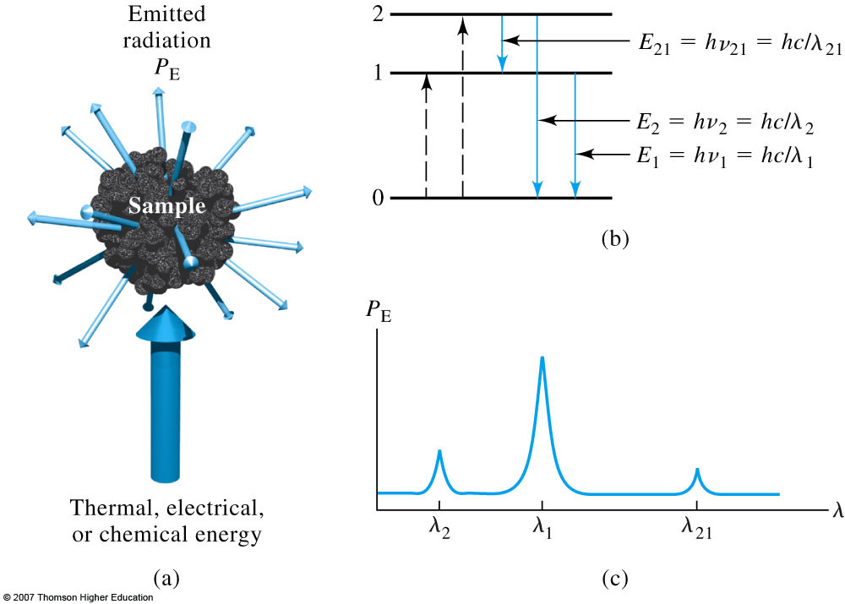
EMISSION OF RADIATION
Emission of Radiation: Electromagnetic radiation is produced when excited particle (atoms, ions, or molecules) relax to lower energy levels by giving up their excess energy as photons. Radiation from an excited source is characterized by means of an emission spectrum.
X → X* → X + hν
Excitation can be done by –
1. Bombardment with electrons 2. Electric current ac spark
3. Heat of a flame 4. An arc or a furnace (produce uv,
vis or ir radiation) 5. Beam of electromagnetic radiation

Slide 14
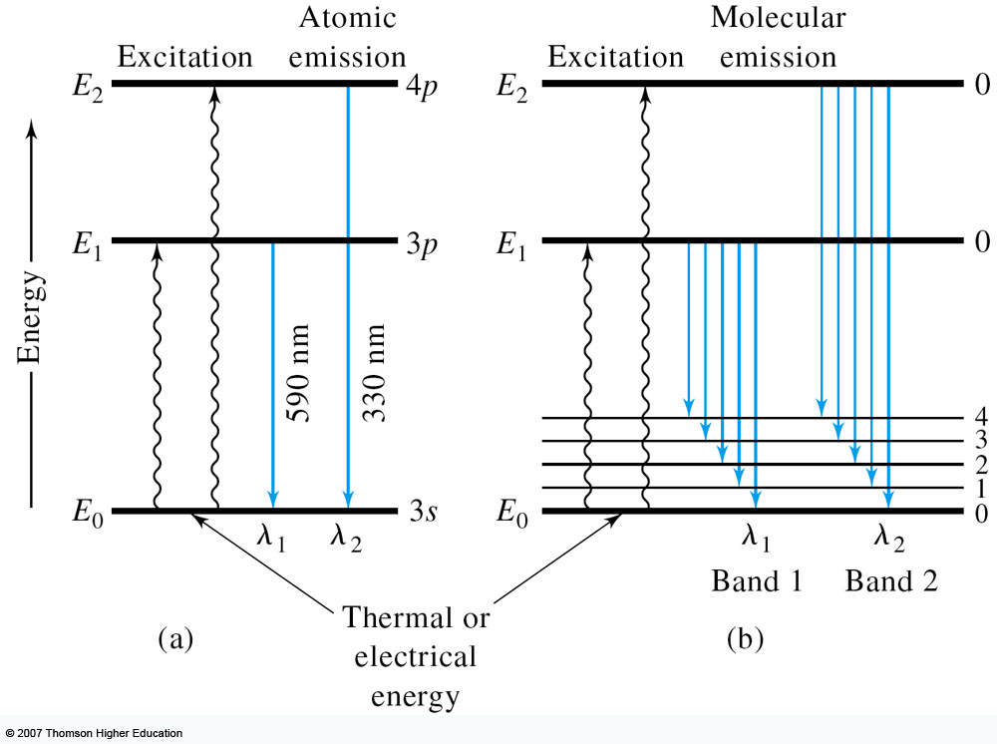
EMISSION OF RADIATION
Three types of emission spectra:
1) Line Spectra 2) Band Spectra 3) Continuum Spectra
Relaxation Processes: The lifetime of an atom or molecule excited by absorption of radiation is brief because there are several relaxation processes that permit its return to the ground state.
Non-radiative Relaxation: Non-radiative relaxation involves the loss of energy in a series of small steps, the excitation energy being converted to kinetic energy by collision with other molecules. A minute increase in the temperature of the system results.

Slide 15
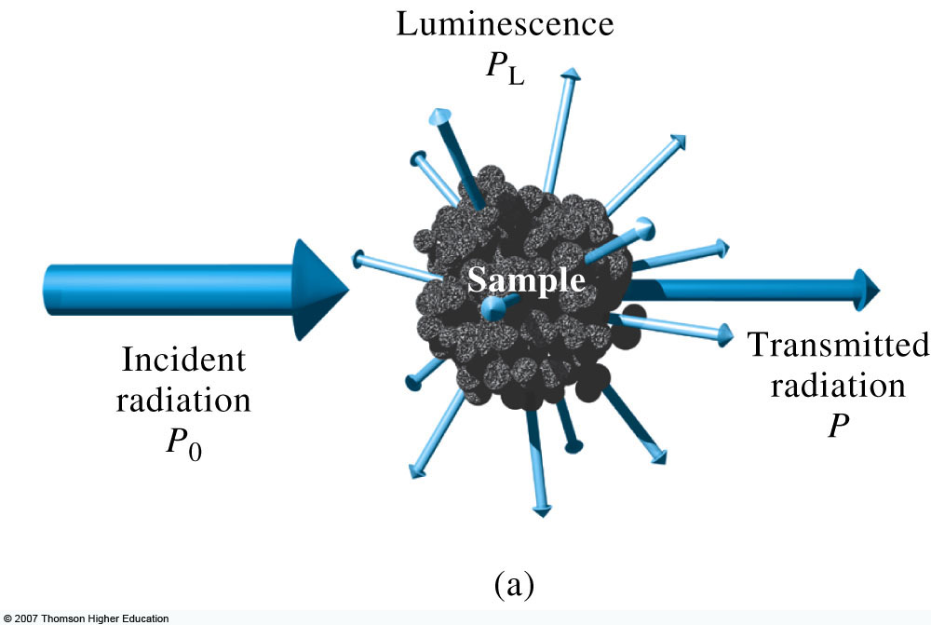
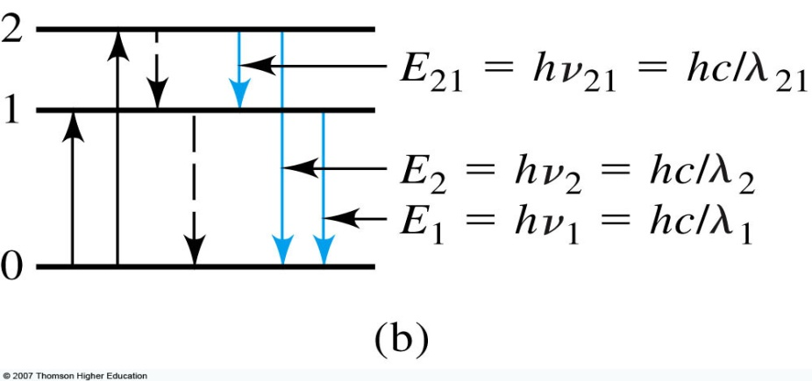
EMISSION OF RADIATION
Fluorescence and Phosphorescence Relaxation: Fluorescence and phosphorescence are analytically important emission processes in which atoms or molecules are excited by absorption of a beam of electromagnetic radiation, radiant emission then occurs as the excited species returned to the ground state.
Fluorescence (10⁻⁴-10⁻⁹s) occurs more rapidly than phosphorescence (10⁻⁴-10s).
Fluorescence and phosphorescence are most easily observed at a 90 degree angle to the excitation beam.
X + hν → X* → X + hν’ (hν > hν’ )

Slide 16
EMISSION OF RADIATION
Resonance fluorescence describe the process in which the emitted radiation is identical in frequency to the radiation employed for excitation. Resonance florescence is most commonly produced by atoms in the gaseous state that do not have vibrational energy states superimposed on electronic energy levels.
Non-resonance fluorescence is brought about by irradiation of molecules in solution or in the gaseous state. Absorption of radiation promotes the molecule into any of the several vibrational levels associated with the excited electronic levels.
The lifetimes of these excited vibrational states are only on the order of 10⁻¹⁵s which is much smaller than the lifetimes of the excited electronic states (10⁻⁸s). Therefore, on the average vibrational relaxation occurs before electronic relaxation. As a consequence the energy of the emitted radiation is smaller than that of the absorbed by an amount equal to the vibrational excitation energy.
Phosphorescence occurs when an excited molecule relaxes to a metastable excited electronic state called the triplet state, which has an average lifetime of greater than about 10⁻⁵ sec.

Slide 17
SPECTROSCOPY CLASSIFICATION
Nature of Radiation Measured (Based of Physical quantity):-
i. Electromagnetic spectroscopy involves interactions with electromagnetic radiation, or light. Ex., Ultraviolet-visible spectroscopy.
ii. Electronic spectroscopy involves interactions with electron beams. Auger spectroscopy involves inducing the Auger effect with an electron beam.
iii. Mechanical spectroscopy involves interactions with macroscopic vibrations, such as phonons. An example is acoustic spectroscopy, involving sound waves.
iv. Mass spectroscopy involves the interaction of charged species with a magnetic field, giving rise to a mass spectrum. Ex., Mass spectroscopy

Slide 18
SPECTROSCOPY CLASSIFICATION
2. Radiation Measurement process (Absorption, emission,scattering):-
i. Absorption spectroscopy uses the range of the electromagnetic spectra in which a substance absorbs. This includes atomic absorption spectroscopy and various molecular techniques, such as infrared spectroscopy (FTIR) in IR region and nuclear magnetic resonance (NMR) spectroscopy in the radio region.
ii. Emission spectroscopy uses the range of electromagnetic spectra in which a substance radiates (emits). The substance first must absorb energy. This energy can be from a variety of sources, which determines the name of the subsequent emission, like luminescence. Molecular luminescence techniques include spectrofluorimetry.
iii. Scattering spectroscopy measures the amount of light that a substance scatters at certain wavelengths, incident angles, and polarisation angles. The scattering process is much faster than the absorption/emission process. Ex., Raman spectroscopy.

Slide 19
ABSORPTION METHODS
Quantitative absorption methods require two power measurements: one before a beam has passed through the medium that contains the analyte (P_{o}) and the other after the sample (P). Two terms, which are widely used in absorption spectrometry and are related to the ratio of P_{o} and P, are transmittance and absorbance.
Transmittance: The transmittance T of the medium is the fraction of incident radiation transmitted by the medium.
T = P/ P_{o} (value from 0 to 1)
where,
- P_{o} is the incident power of the beam and
- P is the power of the beam after absorbed by the sample.
- Transmittance is often expressed as a percentage,
%T = P/ P_{o} x 100 % (value from 0 to 100)
Absorbance: The absorbance A of a medium is defined by the equation,
A = -log₁₀T = -log P/ P_{o} = log P_{o}/ P = log 1/T

Slide 20
ABSORPTION METHODS

Slide 21
ABSORPTION METHODS
Beer’s Law: For monochromatic radiation, absorbance is directly proportional to the path length “b” through the medium and the concentration “c” of the absorbing species. These relationships are given by,
A = abc
where, a is a proportionality constant called the Absorptivity. The magnitude of “a” will clearly depend upon the units used for “b-path length” and “c-concentration”.
Absorptivity then has units of Lg⁻¹cm⁻¹, when the concentration is expressed in moles/liter and cell length is in centimeters, the absorptivity is called the molar absorptivity and is given the spectral symbol ε.
Thus when b – path length (1cm) is in centimeters and c - concentration (1%) is in moles per liter,
A = εbc
where ε has the units L mol⁻¹cm⁻¹
The above equations are expression of Beer’s Law, which serves as the basis for quantitative analyses by both atomic and molecular absorption measurements.

Slide 22
INSTRUMENTATION

Slide 23
INSTRUMENTATION
REGION | SOURCE | RADIATION ENERGY | SAMPLE HOLDER | DETECTOR
Ultraviolet | Deuterium lamp (Plasma "arc" or discharge lamps using hydrogen) | 190 to 350 nm | Quartz/fused silica | Phototube, PM tube, Diode array
Visible | Tungsten lamp (filled with inert gas such as argon or nitrogen) | 350 to 900 nm | Glass/quartz | Phototube, PM tube, Diode array
Infrared | Nernst glower (mixture of certain oxides such as zirconium oxide (ZrO₂), yttrium oxide (Y₂O₃) and erbium oxide (Er₂O₃) at a ratio of 90:7:3 by weight) | 700 nm to 1mm | Salt crystals e.g. crystalline sodium chloride | Thermocouples, bolometers

Slide 24
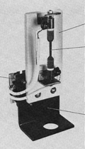
LIGHT SOURCES - IR
Nernst Glower:-
obsolete device for providing a continuous source of (near) infrared radiation for FTIR
Rare earth oxides formed into a cylinder (1-2 mm diameter, ~20mm long).
Pass current to give:
T = 1200 – 2200 K.
Globar:-
Silicon Carbide Rod (5mm diameter, 50 mm long) used as thermal light source for FT-IR.
Heated electrically to 1300 – 1500 K.
Positive temperature coefficient of resistance. Electrical contact must be water cooled to prevent arcing.

Slide 25
LIGHT SOURCES - VISIBLE
Tungsten / Halogen:-
Heated to 2870 K. Useful Range: 350 – 2500nm
Iodine reacts with gaseous W near the quartz wall to form WI₂.
W is re-deposited on the filament.
Gives longer lifetimes
Allows higher temperatures (~3500 K). Weak intensity in UV range
Good intensity in visible range
Very low noise and Low drift

Slide 26
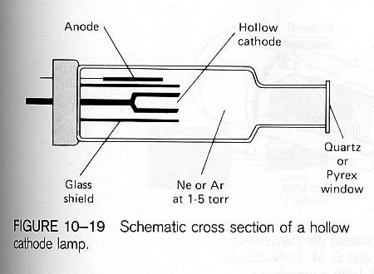
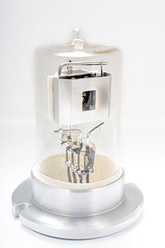
LIGHT SOURCES - UV
Hollow Cathode Discharge Lamp:-
Apply ~300 V across electrodes.
Ar⁺ or Ne⁺ travel toward the cathode.
If potential is high enough cations will sputter metal off the electrode.
Metal emits photons at characteristic atomic lines as the metal returns to the ground state.
Deuterium Arc Lamp:-
A deuterium lamp uses a tungsten filament and anode placed on opposite sides of a nickel box structure designed to produce the best output spectrum .
Arc lamps made with ordinary light-hydrogen (hydrogen-1) provide a very similar UV spectrum to deuterium, and have been used in UV spectroscopes

Slide 27
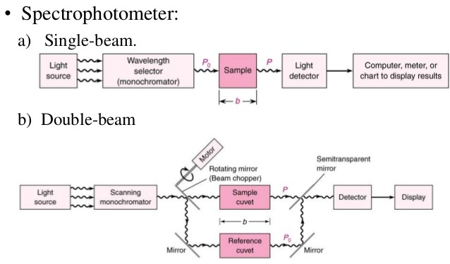
UV-Vis Spectrophotometers

Slide 28
SPECTROFLUORIMETER
When a molecule after absorbing radiations, emits radiation of a longer wavelength, then this phenomenon is referred to as “fluorescence.”
Because of this, the compound absorbing in ultraviolet range might emit radiation in visible range. This is called Stoke’s shift wherein the shift is towards a longer wavelength.
Fluorescence is an extremely short-lived phenomenon which lasts for about 10⁻⁷ seconds or less and thus can provide information about events which take less than 10⁻⁷seconds to occur.
The intensity of fluorescence (F) is F=K ( I_{solvent}-I_{sample} )
Fluorimetry can be used as a tool for the determination of very small concentration of substances which exhibit fluorescence.
Log (I_{solvent}/I_{sample})= ε_{f} Cb
where ε_{f} is the absorptivity of the fluorescent material. C is the concentration of the substance and b is the path length, I_{solvent} and I_{sample} represents the values of intensities of the incident radiant energy and transmitted energy respectively. The intensity of the radiation absorbed can thus be given by I_{solvent} - I_{sample}.

Slide 29
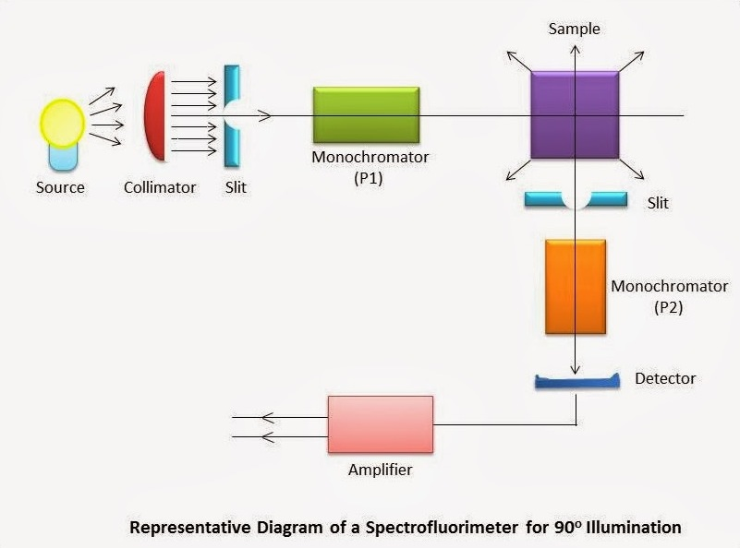
SPECTROFLUORIMETER
The major instrumentation of spectrofluorimeter differs from the spectrophotometer in two major aspects as follows:
1.There are two monochromators (instead of one as is the case of spectro -photometer). These two monochromators are placed before and after the sample holder respectively.
2.The sample-holder has a device to maintain the temperature as the fluorescence is maximum between 25ºC - 30ºC.

Slide 30
SPECTROFLUORIMETER
The following are the different components of spectrofluorimeter:
a. A continuous source of radiant energy (mercury lamp or xenon arc or tungsten lamp)
b. A monochromator usually a prism (P1), to choose the wavelength with which the sample is to be irradiated. c. Sample cell: Sample cells are cylindrical or polyhedral made up of color corrected fused glass and path length normally 10mm to 1cm.
d. A second monochromator (P2) which, placed after the sample, enables the determination of fluorescent spectrum of the sample.
e. A detector which is usually a photomultiplier or photo-voltaic cell or photo-tubes suited for wavelengths greater than 500nm and lastly
f. An amplifier

Slide 31
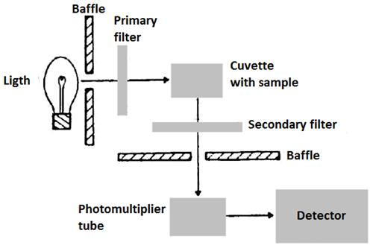
FILTER FLUORIMETER

Slide 32
INSTRUMENTATION OF FTIR
A source generates light across the spectrum of interest.
A monochromater (in IR this can be either a salt prism or a grating with finely spaced etched lines) separates the source radiation into its different wavelengths.
A slit selects the collection of wavelengths that shine through the sample at any given time.
In double beam operation, a beam splitter separates the incident beam in two; half goes to the sample, and half to a reference.
The sample absorbs light according to its chemical properties.
A detector collects the radiation that passes through the sample, and in double-beam operation, compares its energy to that going through the reference.
The detector puts out an electrical signal, which is normally sent directly to an analog recorder. A link between the monochromater and the recorder allows you to record energy as a function of frequency or wavelength, depending on how the recorder is calibrated.

Slide 33
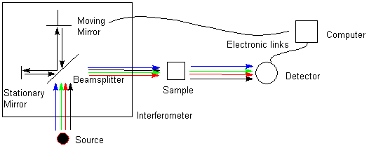
INSTRUMENTATION OF FTIR
The interferometer produces a unique type of signal which has all of the infrared frequencies “encoded” into it.
Most interferometers employ a beam splitter which takes the incoming infrared beam and divides it into two optical beams

Slide 34
INTERFEROMETER IN FTIR
One beam reflects off of a flat mirror which is fixed in place. The other beam reflects off of a flat mirror which is on a mechanism which allows this mirror to move a very short distance (typically a few millimeters) away from the beam splitter.
The two beams reflect off of their respective mirrors and are recombined when they meet back at the beam splitter. Because the path that one beam travels is a fixed length and the other is constantly changing as its mirror moves, the signal which exits the interferometer is the result of these two beams “interfering” with each other. The resulting signal is called an interferogram which has the unique property that every data point (a function of the moving mirror position) which makes up the signal has information about every infrared frequency which comes from the source
The recombined beam passes through the sample. The sample absorbs all the different wavelengths characteristic of its spectrum, and this subtracts specific wavelengths from the interferogram.
The detector now reports variation in energy versus time for all wavelengths simultaneously. A laser beam is superimposed to provide a reference for the instrument operation.

