Slide 1
Neurodegenerative diseases
These are a group of disorders characterized by neuronal loss and generally an accumulation of insoluble intracellular or extracellular material in certain brain regions.
The neurodegenerative disorders include
(1) Alzheimer’s disease, the most common cause of dementia, in which the neural injury is primarily in the hippocampus and cortex;
(2) Parkinson’s disease, a disabling motor impairment disorder due to the loss of nigrostriatal dopamine neurons;

Slide 2
PARKINSON’S DISEASE
In 1817 , James Parkinson defined the distinguishing symptoms of this movement disorder is known as Parkinson’s disease or parkinsonism.
It generally affects the elderly and is estimated to afflict more than 1% of individuals over the age of 65.

Slide 3
Etiology
Most cases are of idiopathic parkinsonism
viral inflammation
Brain trauma, stroke
Poisoning by manganese, carbon monoxide, pesticide, or 1-methyl-4-phenyl,-1,2,3,6-tetrahydropyridine (MPTP).
Intoxication with MPTP, a byproduct of the synthesis of an illegal meperidine analogue, produces a condition closely resembling parkinsonism,

Slide 4
genetic predisposition, environmental Toxins
aging
drug-induced (iatrogenic parkinsonism,) which is often is a complication of antipsychotic therapy, especially following the use of the butyrophenone and phenothiazine drug classes .
(Unlike idiopathic parkinsonism, striatal content of dopamine is not reduced by administration of these drugs. In contrast, they produce a functional decrease in dopamine activity by blocking the action of dopamine on postsynaptic dopamine receptors).

Slide 5
Clinical Findings (Symptoms)
There is a progressive loss of dopamine neurons with age. Relatively smooth functioning of motor control is maintained until neuronal loss is such that it causes an 80% reduction of dopamine in the striatum.
At this time, clinical symptoms appear and then worsen with increasing neuronal loss. The onset of symptoms of Parkinson’s disease is usually gradual.
The most prominent features of parkinsonism are
tremor, rigidity, and bradykinesia.
Tremors are often unilateral in onset, present at rest, and cease during voluntary movement.
Rigidity, is increased muscle tone

Slide 6
Bradykinesia, an extreme slowness of movement, It results in a typical stooped posture when the person is standing or walking and absence of normal arm swinging movements.
The absence of facial expression (masklike face) results from loss of facial muscle function.
Inability to swallow leads to drooling, while bradykinesia
of the muscles in the larynx results in changes in voice quality.
Orthostatic hypotension may also be observed and may complicate therapy.
Cognitive dysfunction and dementia are also seen in a small percentage of Parkinson’s disease patients, especially the elderly

Slide 7
Pathology
The most prominent pathological findings in Parkinson’s disease are degeneration of the darkly pigmented dopamine neurons in the substantia nigra, loss of dopamine in the neostriatum, and the presence of intracellular inclusion bodies known as Lewy bodies.
Other neuronal populations are also affected in Parkinson’s
disease to a much lesser extent, but they may contribute
to some of the other pathology seen in parkinsonism
(e.g., cognitive decline, depression, and dementia).

Slide 8
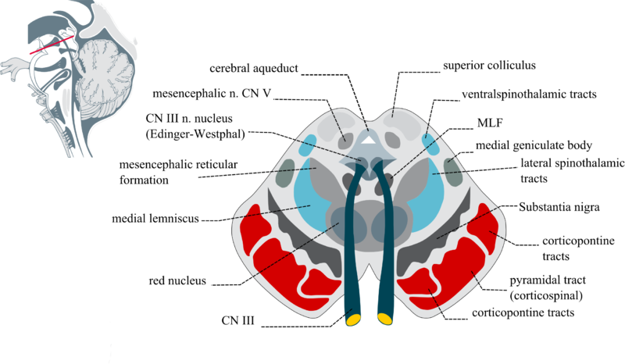

Slide 9
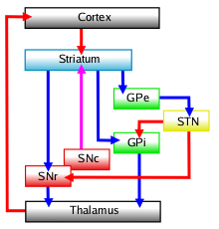
Basal Ganglia Anatomy
Connectivity diagram showing excitatory glutamatergic pathways as red, inhibitory GABAergic pathways as blue, and modulatory dopaminergic pathways as magenta.
(Abbreviations: GPe: globus pallidus external; GPi: globus pallidus internal; STN: subthalamic nucleus; SNc: substantia nigra compacta; SNr: substantia nigra reticulata)

Slide 10
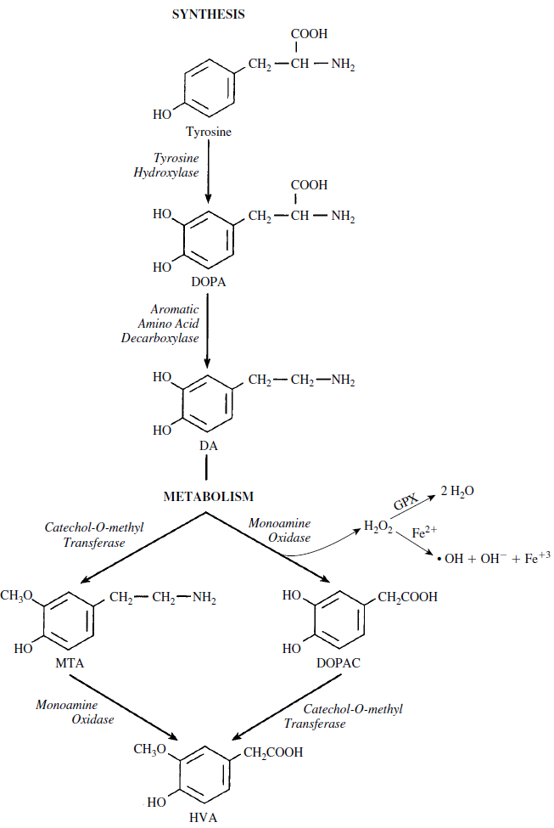
Dopamine Metabolism

Slide 11
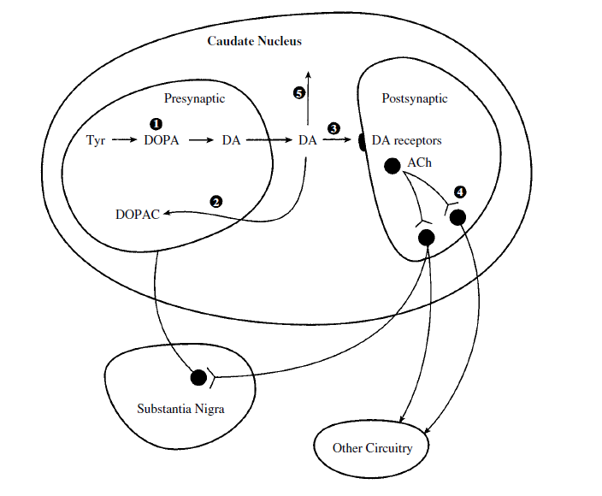
Therapy of Parkinsonism

Slide 12
(1) Levodopa, as the immediate precursor of dopamine, increases dopamine production within the basal ganglia.
(2) MAO-B inhibitors (selegiline) block a major pathway in dopamine metabolism and thus increase the duration of action of dopamine.
(3) Dopamine receptor agonists (pramipexole, pergolide, bromocriptine) directly activate dopamine receptors on postsynaptic neurons.
(4) Anticholinergic drugs block the increased excitatory activity of cholinergic interneurons on outflow pathways from the basal
ganglia, which is secondary to a loss of inhibitor actions of dopamine on these cholinergic interneurons.
(5) COMT inhibitors (with central actions) block an alternate pathway in the metabolism of dopamine.

